Slide 1
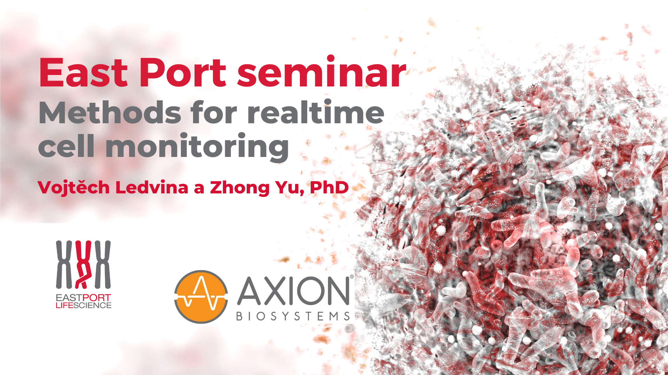

Slide 2


Today‘s Agenda
10:00 – 10:40 Bioluminescent assays for cell health and metabolism (Promega)
10:40 – 11:00 Detecting Mycoplasma in your cell culture using MycoAlert Plus and GloMax (Lonza & Promega)
11:00 – 11:15 Coffee break
11:15 – 12:00 Developing the best immunotherapies with real-time & label- free cell-based killing assays (Axion)
12:00 – 12:15 Questions and answers

Slide 3
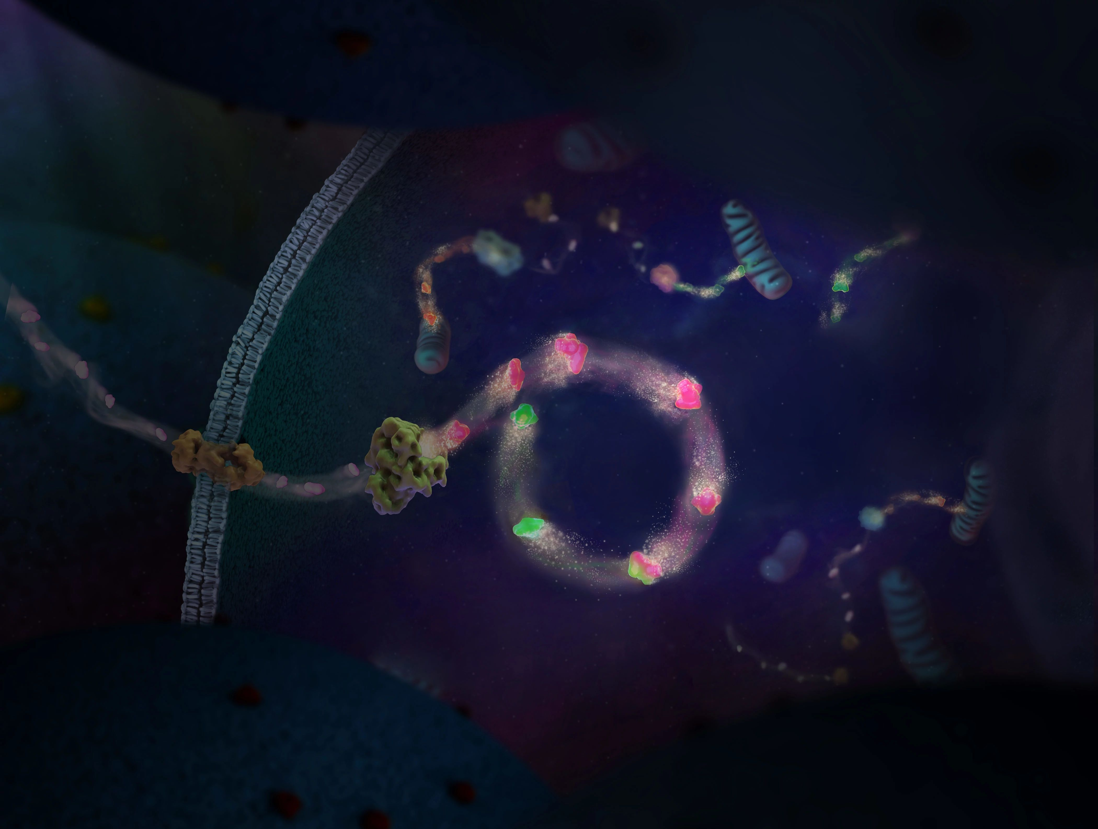


Bioluminescence Assays for Measuring Cell Viability and Metabolism
Vojtěch Ledvina, Ph.D.
vojtech.ledvina@eastport.cz

Slide 4
Presentation Outline
1
Bioluminescence and Luciferases
2
Basic Modes of Detection
3
Measuring Cell Viability and Cytotoxicity
4
Quantifying Apoptosis
5
Assays for Measuring Metabolic Activity
6
GloMax Luminometers and Mycoplasma Testing

Slide 5
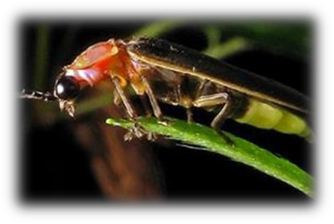
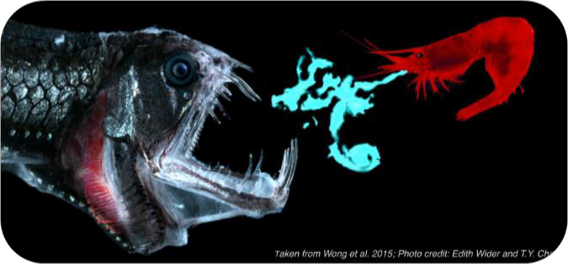
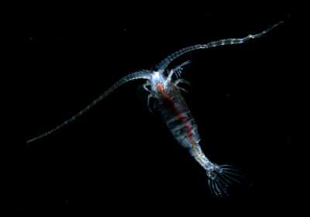
Bioluminescence
Production of light by living organisms
Common in marine vertebrates and inverebrates, fungi, bacteria
Light produced by enzymatic oxidation of a substrate luciferin by an enzyme luciferase
Most used luciferases are – Firefly, Renilla, NanoLuc and Gaussia luciferases

Slide 6
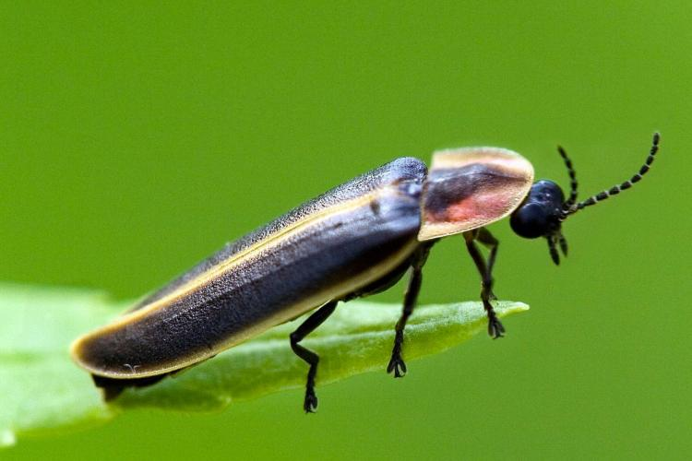
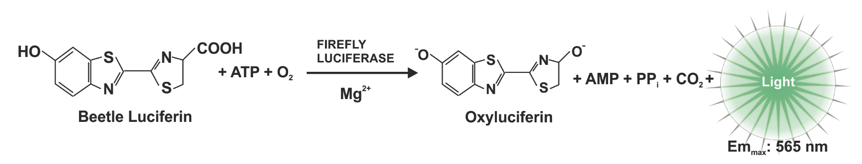
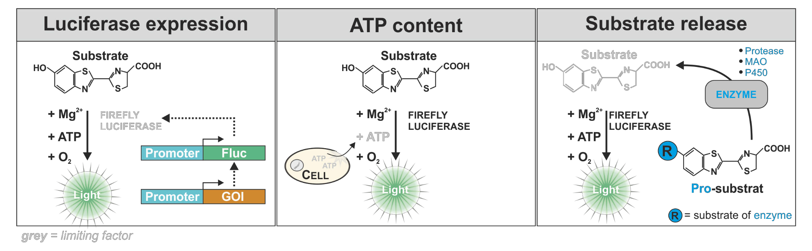
Firefly Luciferase
ATP-dependent luciferase
Universal reaction adaptable for various assays
Ultra-GloTM rLuciferase
  Higher stability in the presence of detergent and reducing agents
  More robust signal – less temperature signal variance
Photinus pyralis
Photuris pensylvanica

Slide 7
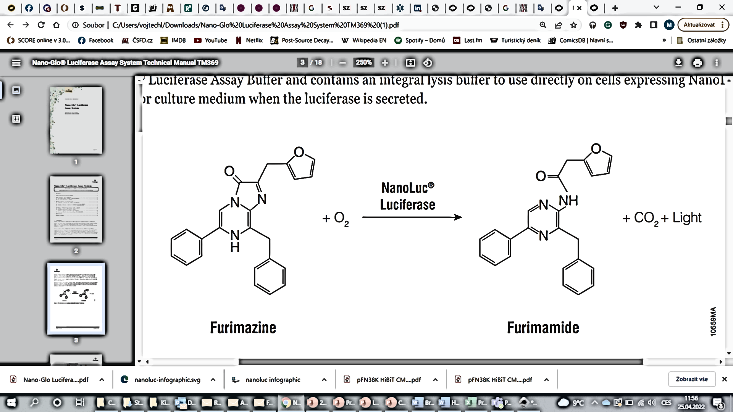
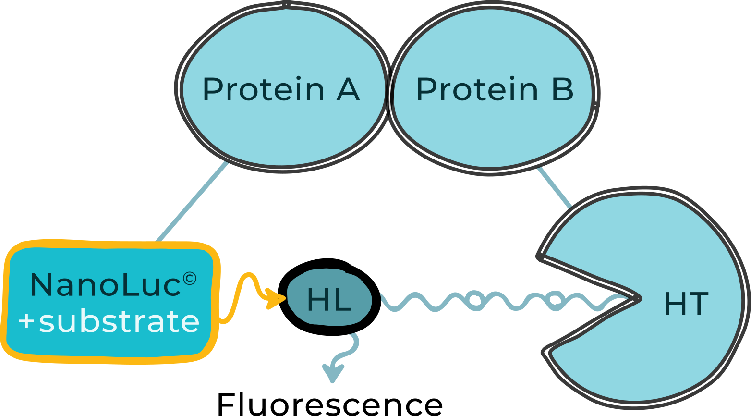
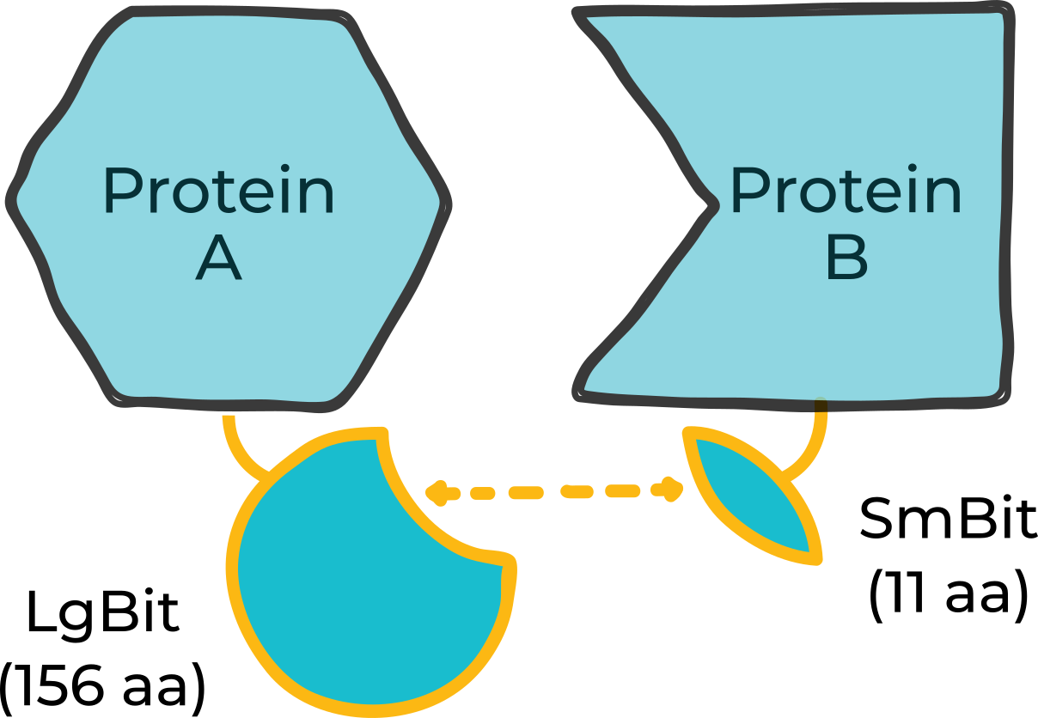
NanoLuc® Luciferase – Novel Experimental Reporter
ATP-independent luciferase from a deep sea shrimp
100x brigther than Rluc and Fluc, glow-type luminescence
Smallest luciferase – 19,1 kDa
Oplophorus gracilirostris
Luciferase expression
NanoBRET assays
Complementation reporter
NanoLuc
luciferase
O₂
Nluc
Light
Notes:
Lze kombinovat s coelenterazinem H – nižší signál, autofluorescence
Konkurence Gaussia luciferase

Slide 8
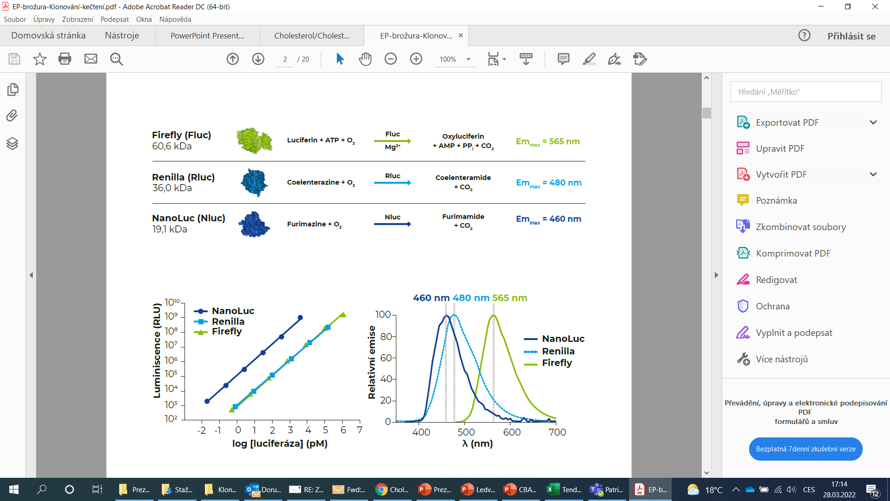

Slide 9
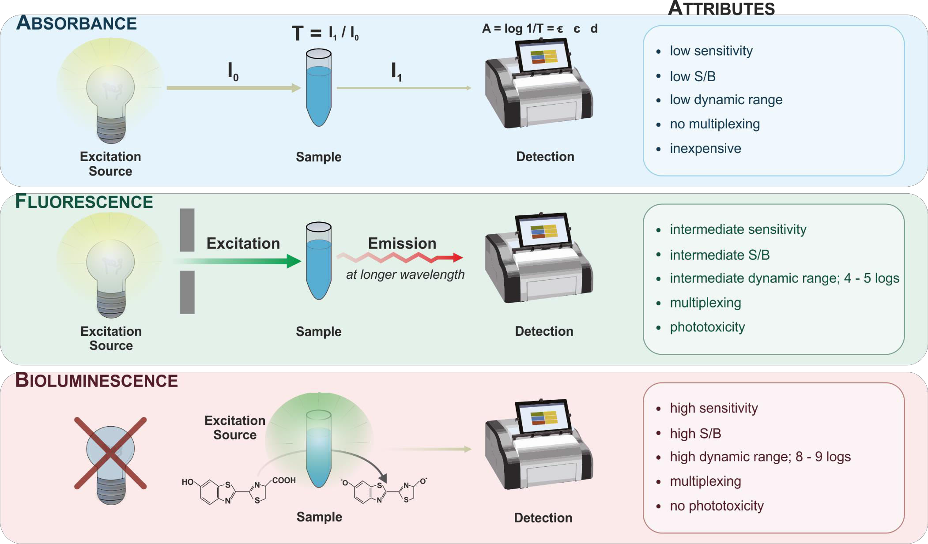

Other Modes of Detection
$$I_{f}=kI_{0}φ(εbc)$$

Slide 10
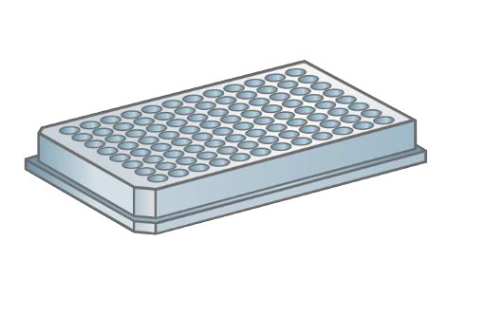
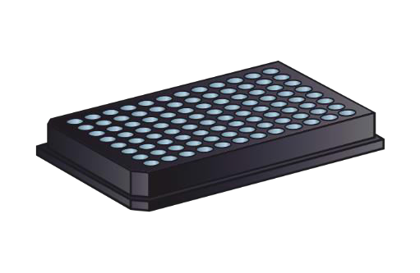
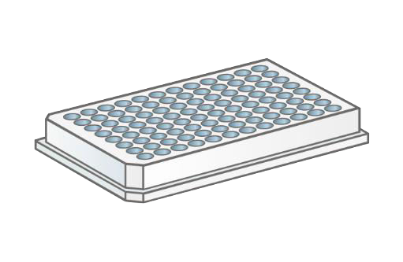
Matching Plate Type and Detection Mode
“clear“
“black”
“white”
TC treated
Sterile
With lid
“solid or clear bottom”
„solid or clear bottom“
ABSORBANCE
YES
(YES)
FLUORESCENCE
YES
(YES)
LUMINISCENCE
NO!
(YES)
YES
• 400 – 800 nm (VIS)
• 200 – 400 nm (UV)
quarz glass
cyclic olefin copolymer
(COC)
plastic autofluorescence (↓)
background (↓)
crosstalk (↓)
maximal reflection
crosstalk (↓)
(!) phosphorescence
Notes:
Watch out for plate quality – low TiO2 content may cause transparency of the well walls and high cross-talk

Slide 11


White Plate ≠ White Plate
Plate A
Luciferase
PBS
281500000 | 207800 | 29240 | 9741 | 4974 | 2556 | 1626 | 1063 | 676 | 446 | 456 | 396
82710000 | 145700 | 25640 | 8537 | 4364 | 2523 | 1526 | 966 | 593 | 500 | 403 | 376
10130000 | 59820 | 18130 | 6518 | 3391 | 2153 | 1196 | 910 | 556 | 476 | 370 | 456
1281000 | 28090 | 12580 | 4014 | 2376 | 1563 | 1020 | 750 | 546 | 440 | 326 | 263
157000 | 14680 | 8287 | 2360 | 1736 | 1366 | 840 | 640 | 416 | 393 | 280 | 316
41940 | 8530 | 5518 | 1460 | 1156 | 933 | 660 | 510 | 356 | 303 | 286 | 233
19840 | 5578 | 3554 | 1170 | 940 | 746 | 643 | 493 | 370 | 313 | 296 | 306
Plate B
Luciferase
PBS
495600000 | 2070 | 76 | 43 | 43 | 50 | 50 | 36 | 96 | 83 | 96 | 96
123900000 | 1033 | 63 | 46 | 66 | 40 | 60 | 60 | 83 | 100 | 116 | 120
13190000 | 326 | 60 | 50 | 40 | 56 | 46 | 43 | 93 | 66 | 90 | 86
1676000 | 120 | 60 | 73 | 36 | 50 | 43 | 86 | 76 | 80 | 110 | 86
1186000 | 56 | 46 | 53 | 60 | 30 | 46 | 46 | 73 | 83 | 83 | 143
90620 | 33 | 36 | 66 | 46 | 46 | 40 | 26 | 56 | 73 | 63 | 86
40010 | 40 | 36 | 43 | 36 | 43 | 66 | 66 | 60 | 63 | 70 | 76
Clear differences in absolute signal intensity and crosstalk
11

Slide 12
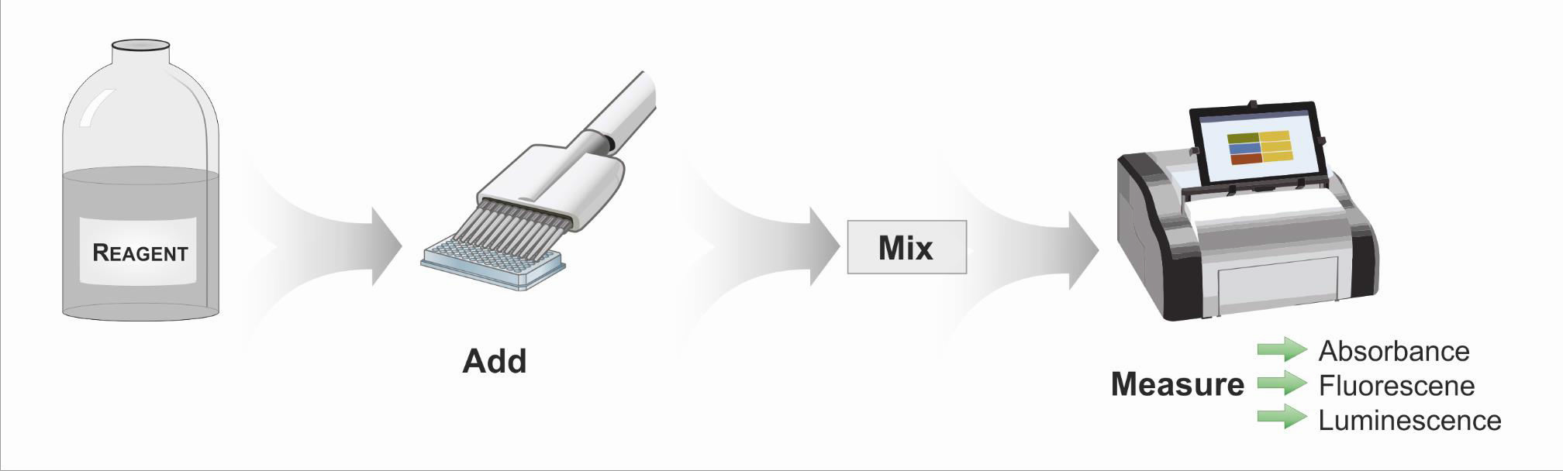
Classic Endpoint Assays
Endpoint Assays
One data point per well
Simple „add-mix-read“ protocol
Minimal space for pipetting errors
Does not require washing or supernatant removal
High reproducibility
CellTiter96® AQueous Proliferation Assay
CellTiter-Fluor
CellTiter-Glo 2.0/3D
Caspase-Glo Assays
NAD(P)H-Glo Assays…

Slide 13
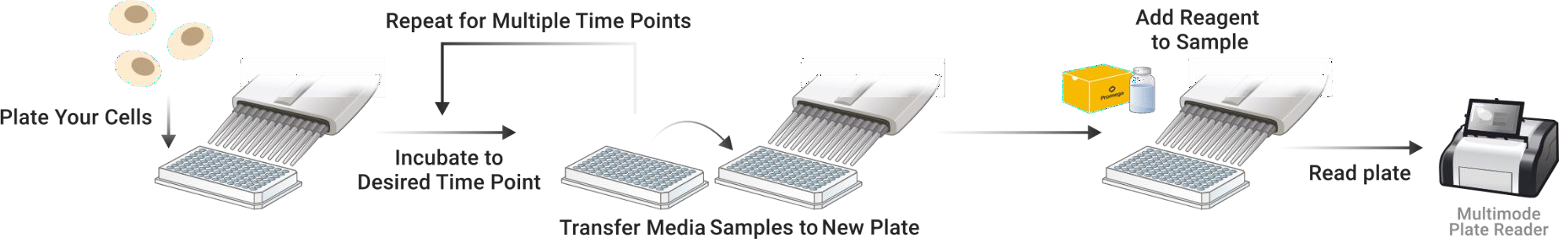
Timed Kinetic Live-Cell Assays
Timed Kinetic
Require periodic sampling of supernatant
Higher hands on time (sampling, dillution, transfer, assay…)
High sensitivity
Number of data points is limited by the sampling volume and/or assay sensitivity
LDH-GloTM Cytotoxicity Assay
Glucose-GloTM Assay
Lactate-GloTM Assay
Glutamate/Glutamine-GloTM Assay
Glutamate-GloTM Assay…
Workflow

Slide 14
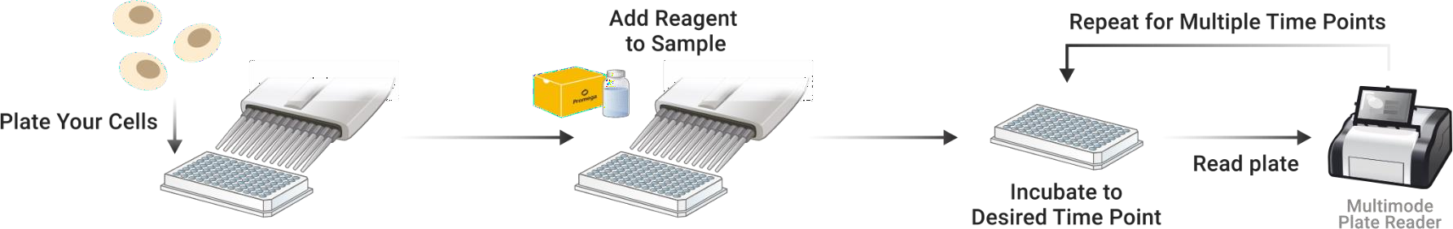
Live-Cell Kinetic Assays
Real-Time Kinetic
Continuous reading from one well
Less hands-on time (no transfer steps required)
Non-toxic for the cells
Number of data points is limited only by instrument/software
RealTime-GloTM MT Cell Viability Assay
RealTime-GloTM Annexin V Apoptosis / Necrosis Assay
RealTime-GloTM Extracellular ATP Assay
CellTox-GreenTM Cytotoxicity Assay
Nano-Glo® Live Cell Assay System
Nano-Glo® VivazineTM Live Cell Substrate
Nano-Glo® EndurazineTM Live Cell Substrate
Workflow

Slide 15
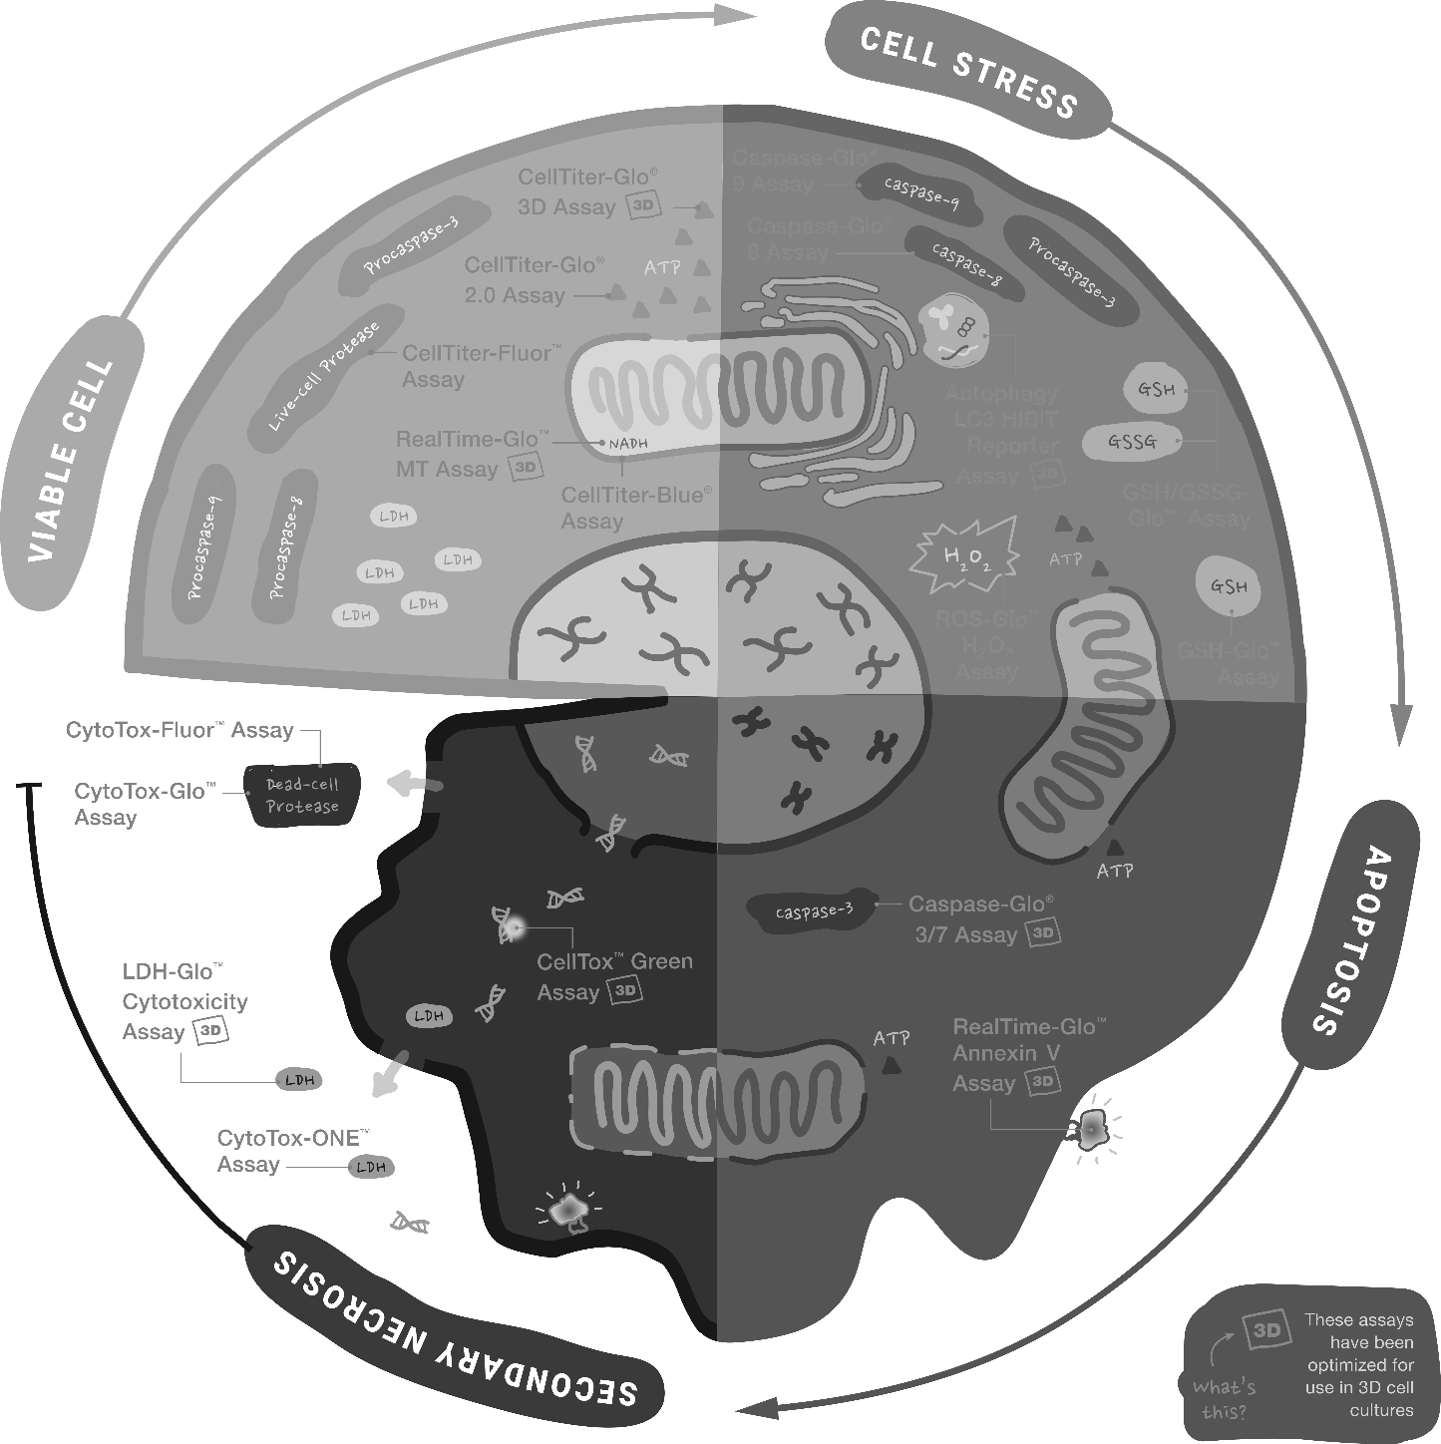
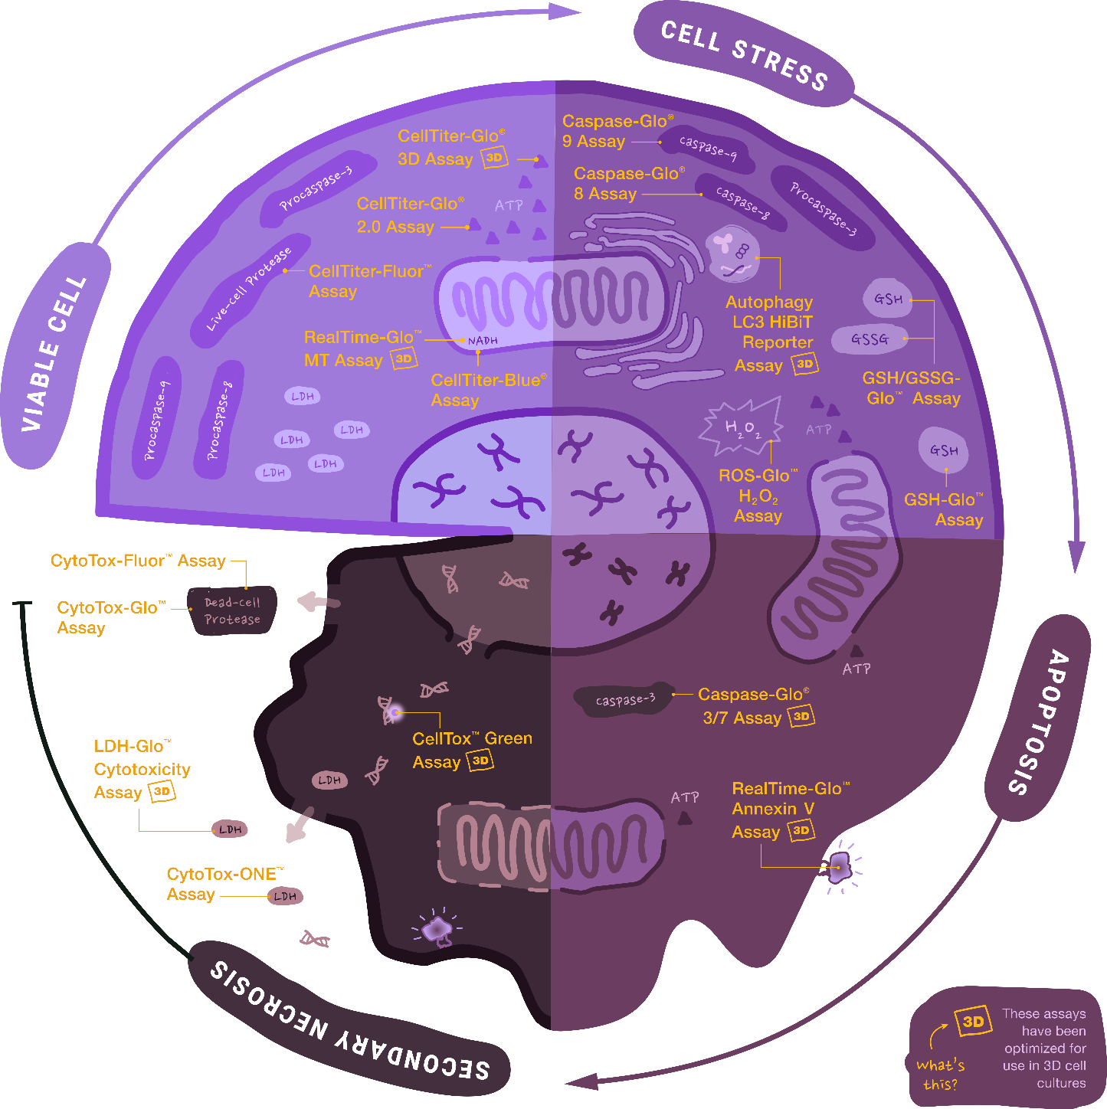
Cell Viability Assays
Viable cell descriptors
Cells are metabolically active
Active proliferation
Cell membrane integrity
Main assays
  CellTiter-Glo
  RealTime-Glo MT Cell Viability Assays

Slide 16
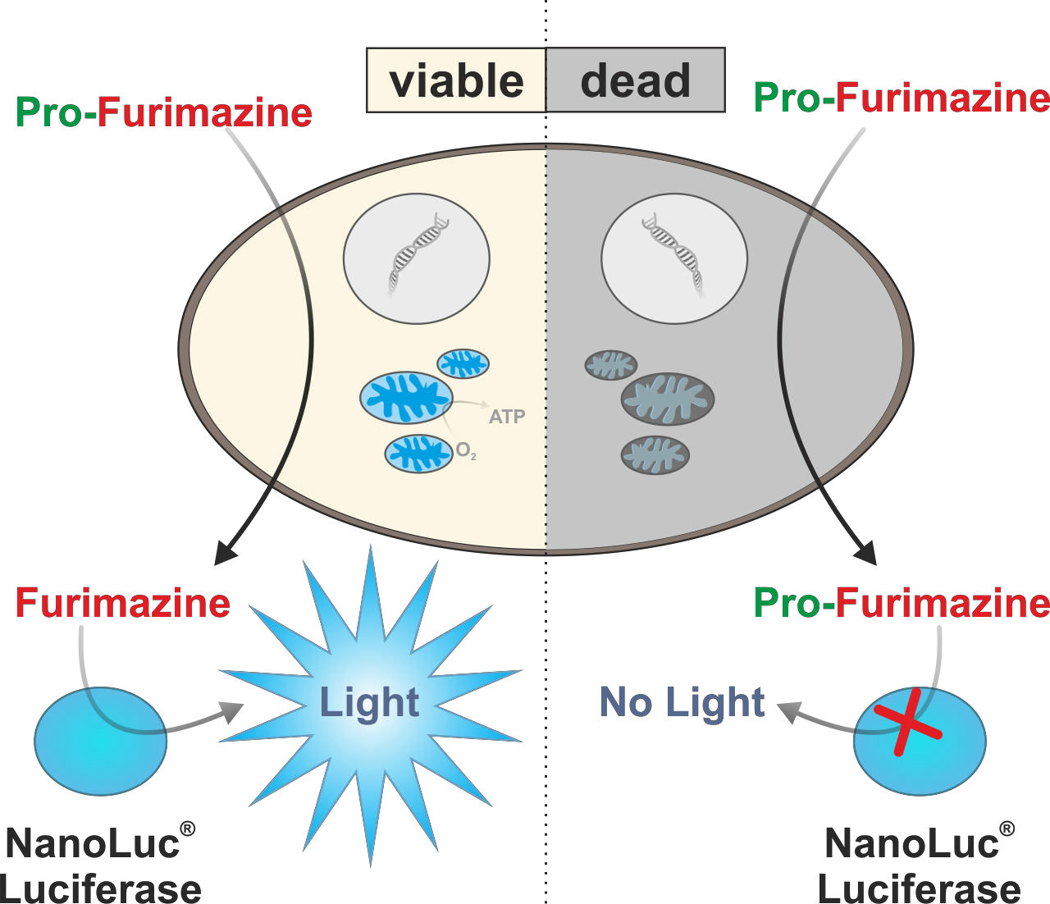
Real Time-Glo MT Cell Viability Assay
True kinetic nonlytic assay based on the NanoLuc luciferase
NanoLuc and prosubstrate pro-furimazine added to the medium
Pro-furimazine diffuses into the cells where it is reduced
Reduced furimazine is released into the medium and processed by the NanoLuc which generates bioluminescence
Suitable for kinetic measurements up to 72 hours

Slide 17
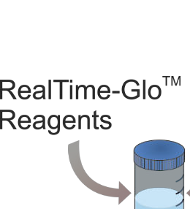
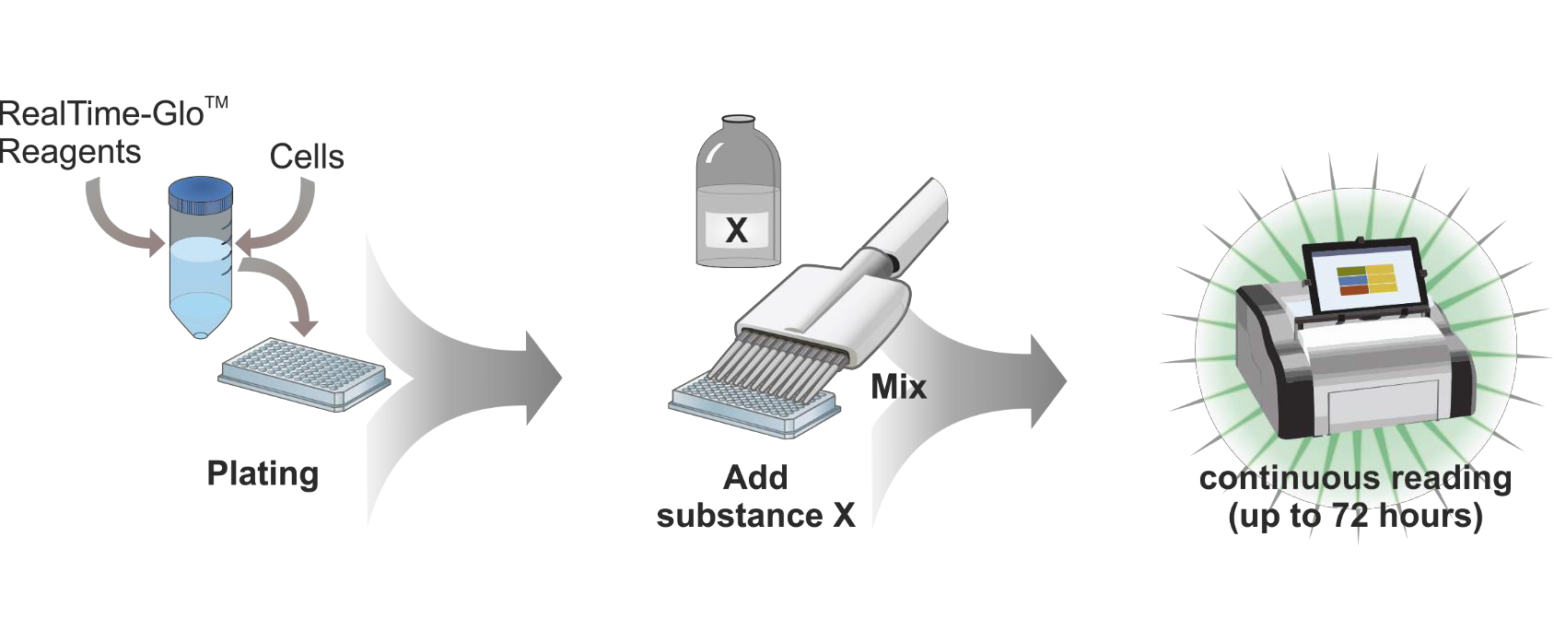
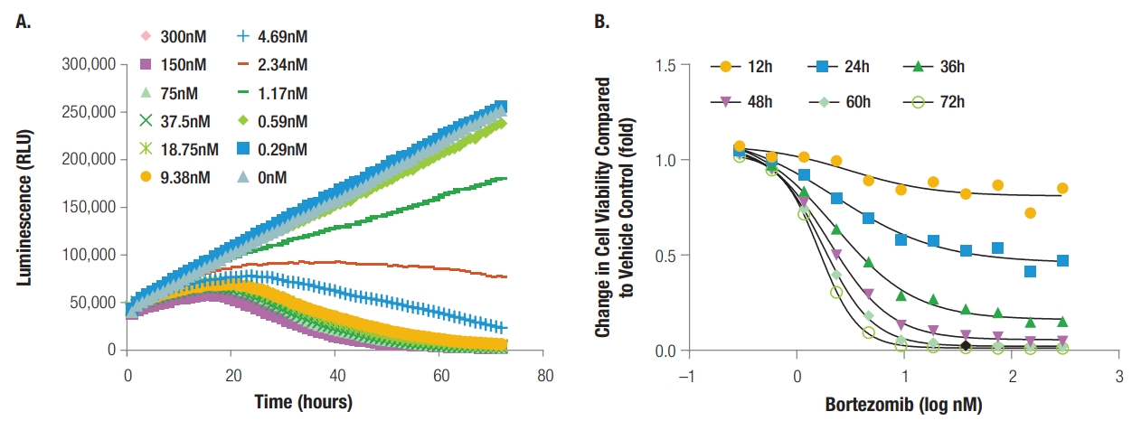
Real Time-Glo MT Assay – Workflow and Data
Five hundred A549 cells/well plated in a 384-well plate in 40μl of medium
RealTime-Glo MT was added directly into the medium
Cells were reated with various concentrations of bortezomib
Luminescence monitored for 72 hours
Notes:
A549 lung carcinoma epithelial cells

Slide 18
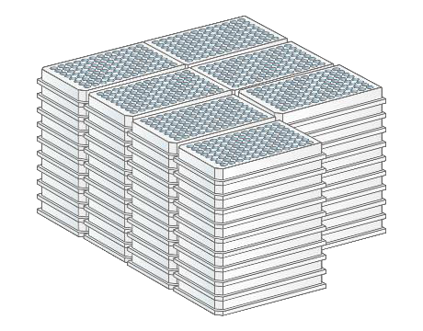
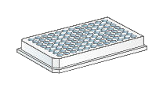
Real Time-Glo MT Assay – Workflow and Data
„endpoint“ VS. „real-time“
72
1
Five hundred A549 cells/well plated in a 384-well plate in 40μl of medium
RealTime-Glo MT was added directly into the medium
Cells were reated with various concentrations of bortezomib
Luminescence monitored for 72 hours
and much less medium, cells and reagent
Notes:
A549 lung carcinoma epithelial cells

Slide 19
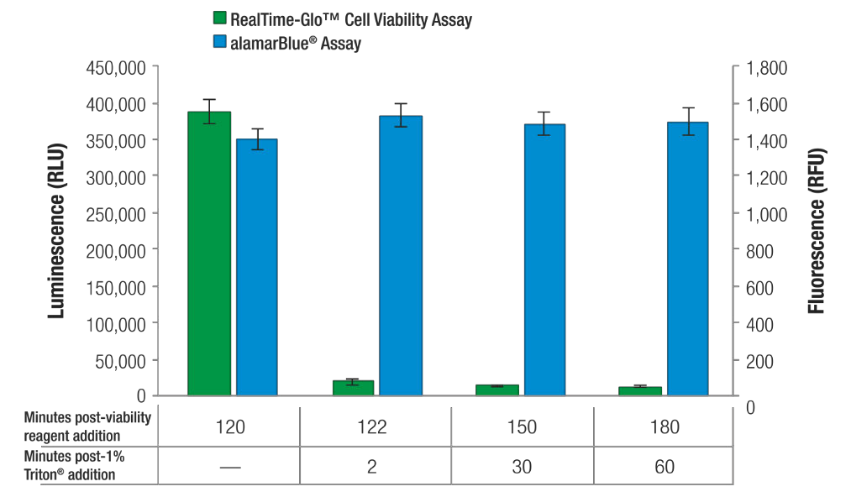
Furimazine does not accumulate in cells
time [min]
+ 1% Triton x-100

Slide 20
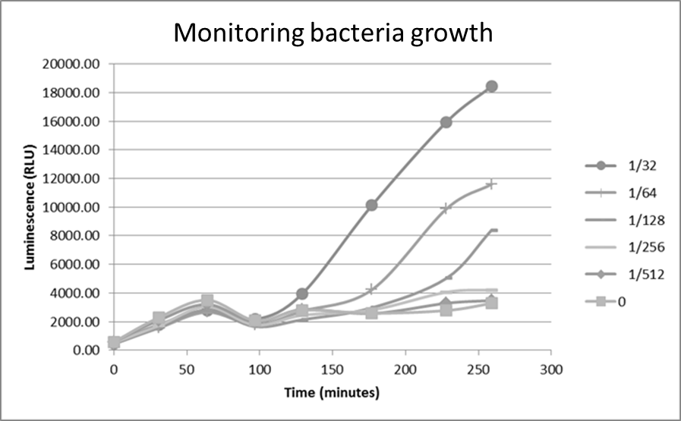
Real Time-Glo MT Assay – Bacterial Viability
Allows measuring viability of both gram-negative and gram-positive bacteria
Serial dillution of G- bacteria E. coli (ATCC25922) cultured in the presence of the RealTime-Glo MT Assay
Comparison of kanamycin EC50 value determination using the bioluminescence and absorbance assays
G+ bacteria Staphylococcus aureus was treated with various concentrations of kanamycin
EC50 values in good correlation but BL assay provides superior sensitivity

Slide 21
Cytotoxicity Assays
Cytotoxicity markers
Loss of cell membrane integrity
Shrinkage of the cell
Disruption of metabolic pathways
Main assays
  CellTox Green Assay
  LDH-Glo Assay

Slide 22
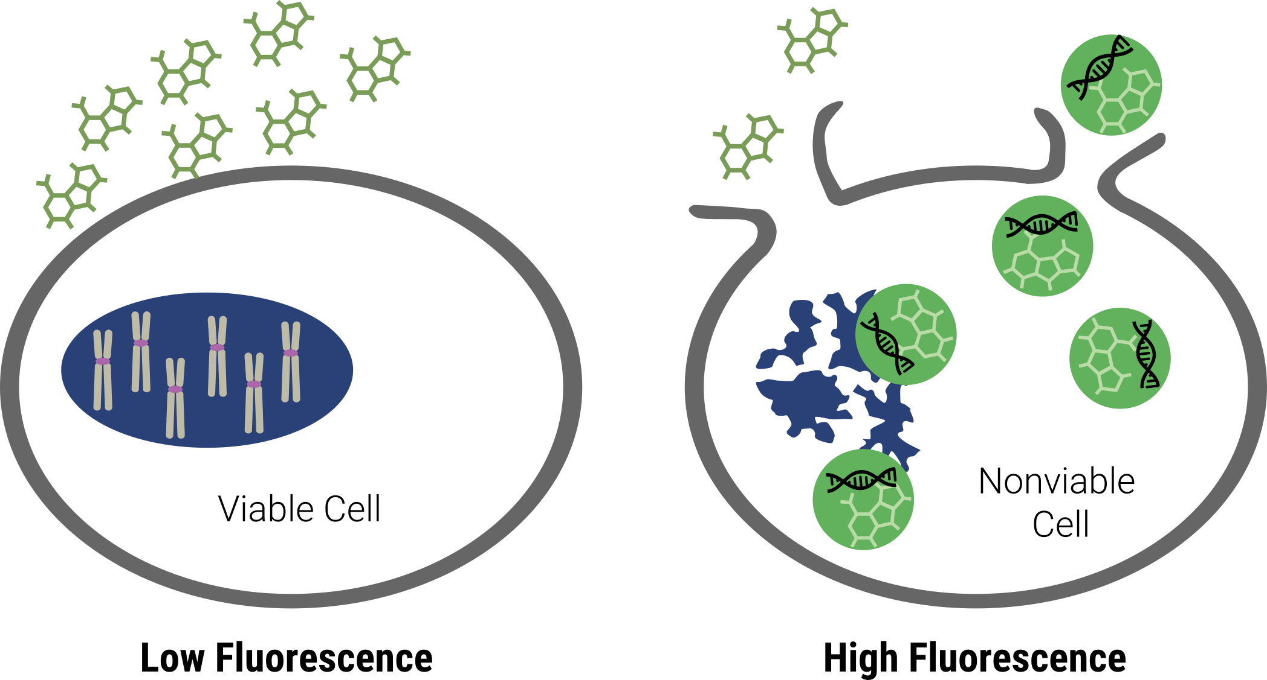
CellTox™ Green Cytotoxicity Assay
Dying cells form pores in the membrane and have compromised membrane integrity
Determines membrane integrity by a non-permeable DNA-binding dye
The dye enters the compromised cells, binds to nuclear DNA and enhances its fluorescence
Excluded dye yields very low background fluorescence
Penetrated dye significantly enhances its fluorescence
Notes:
Nyní bych se rád zaměřil na kvantifikaci cytotoxicity.
Jak se běžně definuje cytotoxicita? Především jako ztráta integrity cytoplazmatické membrány.
Představím pouze dvě z mnoha esejí pro cytotoxicitu od Promegy. První je CellTox Green, o kterém už byla řeč u CellTiterGlo 3D. Je to barvička, která se váže na DNA, ale není schopná pronikat přes cytoplazmatickou membránu a tudíž se váže jen na DNA v nekrotických buňkách. Tuto vazbu jsme poté schopni detekovat jako vzrůstající zelenou fluorescenci.
Esej má několik výhod.

Slide 23
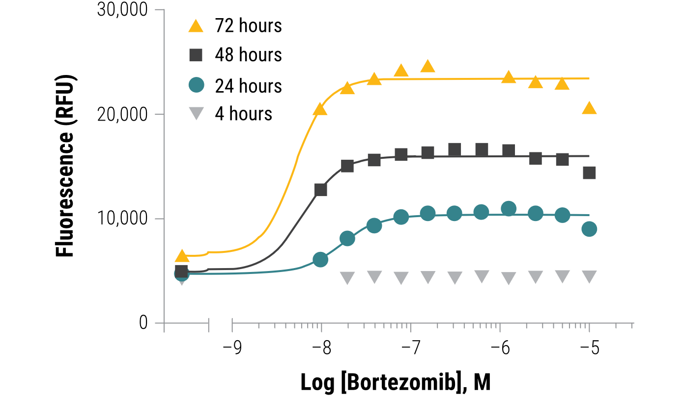
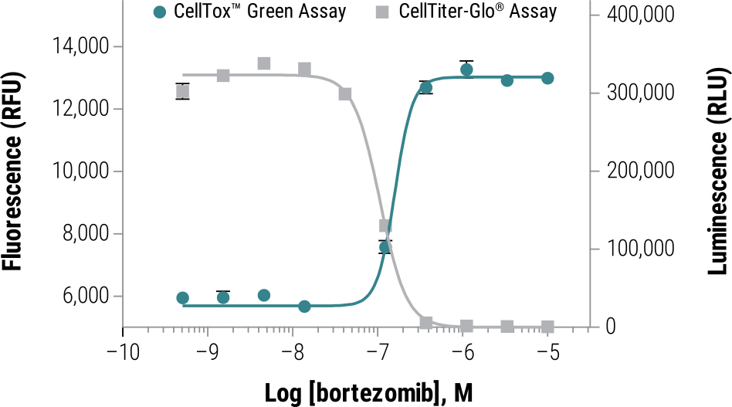
CellTox Green Advantages
True kinetic assay – measurements for up to 72 hours, well tolerated by the cells
Easily multiplexed with other fluorescent and BL assays
Suitable for 3D cultures, easily diffuses inside the spheroids
Compatible with standard GFP/FITC filters
  Microplate readers, flow cytometry, fluorescence microscopy
Low price – 1000x dillution for the experiments
Flexible protocol
Notes:
1. In the experiment shown here, bortezomib caused appreciable cytotoxicity in K562 cells between the 4- and 24-hour time points. Additive fluorescence at later time points indicates continued loss of membrane integrity occurring as a function of cytotoxicity against remaining cells. The CellTox™ Green Dye was added at seeding.
2. Here, CellTox™ Green Dye was mixed with K562 Cells, which were plated, then dosed with compound. CellTiter-Glo® Cell Viability Assay Reagent was added at the end of the 72-hour exposure and luminescence (viability) measured. These two inverse measures of cell health resulted in EC₅₀ agreement.

Slide 24
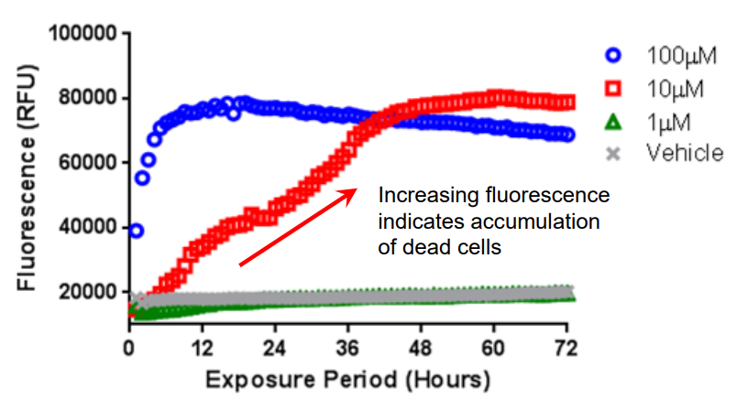
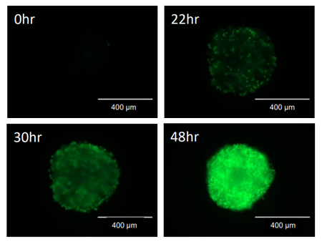
HepG2 cells treated with various doses of terfenadine. Fluorescence measured every hour from the same sample wells.
►
Live cell kinetic imaging of CellToxTM staining of a paclitaxel treated HepG2 cell spheroid photographed at different times over 2 days. Green fluorescence shows the accumulation of dead cells.
Notes:
Terfenadine – modulates Ca2+ homeostasis and induces apoptosis
Paclitaxel – binds to tubullin and prevents it from degradation, cells cannot proceed to metaphase -> apoptosis

Slide 25
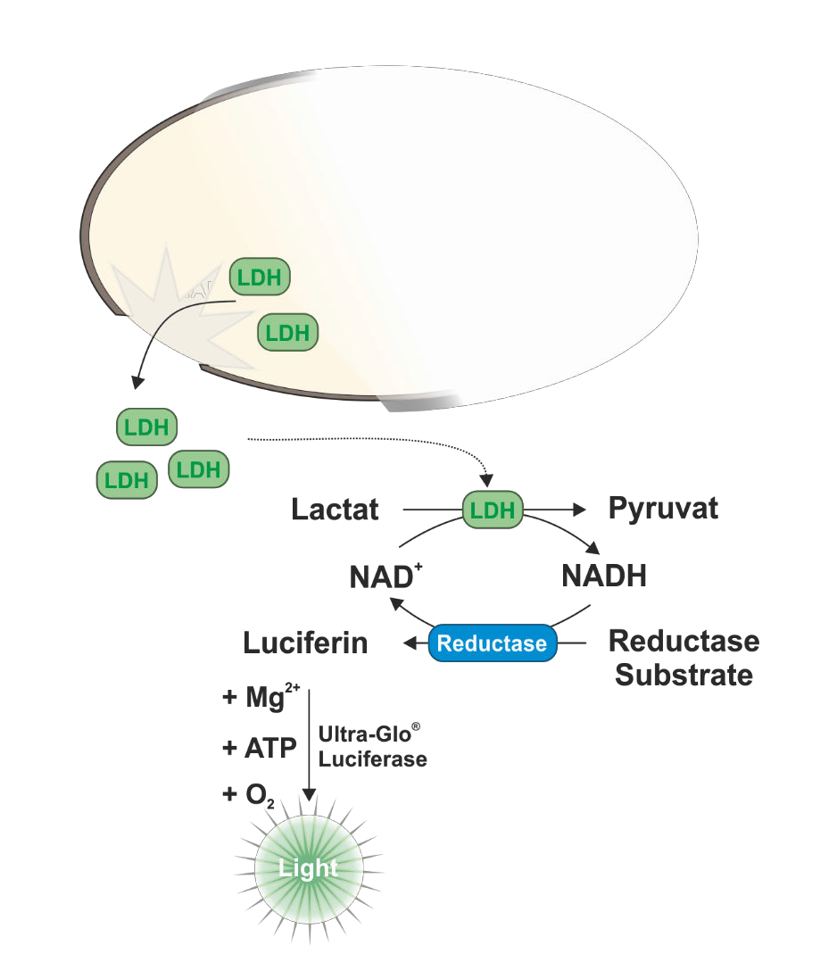
LDH-Glo® Assay – measures LDH leaking from cells
Lactate dehydrogenase leaks from damaged cells
Its activity is detected in supernatant in a coupled enzymatic reaction
Pro-luciferin is reduced by a proprietary reductase to luciferin and processed by firefly luciferase in the medium
Timed kinetic assay
Suitable for 3D cell cultures
Suitable for measuring antibody-dependent-cell-mediated cytotoxicity (ADCC)
Notes:
Další esej pro měření cytotoxicity využívá stejný princip, tedy narušení integrity membrány a kvantifikuje aktivitu laktát dehydrogenázy uniklé z nekrotických buněk. Esejí na měření LDH je na trhu spoustu, ale žádná nedosahuje citlivosti luminiscenční eseje od Promegy.
Esej je založená na detekci NADH, které produkuje LDH oxidací laktátu na pyruvát. NADH je ve spřažené enzymatické reakci použito pro redukci proluciferinu na luciferin. Proluciferin je v tomto typu esejí označován Promegou jako reductase substrate. Luminiscence produkovaná přeměnou tohoto substrátu je přímo úměrná množství LDH.
Esej funguje i pro 3D kultury a je možné ji použít i na měření cytotoxicity typicky u rakovinných buněk, na kterých se zkouší různé nové způsoby biologické léčby. Ať už se jedná buď o monoklonální protilátky, antibody drug conjugates, CAR-T buňky a podobně.

Slide 26
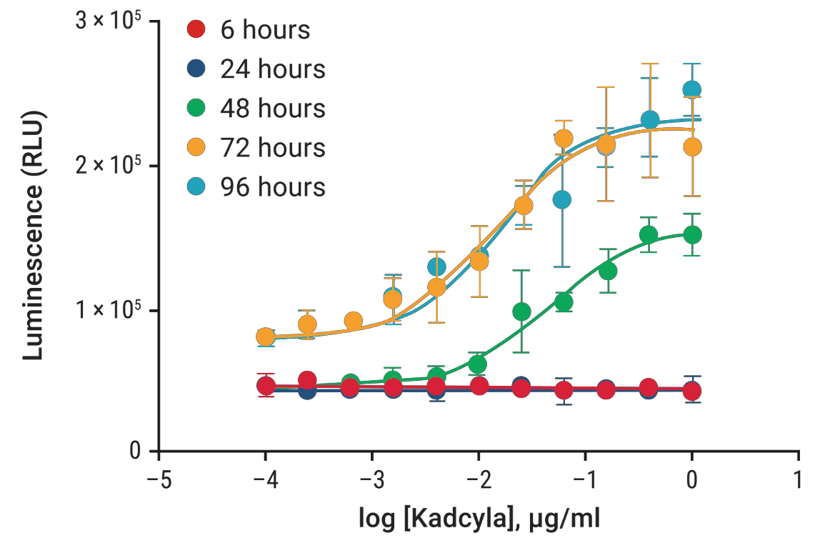
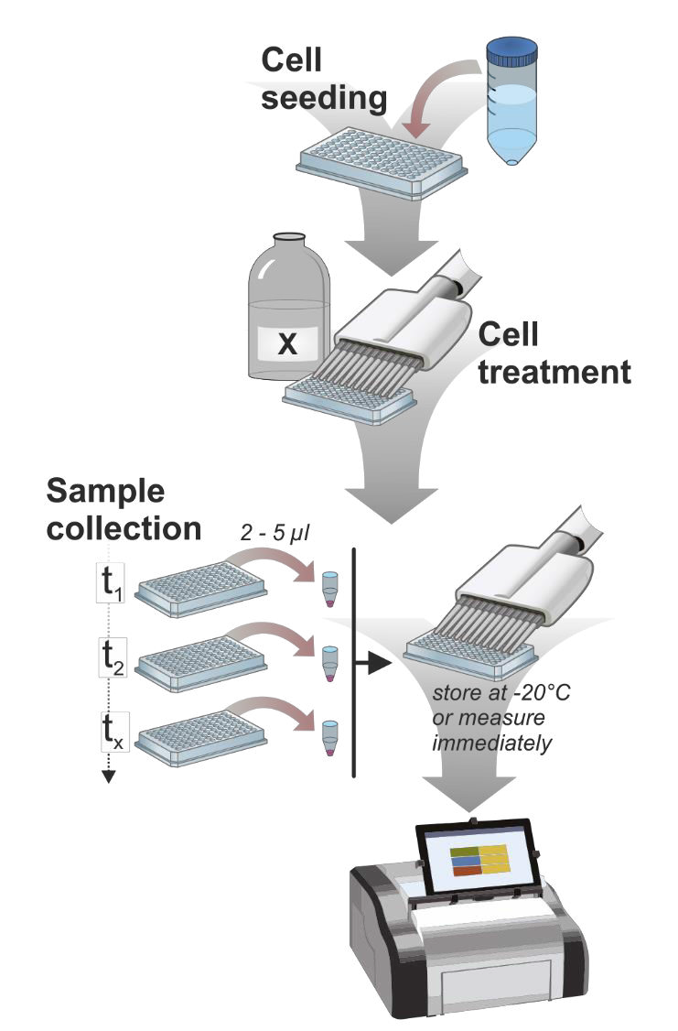
LDH-Glo® Can be Used as a Kinetic Assay
SKBR3 cells (breast cancer)
Experimental workflow
Enzymatic marker of cytotoxicity
Suitable for timed kinetic analysis
For ideal results, use inactivated FBS – residual LDH activity
Notes:
Skutečná síla této eseje spočívá v tom, že je možné jí použít v pseudo kinetickém formátu. Tím, že je hodně citlivá, stačí odebrat několik mikrolitrů média v každém časovém bodě, tyto vzorky zamrazit a na konci experimentu všechny naráz změřit. Získáme tak zpětně kinetická data. Příklad takových dat je na grafu vpravo, kde byli buňky rakoviny prsu vystaveny účinku antibody drug konjugátu Kadcyla což je Herceptin-antiHER2 protilátka konjugovaná s mikrotubulárním inhibitorem.

Slide 27
Apoptotic Assays
Apoptosis
Exposure of phosphatidylserine (PS) on the cell surface
Activation of apoptotic caspases
DNA fragmentation
Caspase-Glo assays
RealTime-Glo Annexin V Assay

Slide 28
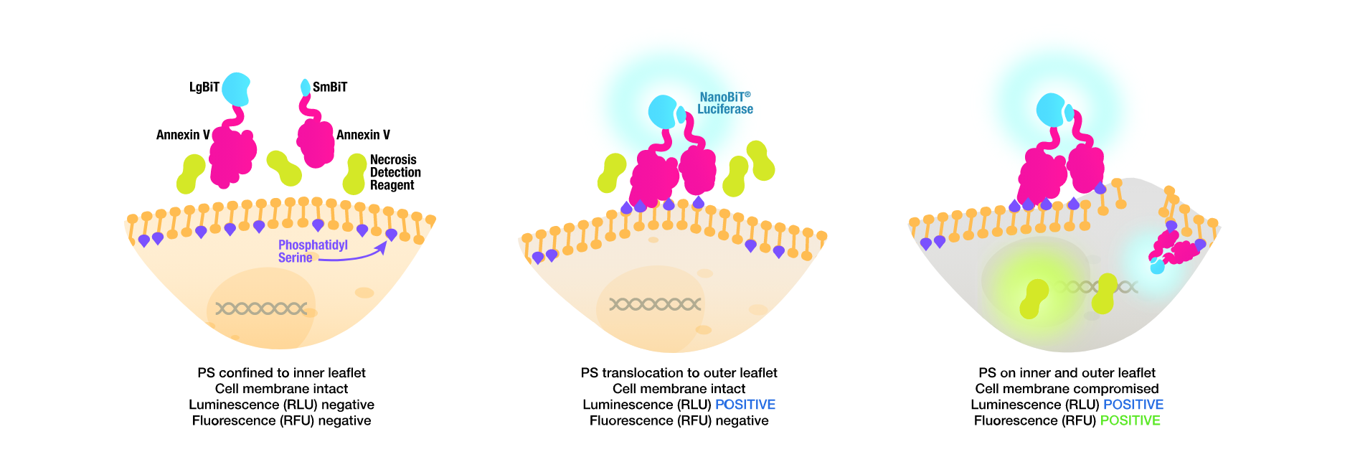
RealTime-Glo Annexin V Assay
Detects onset of apoptosis by measuring the phosphatidylserin (PS) exposure on surface of the cell membrane
Based on the NanoBiT split NanoLuc luciferase technology
Annexin V conjugated with LgBiT and SmBiT subunits of NanoLuc
Annexin V-LgBiT/SmBiT bind to PS on the membrane → subunits brought to close proximity recombine and restore the NanoLuc luminescent activity
Easily combined with CellTox Green
Notes:
Promega vyvinula esej na základě známého markeru apoptózy Annexinu pět, který váže fosfatidylserin. Annexin zfúzovala se dvěma podjednotkami split NanoLuc luciferázy LgBiT a SmBiT. LgBiT a SmBiT k sobě nemají příliš vysokou afinitu. Potřebují nějaký další protein, který by je přivedl k sobě blíž, což se právě stává snadno na vnějším povrchu buňky, která podléhá apoptóze. Buňka vystavuje na svém povrchu fosfatidylserin, na nějž se naváže Annexin, Luciferáza se zkomplementuje a my detekujeme luminiscenci.

Slide 29
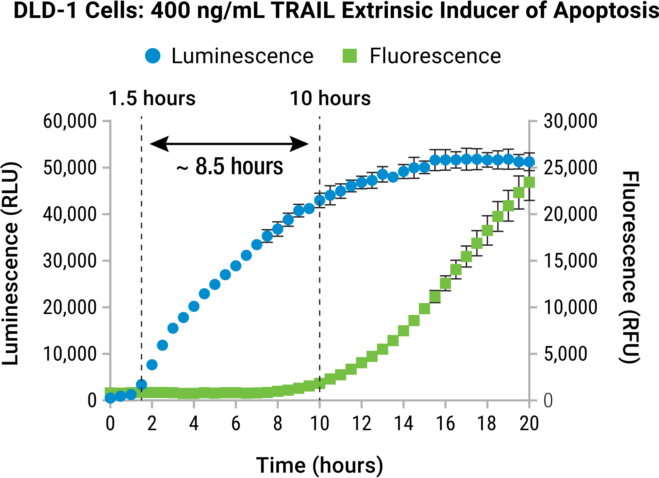
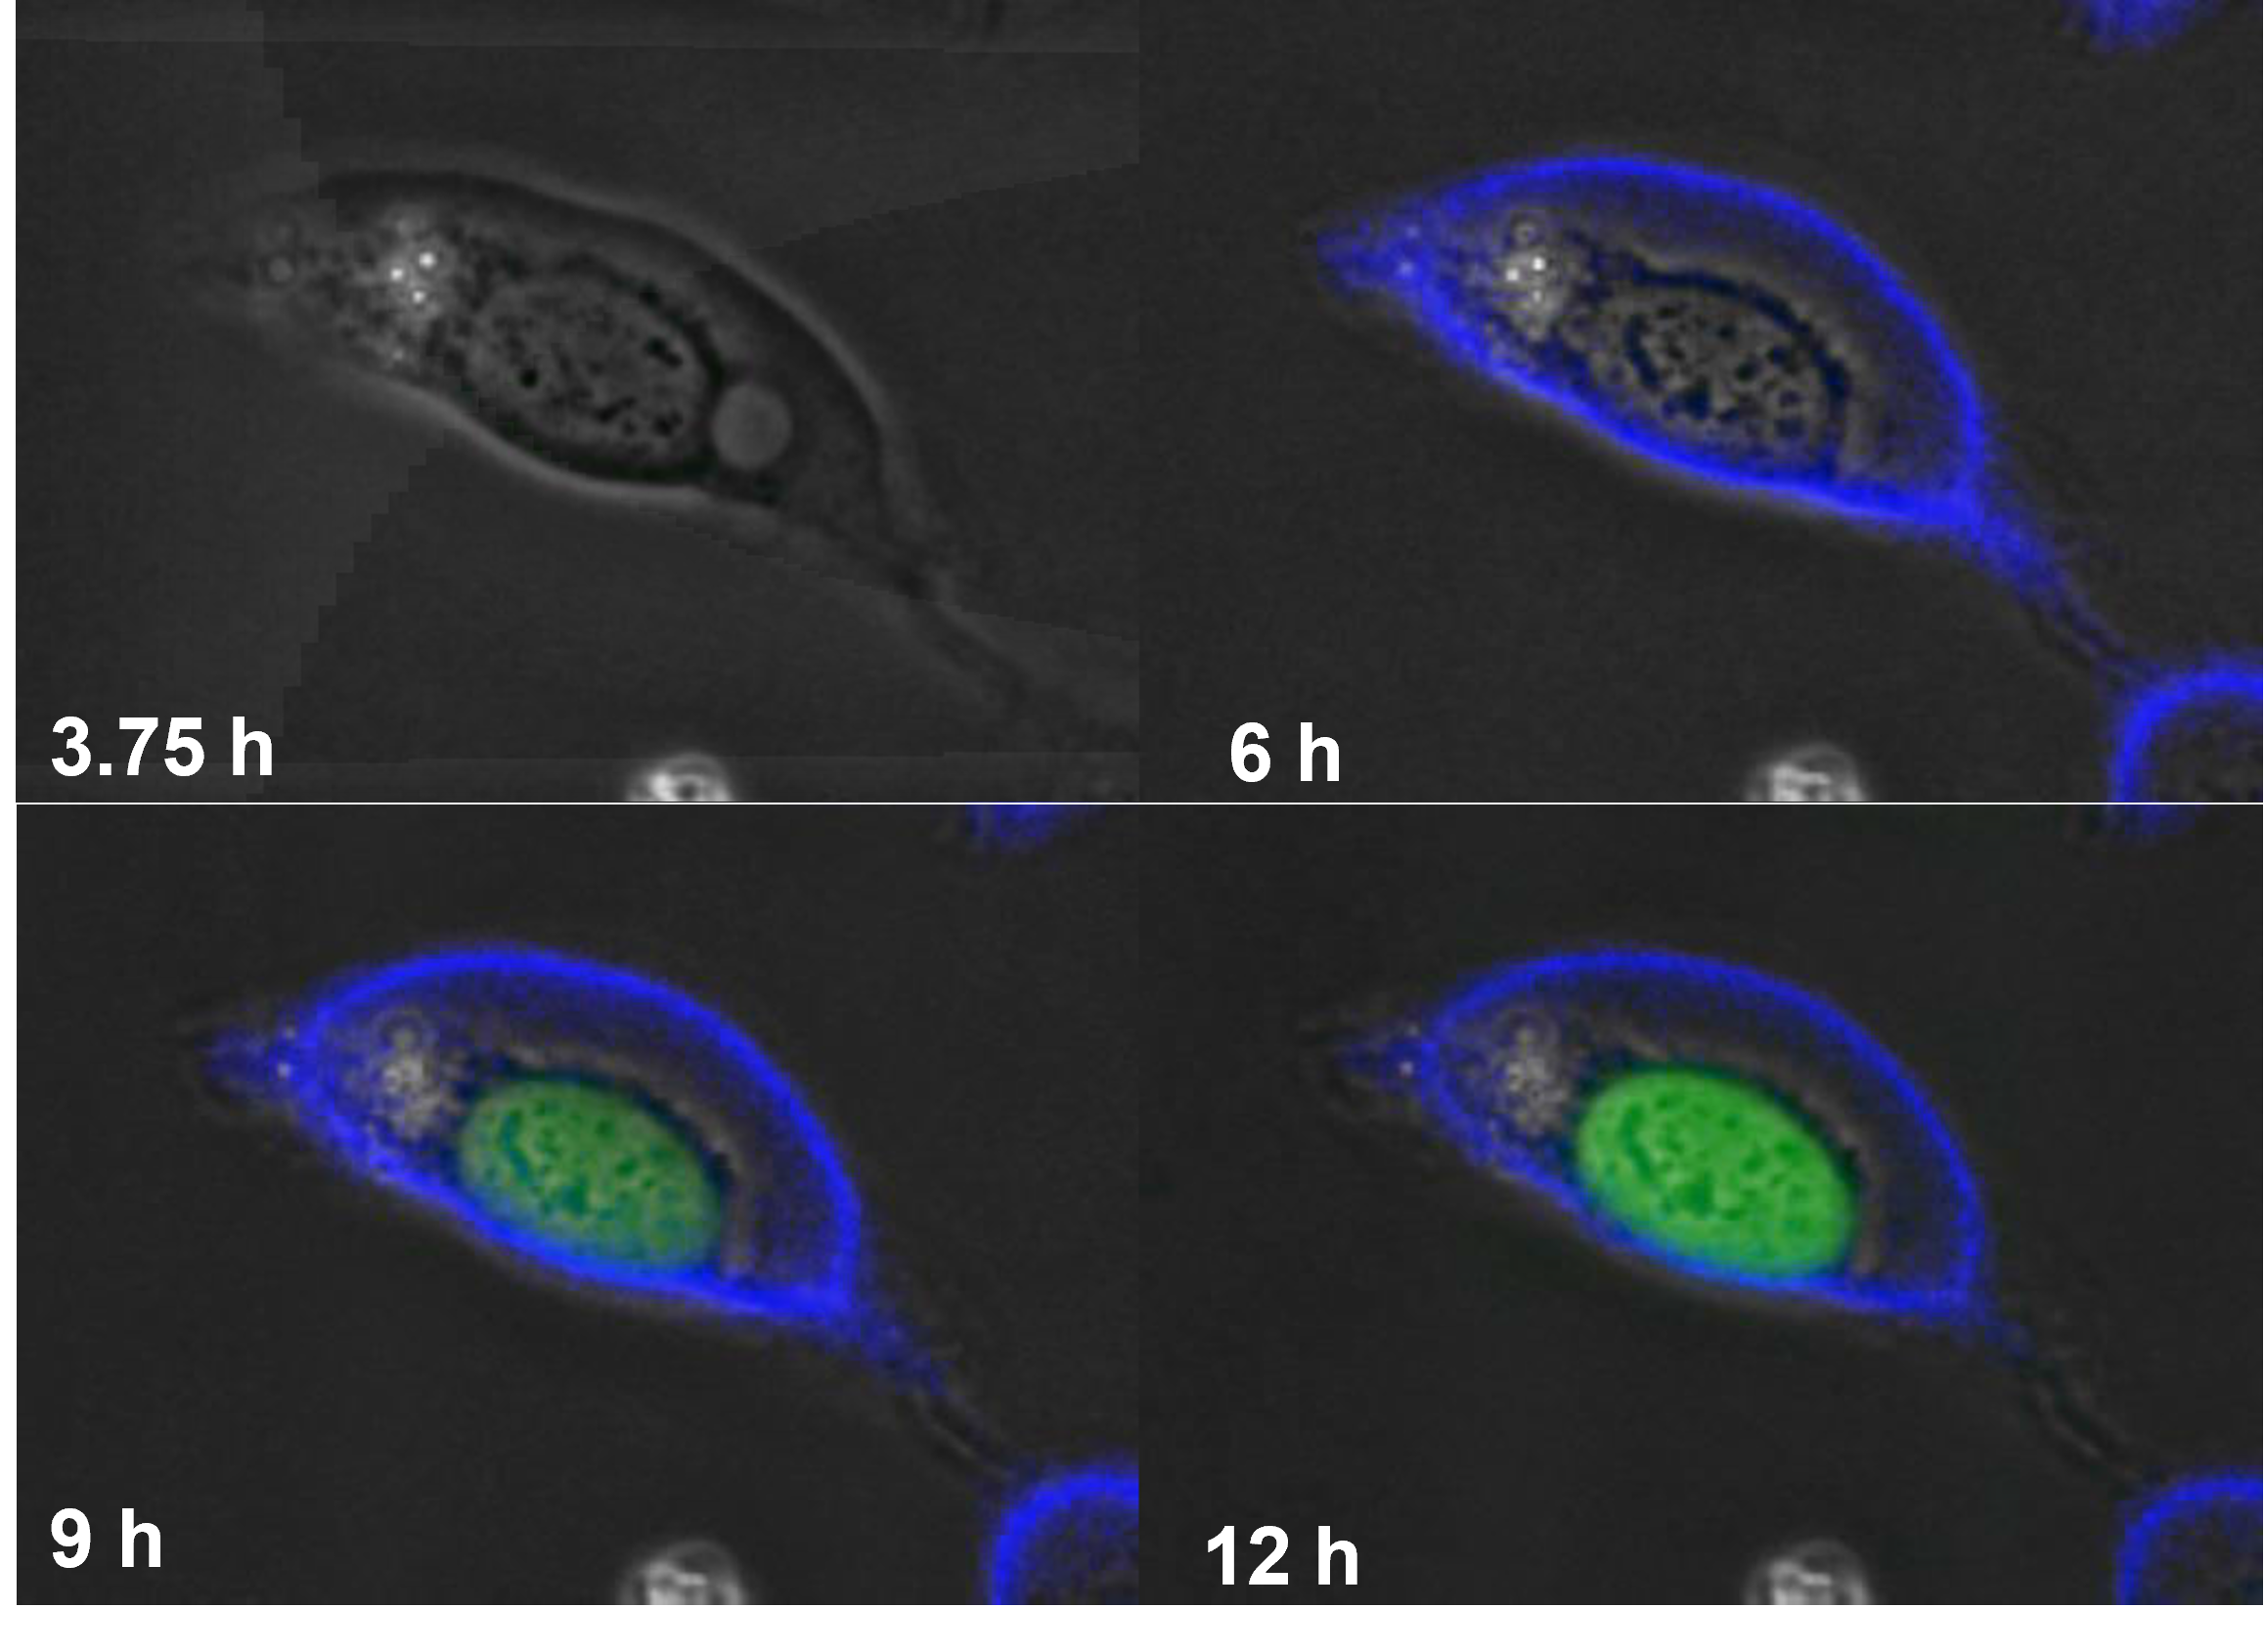
RealTime-Glo Annexin V Assay - Advantages
Different compounds trigger apoptosis with various kinetics in different cell lines
Easily identify the onset of apoptosis caused by your treatment
More information from a single well
Simple no-wash protocol, saves reagents, cells and plates
U2OS cells treated with 1 µM staurosporin at 0 h
Notes:
Esej je velmi užitečná buď v případech, ve kterých nevíme přesně, kdy nastává apoptóza a kdy změřit end point esej. Nebo v případech, kdy nás přímo zajímá kinetika apoptózy, protože různé látky způsobují apoptózu s různou kinetikou a to je samo o sobě cenná informace. Díky tomu, že každou jamku měříme mnohokrát opakovaně, tak v porovnání s end point esejí, která by měla získat stejná data, ušetříme obrovské množstí, reagencií, buněk, eseje a tak dále.
A to už je o apoptotických esejích vše. Na tomto místě bych chtěl připomenout, že East Port nedistribuuje jen Promegu.

Slide 30
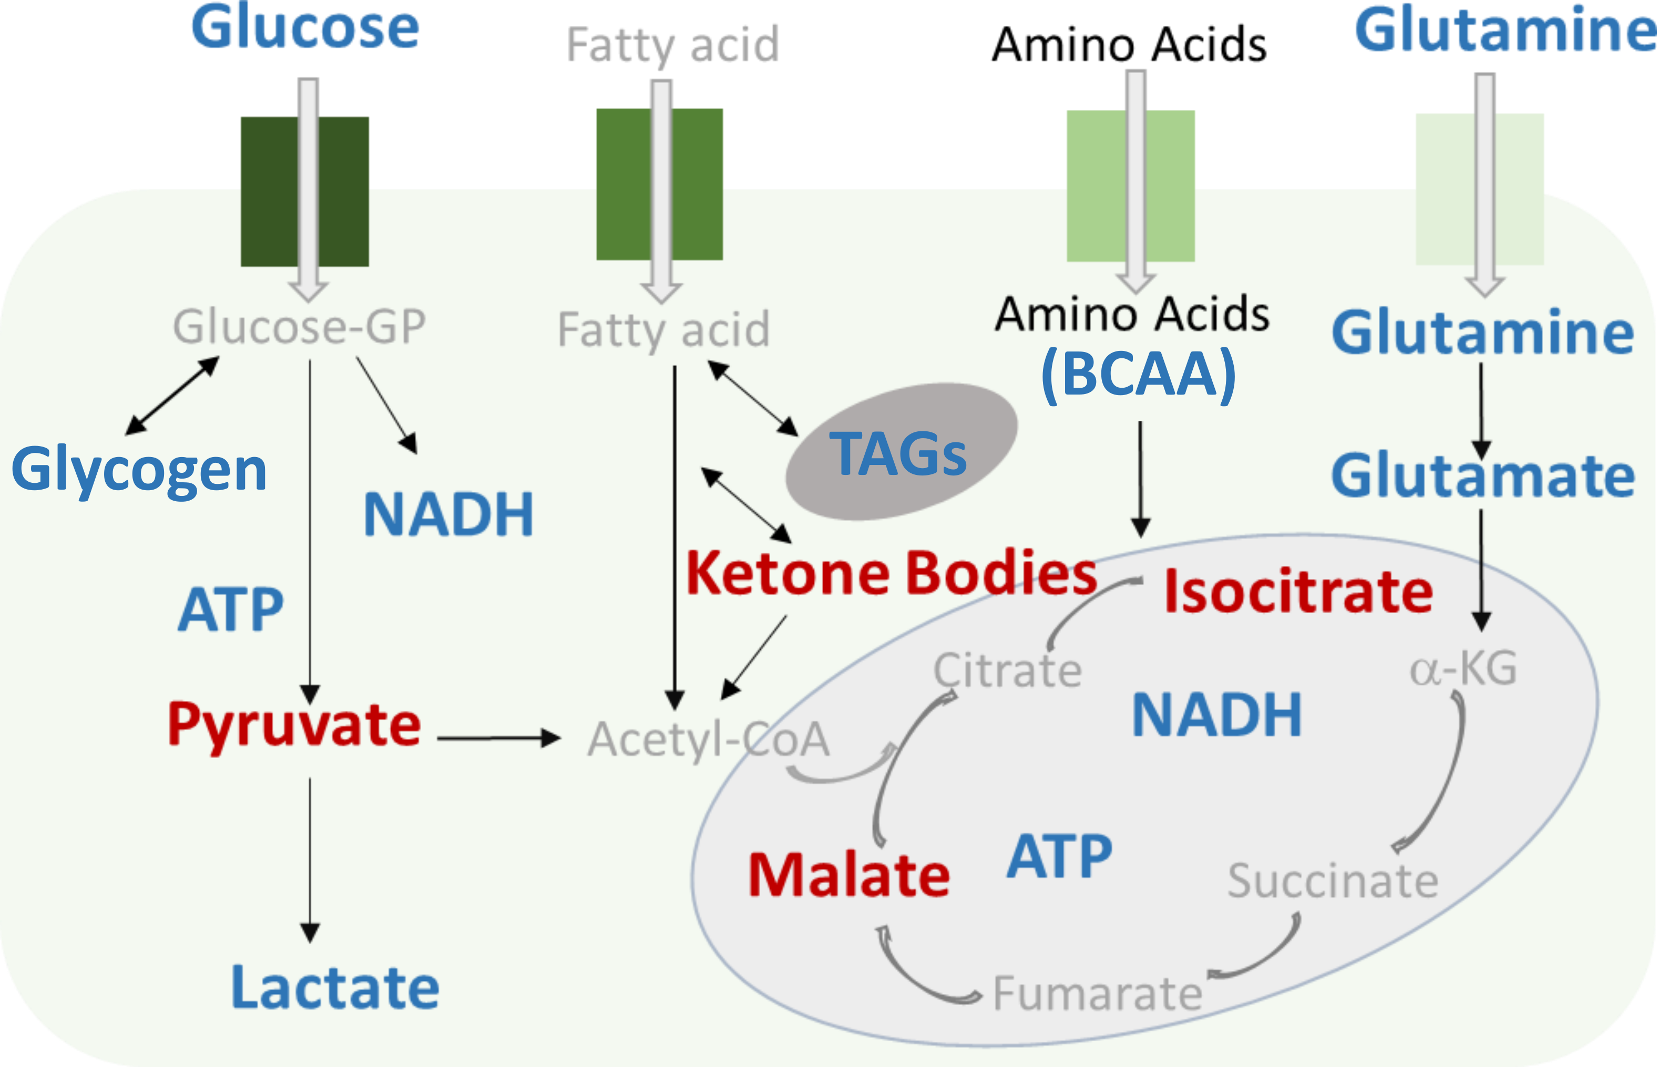
Cellular Energy Metabolism
Comprehensive analysis of metabolic pathways relies on multiple metabolite detection
Blue = Catalog
Assays for key cofactors, glycolysis, glutaminolysis and lipid metabolism
Red = In development
Assays targeting mitochondria function and key
“fasting and feeding” responses;
DIY kits for measuring metabolites and
pathways of interest
*
*Ketone bodies = 3-hydroxybutyrate

Slide 31
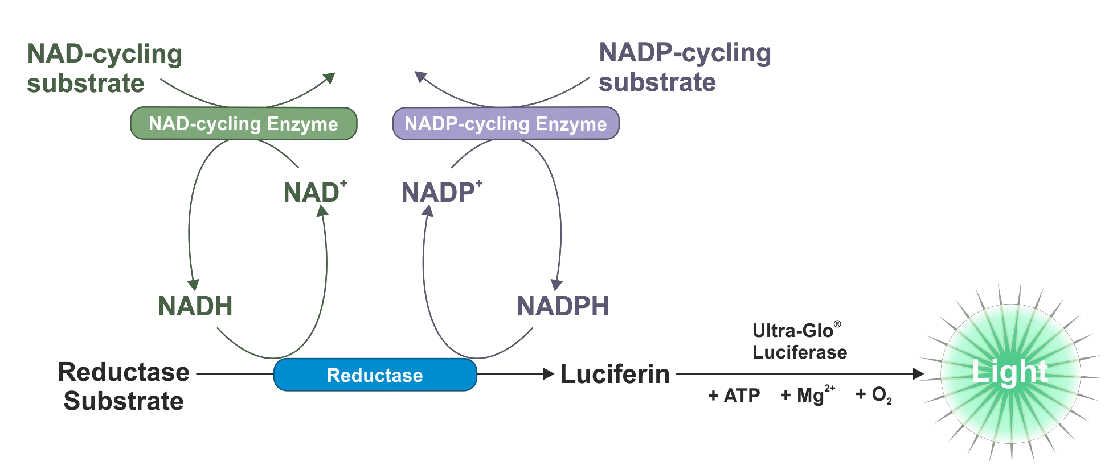
NAD(H) & NADP(H) Detection Assays
NAD/NADH-GloTM Assay NADP/NADPH-GloTM Assay
(Proluciferin)
Quick assay for measuring cellular NAD(H) and NADP(H) levels
To detect total NAD⁺/NADH or NADP⁺/NADPH selective cycling enzymes are added to the detection reagents
Cycling enzymes amplify reaction until reductase substrate becomes limiting
Notes:
Cycling enzyme? Cyklizuje NAD nebo jen řídí obrat?

Slide 32
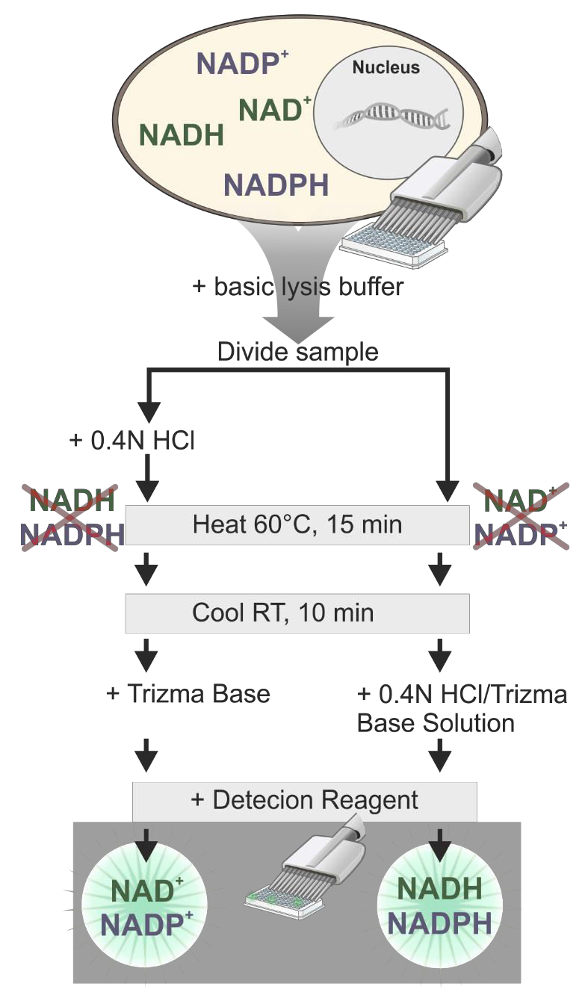
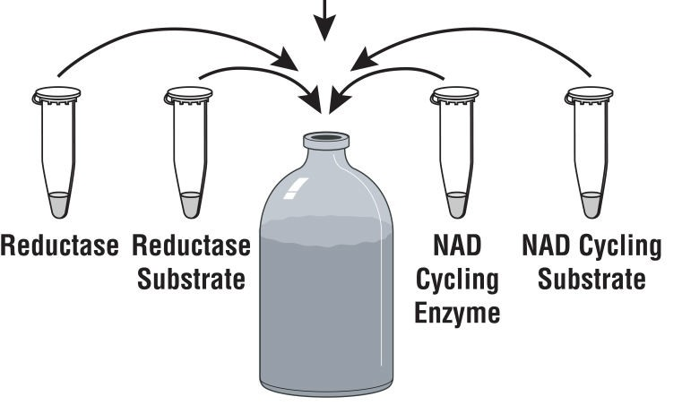
Measure Oxidized and Reduced Forms Individually
Key benefits
Homogeneous sensitive bioluminescent assay
Requires less sample
Everything done in the same well
Samples are in the same buffers at the end of treatment
The ratio (NAD/NADH or NADP/NADPH) can be calculated directly based on the RLU values
Reductase Reductase
Cycling Enzyme
Cycling
Substrate
Substrate
Detection Reagent
Notes:
Okyselení a zahřátí 0,4M HCl zničí redukované formy kofaktoru, v bazickém pufru (součást assaye) je zlikvidována oxidovaná forma kofaktorů.

Slide 33
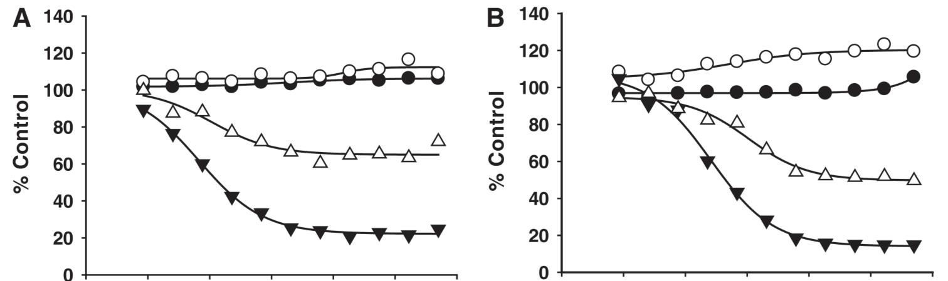
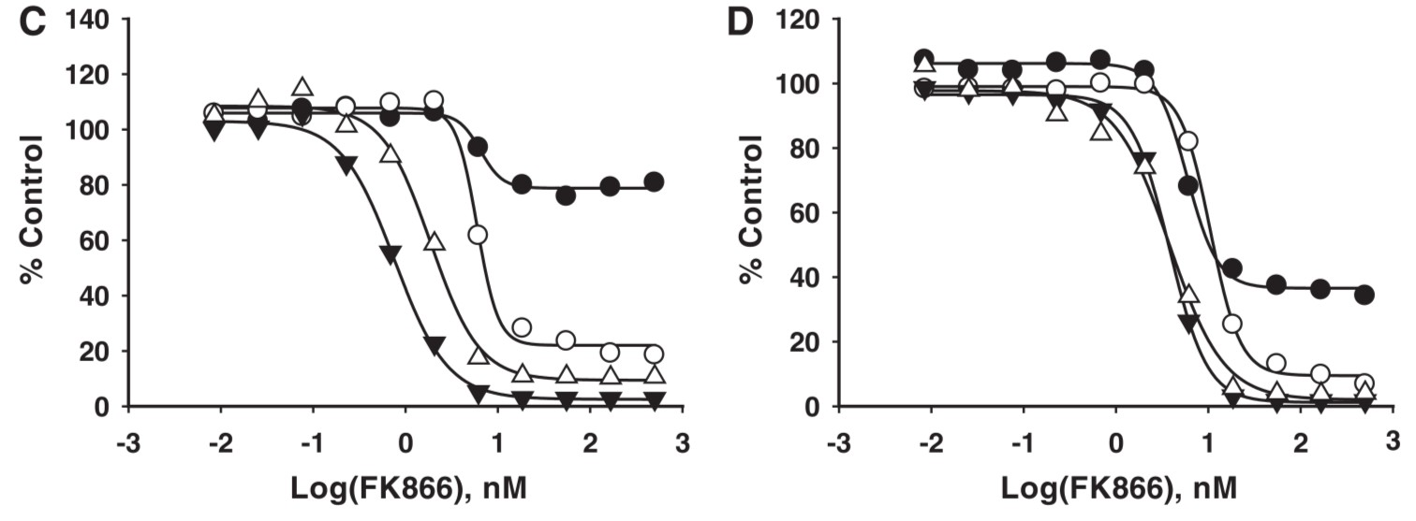
Dinucleotide Depletion by Inhibition of NAD Synthesis
ATP (CellTiter-Glo)
CTF (CellTiter-Fluor)
NADP+NADPH
NAD+NADH
FK866 - highly specific noncompetitive inhibitor of nicotinamide phosphoribosyltransferase
16 h
24 h
41 h
71 h
Adapted from Vidugiriene, J et al. (2014), Assay Drug Dev Technol. 12(9-10):514-26
Notes:
FK866 -

Slide 34
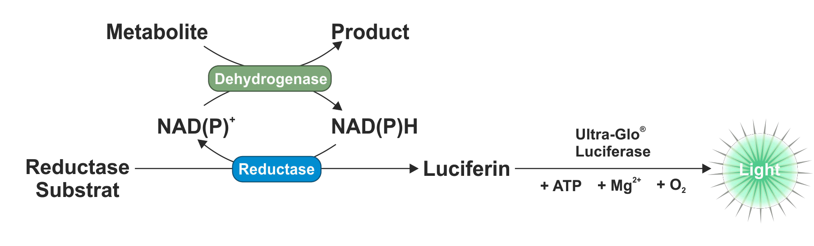
Metabolite Assays – One Reaction to Rule Them All
Metabolite-selective dehydrogenases coupled to bioluminescent NAD(P)H detection
Pro-luciferin
“With the aid of auxiliary enzymes nearly every substance of biological interest could
be measured with a pyridine nucleotide system”
Oliver Lowry JBC (1961) 236, 2746
Metabolites are detected by coupled enzymatic reactions of metabolite oxidation and pro-luciferin molecule reduction
The metabolite is oxidized by its specific dehydrogenase in the presence of NAD(P)+ and generates a reduced NAD(P)H molecule
The NAD(P)H is used for the reduction of pro-luciferin to luciferin by a proprietary reductase enzyme
The luciferin is processed by Ultra-Glo luciferase and light emission is generated

Slide 35
Metabolite Assays – One Reaction to Rule Them All
Metabolite-selective dehydrogenases coupled to bioluminescent NAD(P)H detection
Pro-luciferin
“With the aid of auxiliary enzymes nearly every substance of biological interest could
be measured with a pyridine nucleotide system”
Oliver Lowry JBC (1961) 236, 2746
Broad linear range of 3 logs (0,1-100 μM)
Wide dynamic range S/B < 100
High sensitivity, requiring only a small sample volume - > can be run in a 384-well plate format
Simplified protocol applicable to many sample types – homogenized tissue, 2D & 3D culture, serum, medium
Can be used as an endpoint or timed kinetic assays

Slide 36
Metabolite Assays – Available Kits
 | Cofactors | Glucose Metabolism | Amino Acid Metabolism | Lipid Metabolism | Mitochondrial Function
Cat. products | NAD/NADH​ NADP/NADPH NAD(P)H | Glucose Uptake (2DG6P)​ Glucose​ Lactate​ | Glutamine Glutamate | Triglyceride Glycerol Cholesterol Cholesterol Ester​
Early Access |  | Glycogen | Branched Chain Amino Acids (BCAA) | Ketone Bodies (3HB)
In development |  |  |  |  | Malate Isocitrate Pyruvate
Notes:
Malate, 3-Hydroxybutyrate and Pyruvate available for testing after

Slide 37
Metabolite Assays – Available Kits
 | Cofactors | Glucose Metabolism | Amino Acid Metabolism | Lipid Metabolism | Mitochondrial Function
Cat. products | NAD/NADH​ NADP/NADPH NAD(P)H | Glucose Uptake (2DG6P)​ Glucose​ Lactate​ | Glutamine Glutamate | Triglyceride Glycerol Cholesterol Cholesterol Ester​
Early Access |  | Glycogen | Branched Chain Amino Acids (BCAA) | Ketone Bodies (3HB)
In development |  |  |  |  | Malate Isocitrate Pyruvate
Can be used in a timed kinetic mode to measure signal from supernatant
Notes:
Malate, 3-Hydroxybutyrate and Pyruvate available for testing after

Slide 38
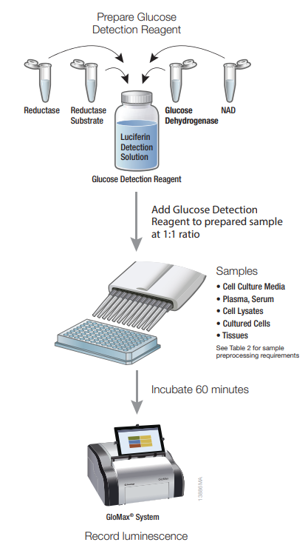
Metabolic Assays Workflow
Direct measurement
Timed kinetic measurement

Slide 39
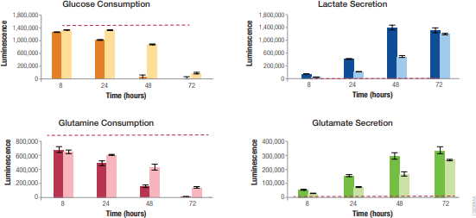
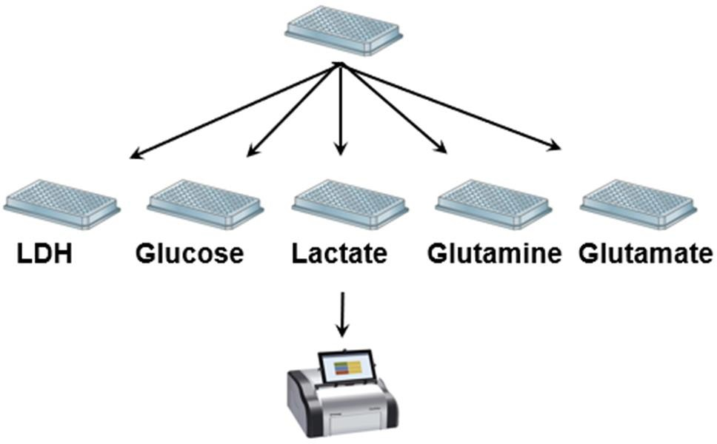
Measuring Multiple Metabolites from a Single Sample
Dilluted sample
Measure light output
A549 cells plated at 15 000 (dark bars) or 5000 (light bars) cells per well in DMEM medium
2,5 μl of medium removed, dilluted in 97,5 μl of PBS at different time points and frozen at -20 °C
At the end of the experiment, sample aliquotes were pipetted into four wells of 384-well plate
Glucose, lactate, glutamine and glutamate concentrations were measured using the metabolic assays
Red lines = controls – medium without cells
Leippe, D., et al. (2017) SLAS Discovery 22, 366-77

Slide 40

Applying NAD(P)H Detection for DIY Metabolite and Dehydrogenase Activity Assays
In Development Dehydrogenase-Glo™ Detection System
Application: Detect the enzymatic activity of a dehydrogenase of interest
In Development Metabolite-Glo™ Detection System
Application: Measure the amount of a metabolite of interest present in a sample
DIY Kit Components
Reductase substrate
Reductase enzyme
NAD+ and NAD(P)+
Luciferase detection reagent
Acid lysis solution*
Neutralization detection*
Metabolite-Glo™ Detection System Kit Only
Dehydrogenase substrate
Metabolite of Interest
NAD(P)+
Dehydrogenase
of Interest
Metabolite-specific dehydrogenase
NAD(P)H
NAD(P)+
NAD(P)H
NAD(P)H
NAD(P)+
Ultra-Glo™ rLuciferase
+ ATP
Light Output depends on [Metabolite]
Reductase Substrate (Pro-Luciferin)
Reductase
Luciferin
Light

Slide 41
Kit Components
Dehydrogenase-Glo™ Detection System | Metabolite-Glo™ Detection System | Validated, Ready-to-use Metabolite Detection Assay Kits
Reductase Substrate | Reductase Substrate | Reductase Substrate
Reductase Enzyme | Reductase Enzyme | Reductase Enzyme
NAD+ and NAD(P)+ | NAD+ and NAD(P)+ | NAD+ or NAD(P)+
Luciferase Detection Reagent | Luciferase Detection Reagent | Luciferase Detection Reagent
 | Acid lysis solution | Acid lysis solution
 | Neutralization solution | Neutralization solution
 |  | Metabolite-Specific Dehydrogenase
 |  | Metabolite-Specific Standard

Slide 42


High Quality Cell Culture Media and Sera
German company established in 2013
Specialises on the production of high quality sera and cell culture media and reagents
Possibility of custom manufacturing from 20 liters
Sera
FBS
Other bovine and animal sera
Human sera
Cell Culture Media
Classic liquid media
Classic powdered media
Special culture media
Cryopreservation
Cell Culture reagents
Supplements and additives
Antibiotics
BSA
Trypsin
Cell separation
Balanced Salt Solutions
Liquid buffers
Powdered buffers
Diagnostics
Virology media
Cytogenetics

Slide 43
High Quality Cell Sera
FBS Standard
  Standard FBS of various origin
  Works with all cell types
FBS Advanced
  Pooled homogeneous medium with limited batch-to-batch variations
  Key components responsible for cell growth are supplemented to specific concentrations
  More controlled composition
FBS Xtra
  Half way to serum-free cell culture
  Special serum with reduced serum content
  Key cell growth components are prepared synthetically or recombinantly and added at specific concentrations (transferrin, insulin, rare elements)
  Better chemically defined, even less batch-to-batch variations
  Less sensitive to FBS raw supply fluctuations

Slide 44

Primary Cells, Stem Cells & Media
Primary cells - over 150 human and animal cell types available
Clonetics media a growth factors for wide spectrum of primary cells
Stem cells together with media
Blood and immune cells from vast collection of donors and sources
  Specialized X-VivoTM media

Slide 45


Mycoplasma Testing
Mycoplasma = small bacteria lacking cell wall, not susceptible to penicillin and other antibiotics
Widespread contamination in a variety of cell culture systems
Size below 1 μm, hardly visible in optical microscope
BL MycoAlertTM kit:
  Mycoplasma from cell culture supernatant are lysed and their enzymes released into the medium
  Enzymes convert added ADP to ATP
  ATP is processed by firefly luciferase from the detection reagent and in case of contamination bioluminescence is produced

Slide 46



Monochromator-Based Microplate Readers

Slide 47


Monochromator-Based Microplate Readers
SpectraMax Mini
Visit our booth!
ImageXpress Pico Live-Cell Imaging System

Slide 48

GloMax luminometers – Features and Benefits
Dedicated luminometers or combination with filter-based fluorescence and absorbance module
Most sensitive luminometer on the market - LOD 3·10⁻²¹ mol firefly luciferase
Linear dynamic range of 9 orders of magnitude, low crosstalk
Intuitive tablet control
Automatic gain adjustments
Preset protocols for all Promega luciferase and cell-based assays
Simple protocol creation and modification

Slide 49









GloMax Plate Readers – Configurations
GloMax® Navigator
96-well
GloMax® Explorer
6-, 12-, 24-, 48-, 96- and 384-well
GloMax® Discover
6-, 12-, 24-, 48-, 96- and 384-well
Luminescence
Heating
Shaking
Luminescence
Fluorescence
Heating
Shaking
Luminescence
Fluorescence
UV/Vis Absorbance
BRET / FRET
Available Upgrades
Vis Absorbance
UV/Vis Absorbance
BRET / FRET
49

Slide 50

East Port Academy – Seminars on Demand
Seminars for a single research group or a laboratory
Provided completely free and without any obligations
On site or online presentation of our products suitable for your specific applications
Thorough discussion of your needs and what you want to achieve
Primary contact is me
  Vojtěch Ledvina
  Vojtech.ledvina@eastport.cz

Slide 51

East Port Seminar/Workshop Invitation
Guidance to the Sustainable Bacterial Endotoxin Testing
Practical Introduction to the Recombinant Factor C Assay and Lonza Solution for Pyrogen Testing
19. 4. 2023 from 9:30 to 15:00
Café Louvre Gallery
Národní 22, Prague

Slide 52

Thank you for your attention!
Questions?

