Slide 1
Developing the best immunotherapies with real-time & label-free cell-based killing assays
>> Ensuring biological fidelity from Discovery to Manufacturing
Zhong Yu, PhD
Scientific Liaisons Manager
zyu@axionbio.com

Slide 2
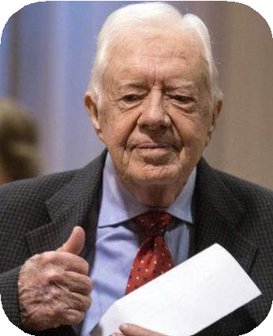
Immunotherapy has changed how we intervene in disease
Emily Whitehead Pediatric ALL
First FDA approved cell therapy 2017 CD19 CAR T
Jimmy Carter Melanoma
Pembrolizumab 2015 anti-PD1 mAb
Therapeutic vaccination
Checkpoint inhibitors
Adoptive cell
transfer
axionbio.com
2

Slide 3
Cell therapy has great potential but has its limitations
Cells as drugs have potential advantages
Therapeutic vaccination
Checkpoint inhibitors
High demand for:
Real-time, kinetic measures of living cells
Non-perturbing, label-free detection
Adoptive cell
transfer
➔ More predictive live-cell in vitro assays
Manufacturing standards for cell & gene therapeutics
Closed systems with easy, digital tools
➔ Ensuring biological fidelity from Discovery to Manufacturing
axionbio.com
3

Slide 4
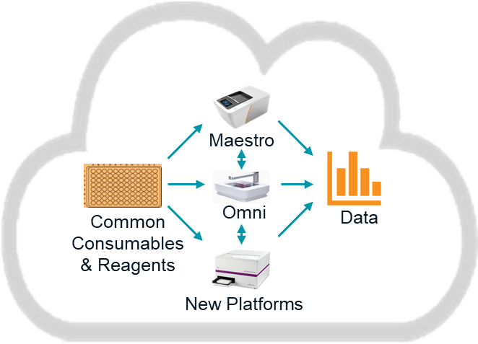
Cell analytics will span the precision medicine value chain
To achieve biological fidelity, non-perturbing analytics are needed to monitor and control the entire process
Need for cell analytical solutions
Live-cell analytical ecosystem
Cell Research, Discovery, Development
Analytics
Sourcing
Analytics
Processing
Analytics
Culture
Analytics
Analysis
Outcome
Cell Production
Analytics Analytics Analytics Processing Production Release Testing
Analytics
Sourcing
Outcome
Gap
Real-time, kinetic measures of living cells
Non-perturbing, label-free detection
Manufacturing standards for cell & gene therapeutics
Closed systems with easy, digital tools for data analysis
Value
Confidence in outcomes facilitates decision making
Maintains biological fidelity from discovery to manufacturing
Reduces sample preparation & experimental variabilibily
Streamlines data analysis and comparability of data
axionbio.com
4

Slide 5
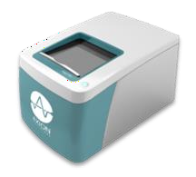
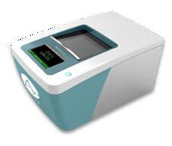
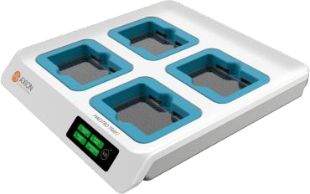
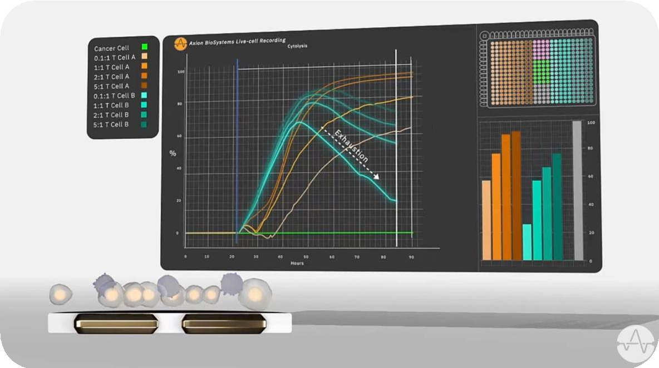
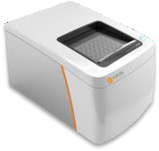
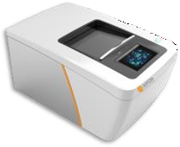
Label free, data rich, functional assays
Discover and follow the biology from milliseconds to months
Maestro Z Impedance
AxIS Software
Maestro MEA
Label free does not impact biology, no optimization of labels, dyes or incubation time required

Slide 6
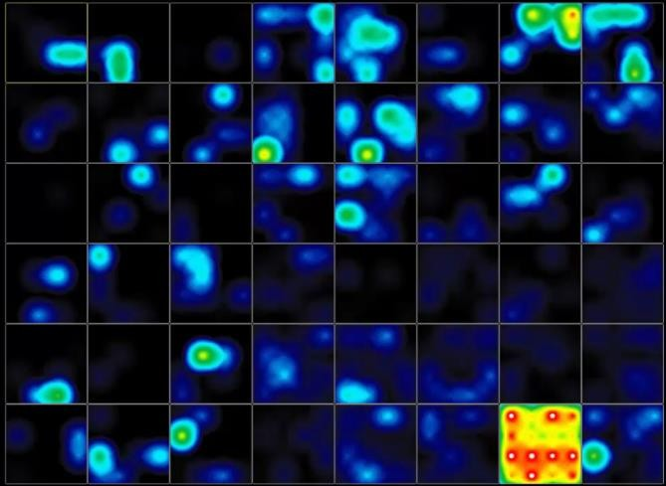
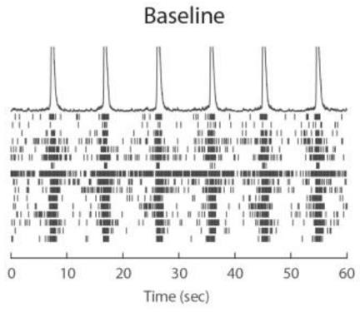
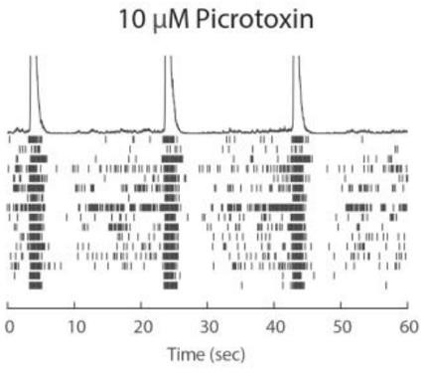
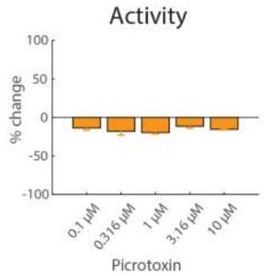
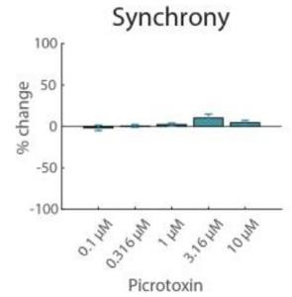
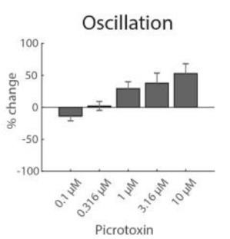
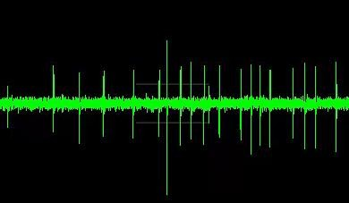
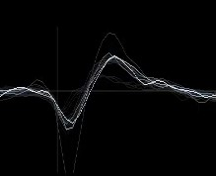
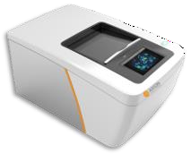
Neural analysis: live neurons in action
Fast, easy, and relevant
1
Watch the entire plate or a single neuron
Quickly analyze network metrics
3
Export tracings, raster plots, and graphs
2
Maestro Pro and Edge

Slide 7
Impedance assay measures resistance
How does it work?
Intervention
Measures resistance: how easily signal passes the
electrode-cell interface
Resistance increases as coverage and attachment increases
Can detect:
Proliferation
Viability & cytotoxicity
Cell signaling
Cell migration
Cell-cell coupling strength (barrier function)
Resistance
(Ohms, Ω)
Time

Slide 8
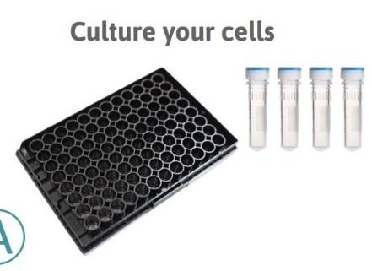
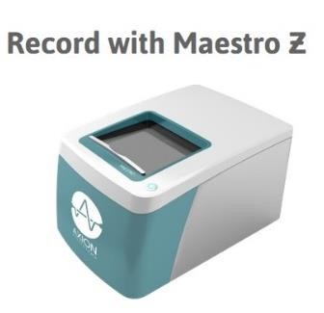
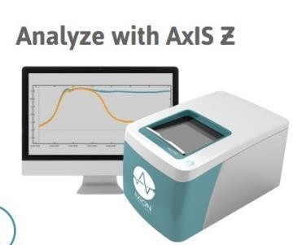
Impedance analysis: easy, real-time, label-free
A Comparison to Traditional Assays
Plate cells Dosing
Captures all stages of an experiment
Cell growth and death
Acute or chronic treatments
Hands-free data collection
Plate cells, add treatments, done
Label-free
Measurement does not impact biology
No optimization of labels, dyes, or incubation times required
Cell Growth
Cell Death
0
20
40 60
Impedance Assay
80
1
2
3

Slide 9
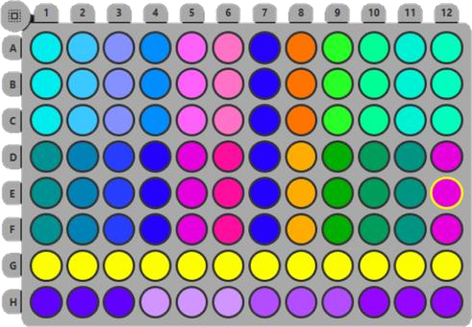
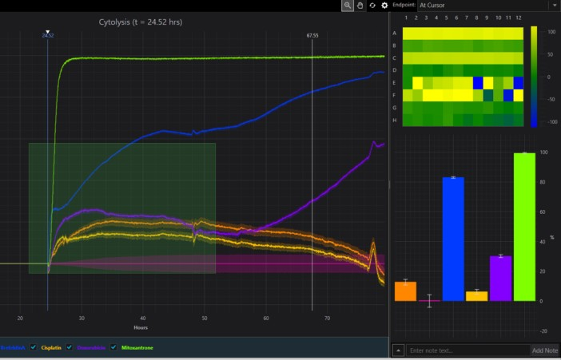
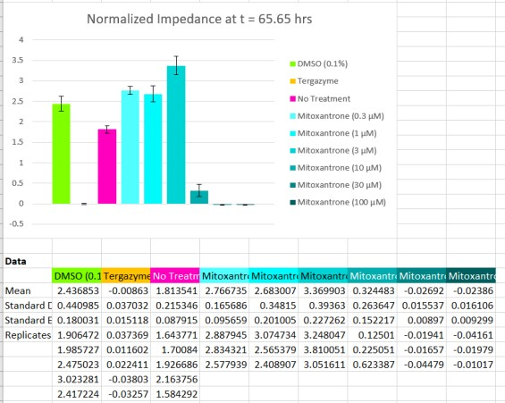
Impedance analysis: simple setup and data analysis
Easy interface for data rich experiments
Plate maps track
conditions and controls
Fully interactive display results
Export plots to Excel with data-linked charts
1
2
3

Slide 10
Assessing effectiveness of CAR T cell costimulatory domains
SKOV3 Ovarian adenocarcinoma target cell: 41BB vs CD28
Cytolysis
Cytolysis at t = 99 hrs
100
100
 | SKOV3
 | 1:10 41BB
 | 1:5 41BB
 | 1:2 41BB
 | 1:1 41BB
 | 5:1 41BB
 | 1:10 CD28
 | 1:5 CD28
 | 1:2 CD28
 | 1:1 CD28
 | 5:1 CD28
80
80
60
60
%
%
40
40
20
20
0
0
0
50
100
Hours
150
HER2-targeted CAR T cells
Unpublished results

Slide 11
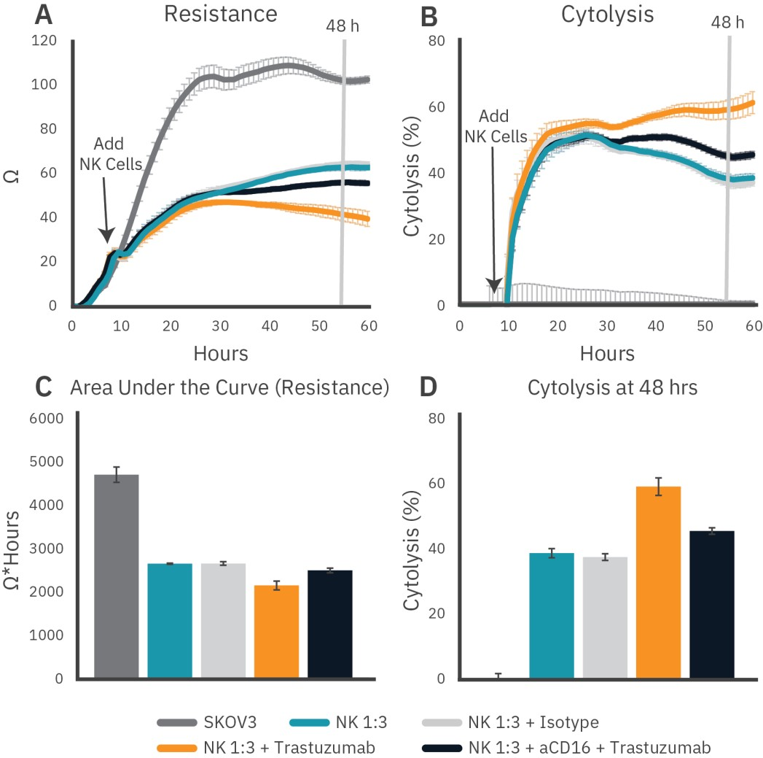
NK cell antibody-dependent cellular cytotoxicity (ADCC)
Quantify ADCC compared to standard NK-mediated cytolysis
HER2-targeting via trastuzumab addition results in significantly enhanced cytolysis compared to isotype control or NK cells, alone
Effect is partially blocked by anti-CD16, suggesting a CD16-dependent mechanism for ADCC
Antibody-dependent Cellular Cytotoxicity of Natural Killer Cells Application Note (2022). (Data provided by Glycostem Therapeutics) https://www.axionbiosystems.com/resources/application-note/antibody-dependent- cellular-cytotoxicity-natural-killer-cells

Slide 12
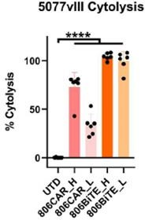
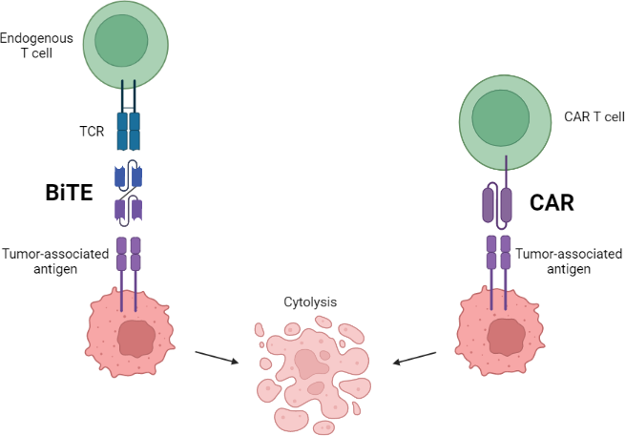
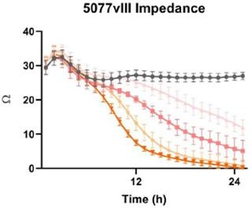
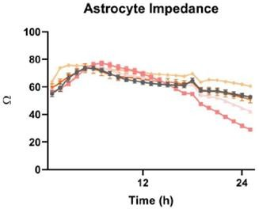
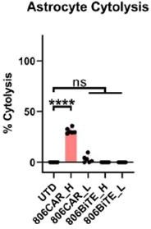
Glioma cell targeting with Bispecific T cell engagers (BiTEs)
Locally secreted BiTEs complement CAR T cells
Cytolysis
High expressing EGFT target cells
Untransduced
806CAR_L
806CAR_H
806BiTE_L
806BiTE_H
Low expressing
Cytolysis
Quantify and compare BiTE-mediated cytolysis to CAR T-mediated cytolysis
BiTE-secreting T cells are more effective, even at low
transduction efficiency, demonstrating high sensitivity
EGFR targeting via 806 results in little-to-no off-target cytotoxicity of non-tumor astrocytes
806BiTE_L
Untransduced 806BiTE_H
806CAR_L
806CAR_H
Yin et al., Mol Ther. 2022 May 14 (online ahead of print)

Slide 13
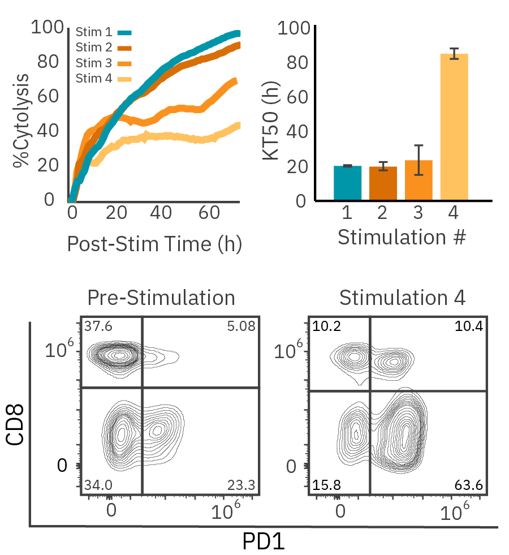
T Cell Exhaustion and Persistence
Repeated Challenge Assay
Effector cells transferred to new target cells at 1:1 ratio every 72 hours on Maestro Z
Effectors: HER2-targeted CAR T cells
Targets: SKOV3 cells (ovarian cancer line)
Decrease in cytolysis with every transfer (stimulation)
Flow cytometry showed an increase in PD1 and
decrease CD8 over time

Slide 14
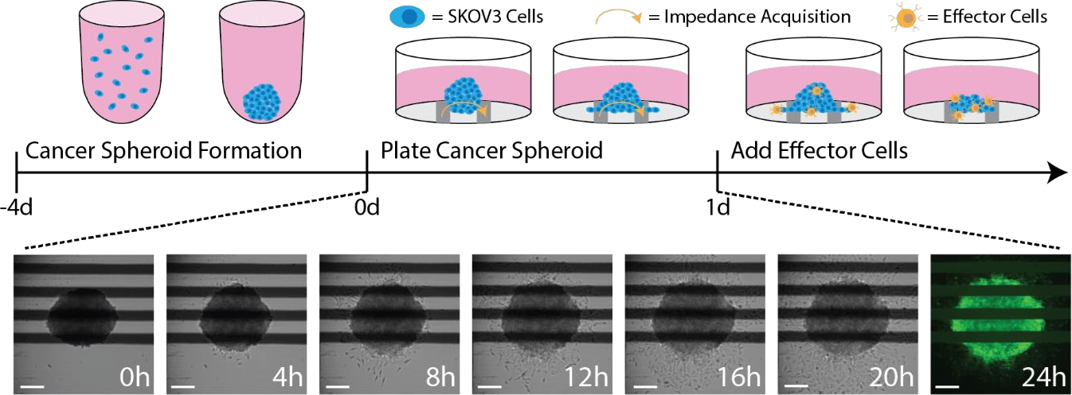
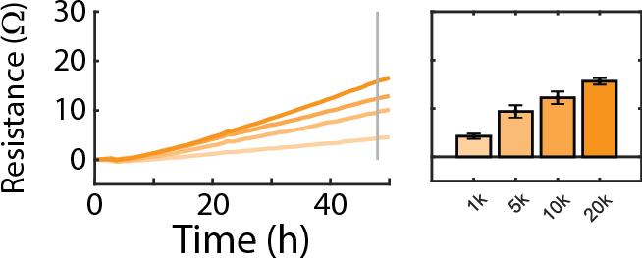
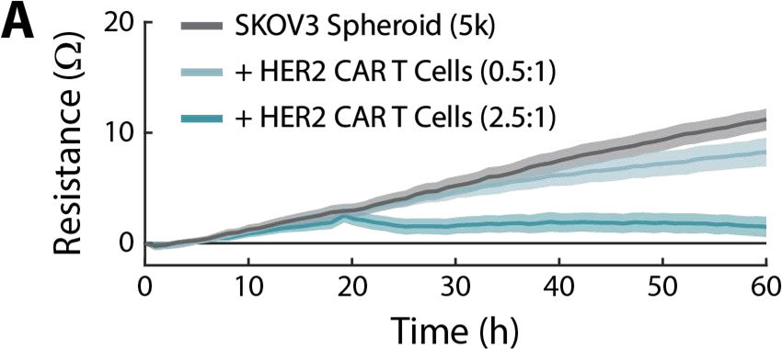
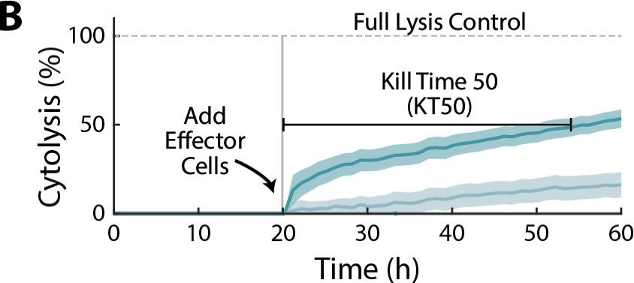
CAR T Cell Potency Assessment
with 3D Cancer Spheroid Models
Spheroid Formation, Attachment, and Growth
Impedance data correlates with
spheroid density
400 – 1000 µm Diameter
200 µm
CAR T cell-mediated Cytotoxicity
Cancer Spheroids for the Maestro Z. Application Note (2022) https://www.axionbiosystems.com/resources/culture-protocol/cancer-spheroids-maestro-z

Slide 15
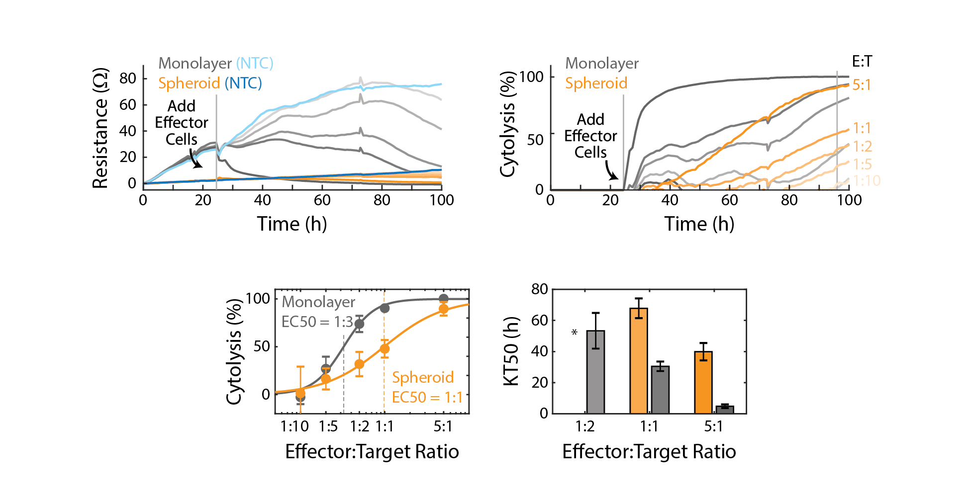
CAR T Cell Potency Assessment with 3D Cancer Spheroid Models
Delayed CAR T cytotoxicity in cancer spheroids relative to monolayer cultures
3x lower potency of CAR T against 3D cancer spheroids

Slide 16
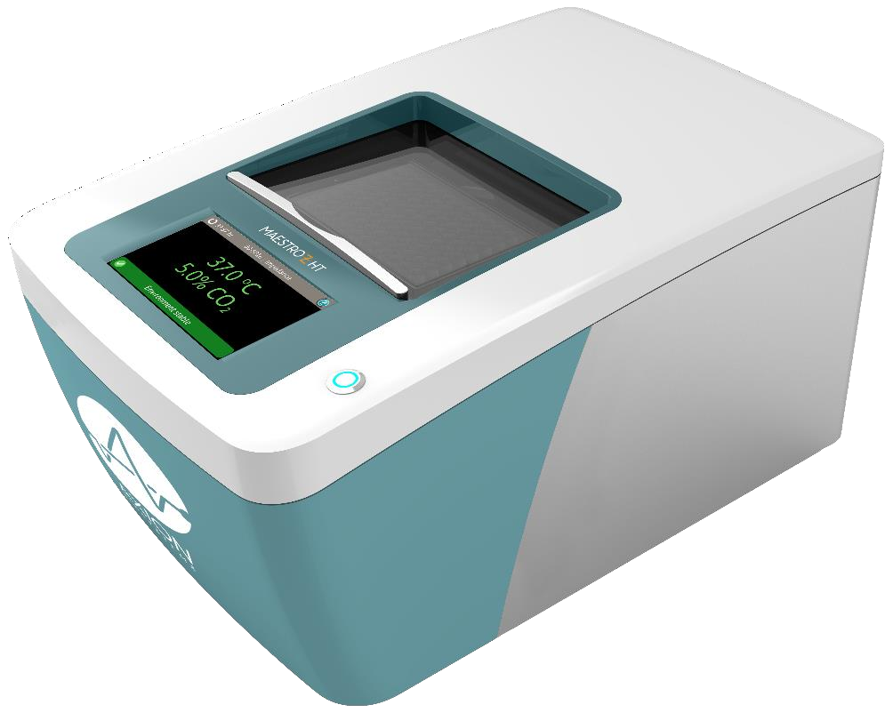
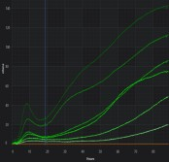
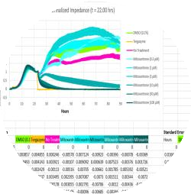
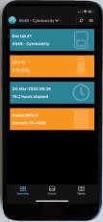
Maestro Z Impendance advantages
Intuitive Software (GxP available)
Full Environmental
Control
Automated Acquisition
Multiplexing Plate
Interactive Report
Small Footprint
Mobile App

Slide 17
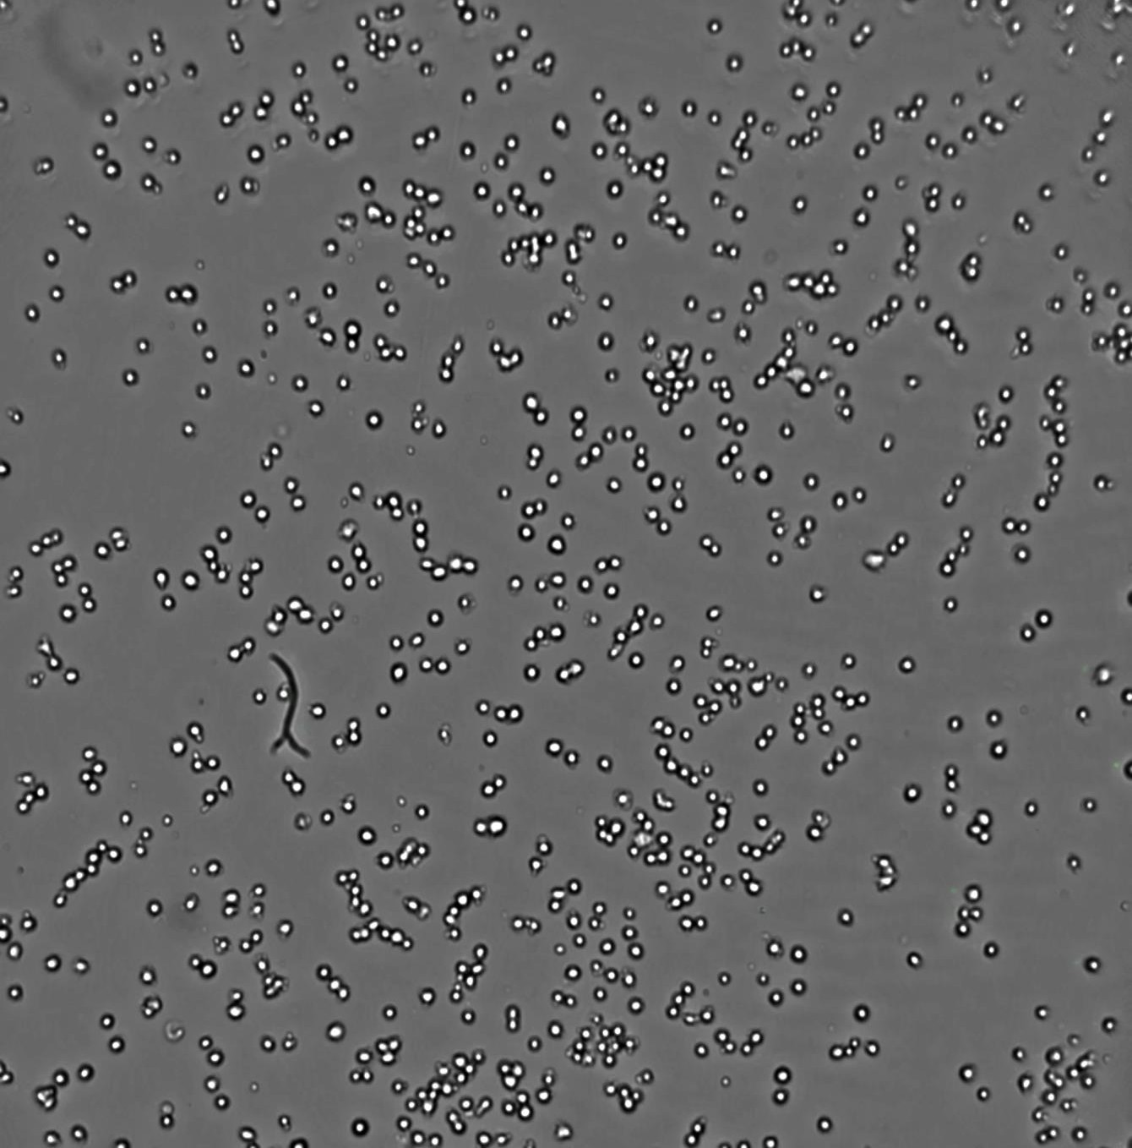
Incubator-based imaging

Slide 18
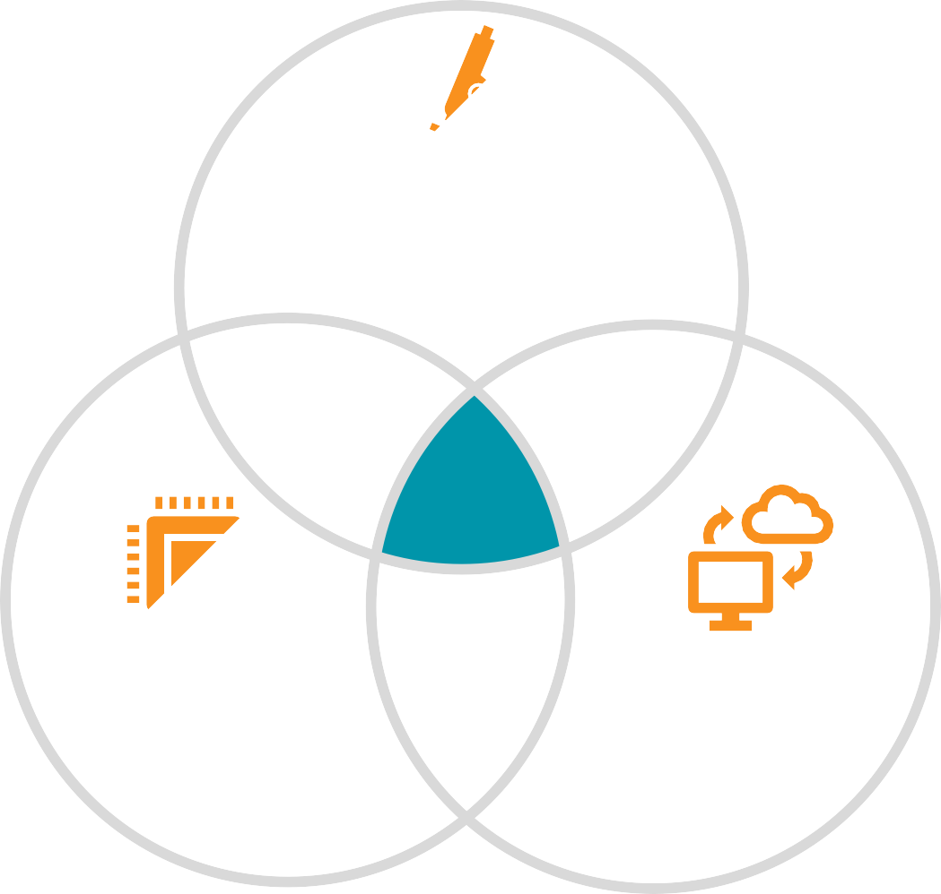
The vision
Accessible, continuous cell monitoring and functional analysis
Affordable label-free, long-term, quantitative microscopy
Next-gen microscope hardware 10x lower in size and weight
AI Image Analysis Requiring less human interference
Cloud
Cheap computing
power

Slide 19
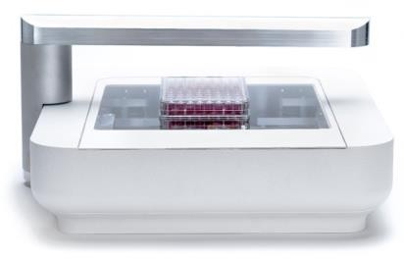
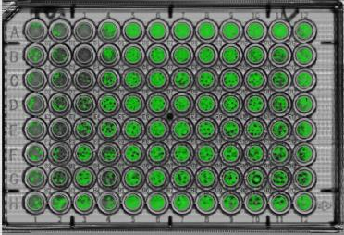
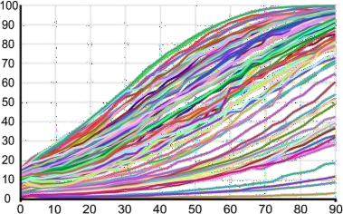
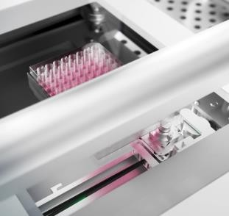
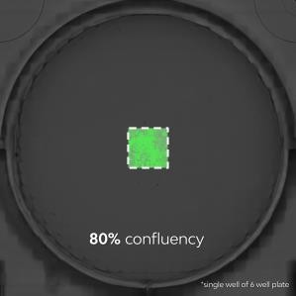
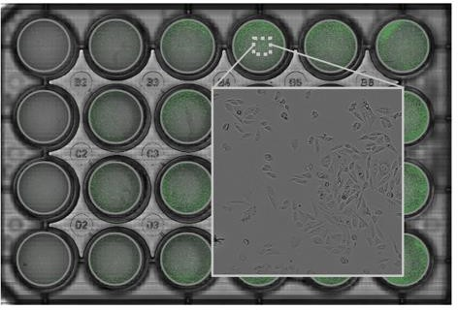
Omni full plate scanner
On demand, in incubator imaging
Confluence (%)
Time (h)
SSccaann
CClloouudd UUppllooaadd
AAuuttoo--ssttiittcchhiinngg
IImmaaggee AAnnaallyyssiiss
PPlloott DDaattaa
Continuous motion imaging
Full well readout
Scans entire well and instantly stitches images to
give a full well view
CytoSMART Omni AI
The AI image analysis enables:
Automated whole-plate imaging
Continuous motion recording
9,000 images per scan (e.g., hour)
Undisturbed image acquisition (weeks)
Automated stitching of 9,000 images/scan
Automated ROI detection
Automated detection & quantification within ROIs

Slide 20
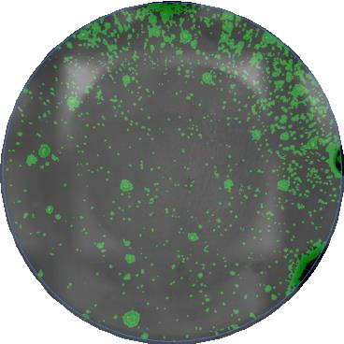
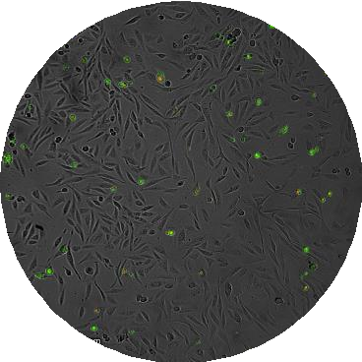
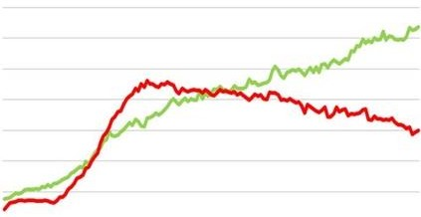
Application Examples
Applications
Proliferation, viability
Cytotoxicity assays
Cell-cell interaction
Stem cell differentiation
Transfection efficiency
Organoid growth
Cell Migration
Fluorescent area % Fluorescent object number
Proliferation, confluency, viability
Integrated image
analysis
Immune-mediated killing
Tumor spheroids
Transfection optimization

Slide 21
Automated live-cell imaging of organoids

Slide 22
Targeting multidimensional biology (Multimodal Analytical Ecosystem)
Complementary, label-free platforms the enable control and measurement of biological outcomes in real-time
Sourcing
Processing
Culture/Production
Analysis/Testing
Outcome
Cell Monitoring, Control and Analysis
Technology enablers:
Quantitative, kinetic measurements
Label free, non-invasive biosensors
Build and assess 3D models
Workflow translatable from Discovery to Production
Maestro Pro & Edge
Maestro Z, ZHT, & TrayZ
Omni
Lux
Exact

Slide 23
Thank you!
Zhong Yu, PhD
Scientific Liaisons Manager
zyu@axionbio.com

