Slide 1



Live-Cell Kinetic Assays for Monitoring Cell Health and Metabolism
Vojtěch Ledvina, Ph.D.
vojtech.ledvina@eastport.cz

Slide 2
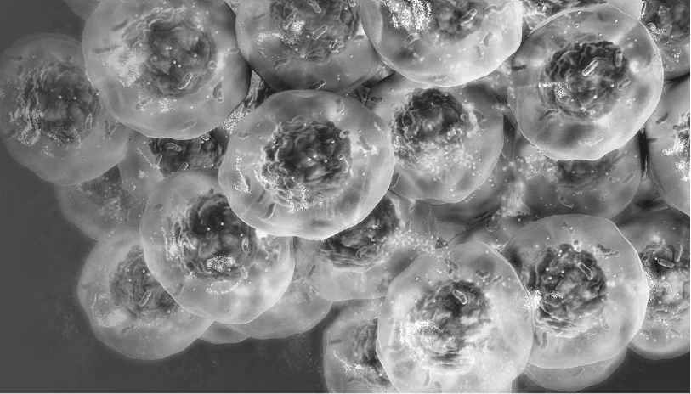

Today‘s Agenda
1
Bioluminescence
2
Basic modes of detection
3
What Defines a Live-Cell Kinetic Assay?
4
What Are the Benefits of Live-Cell Kinetic Assay?
5
What to Consider When Using Live-Cell Kinetic Assays?
6
Which Live-Cell Kinetic Assay Do We Offer?

Slide 3
Today‘s Agenda
1
Bioluminescence
2
Basic modes of detection
3
What Defines a Live-Cell Kinetic Assay?
4
What Are the Benefits of Live-Cell Kinetic Assay?
5
What to Consider When Using Live-Cell Kinetic Assays?
6
Which Live-Cell Kinetic Assay Do We Offer?

Slide 4
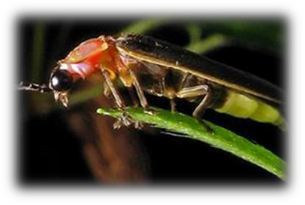
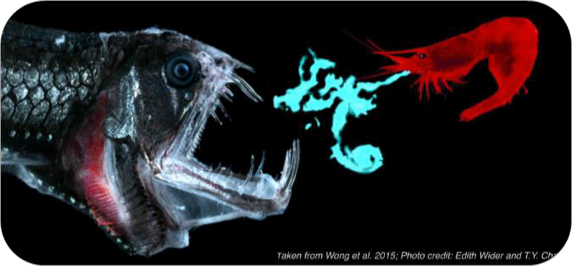
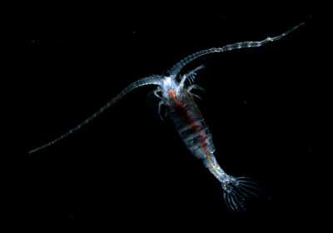

Bioluminescence
Production of light by living organisms
Light produced by enzymatic oxidation of a substrate luciferin by an enzyme luciferase
Common in marine vertebrates and inverebrates, fungi, bacteria
Most used luciferases are – Firefly, Renilla, NanoLuc and Gaussia luciferases

Slide 5
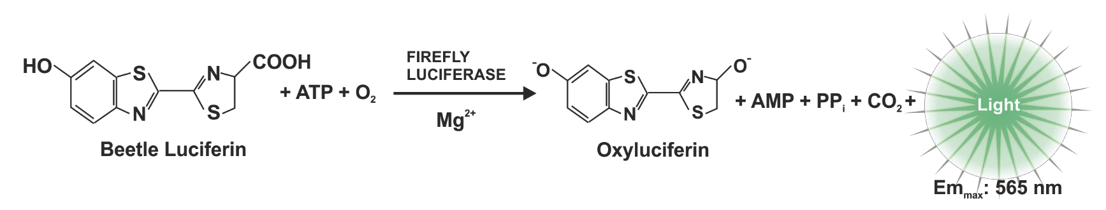
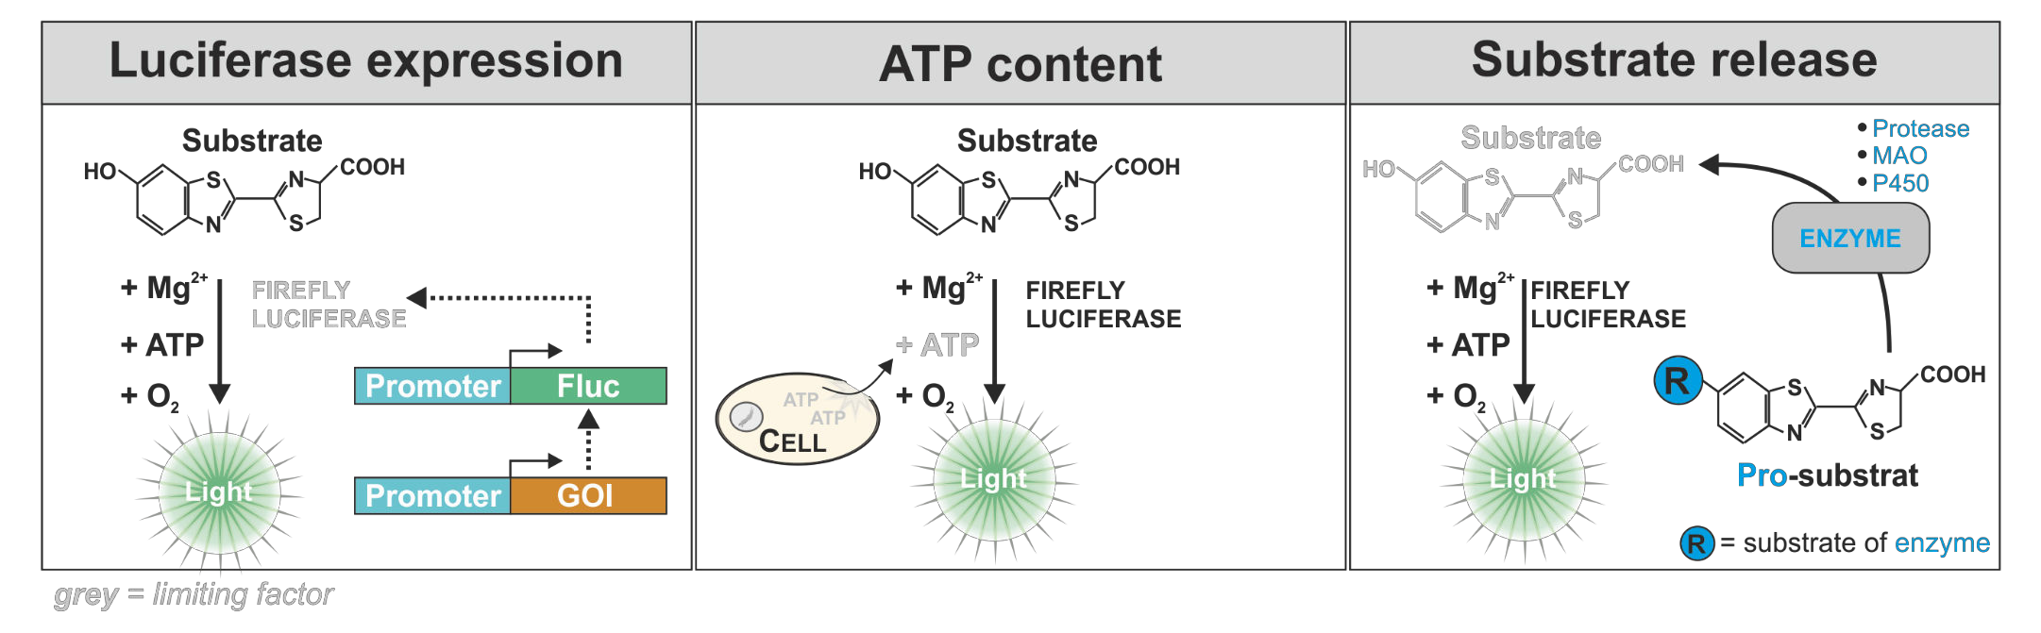
Firefly Luciferase
ATP-dependent luciferase
Universal reaction adaptable for various assays
Ultra-GloTM rLuciferase
Higher stability in the presence of detergent and reducing agents
More robust signal – less temperature signal variance
Photinus pyralis

Slide 6
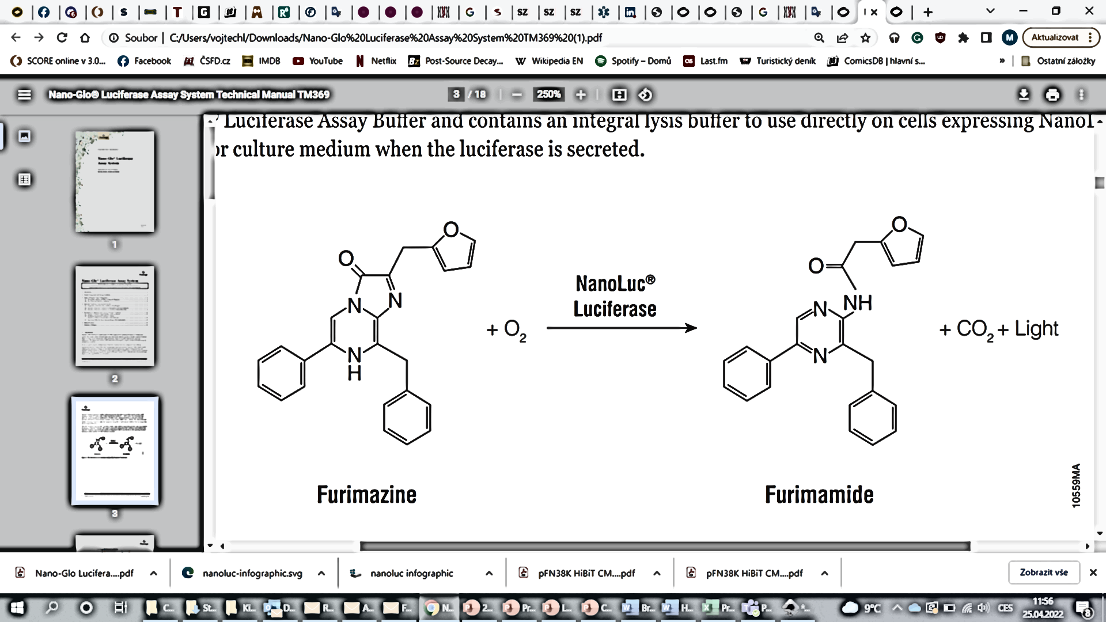
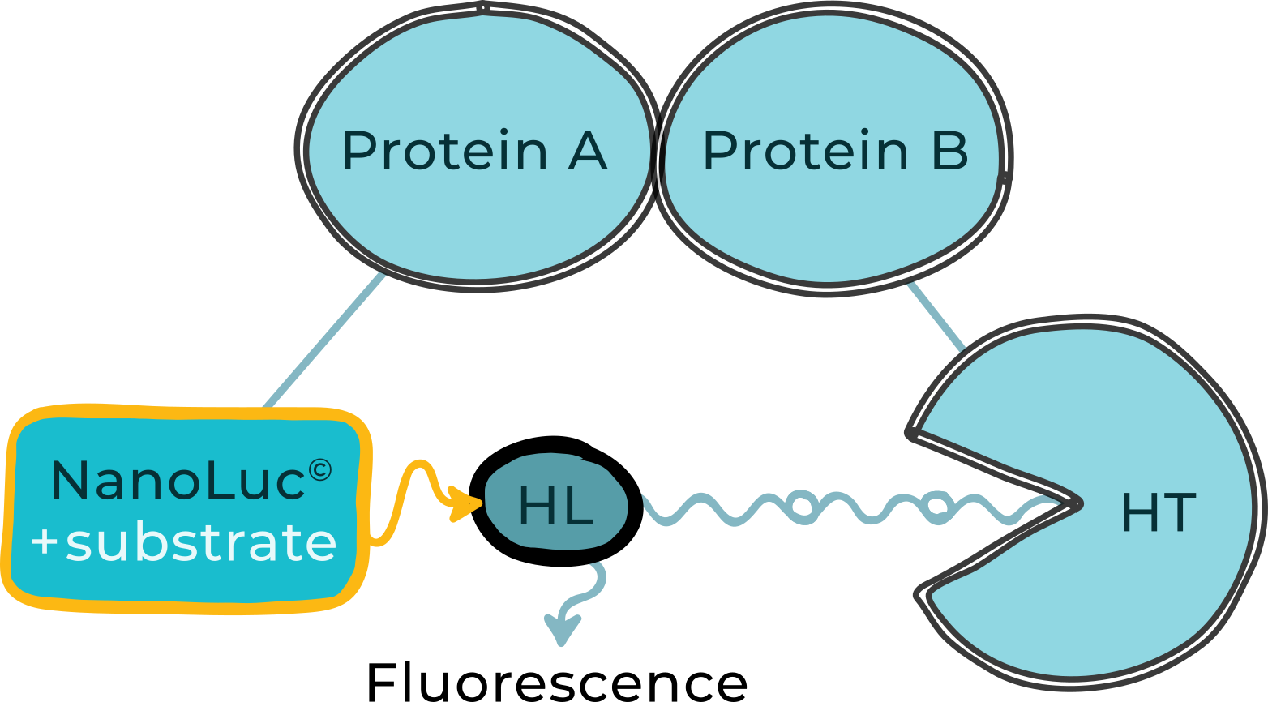
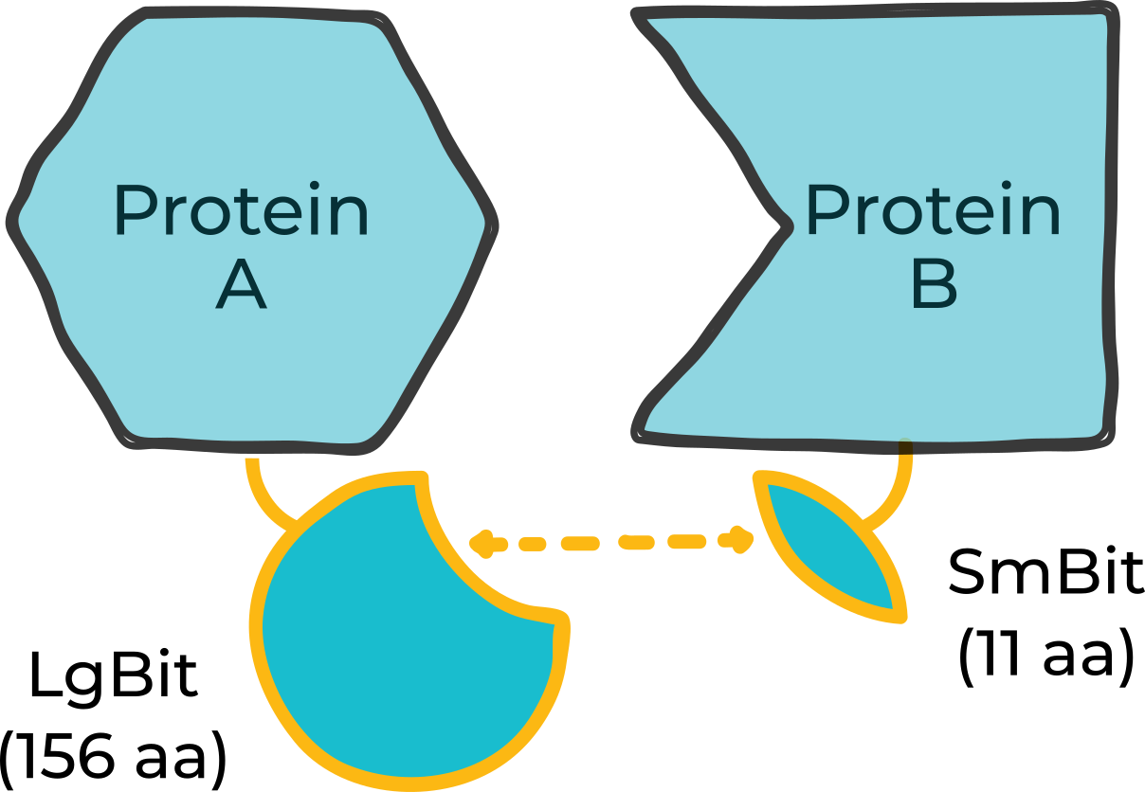
NanoLuc® Luciferase – Novel Experimental Reporter
ATP-independent luciferase from a deep sea shrimp
100x brigther than Rluc and Fluc, glow-type luminescence
Smallest luciferase – 19,1 kDa
Oplophorus gracilirostris
Luciferase expression
NanoBRET assays
Complementation reporter
NanoLuc
luciferase
O₂
Nluc
Light
Notes:
Lze kombinovat s coelenterazinem H – nižší signál, autofluorescence
Konkurence Gaussia luciferase

Slide 7
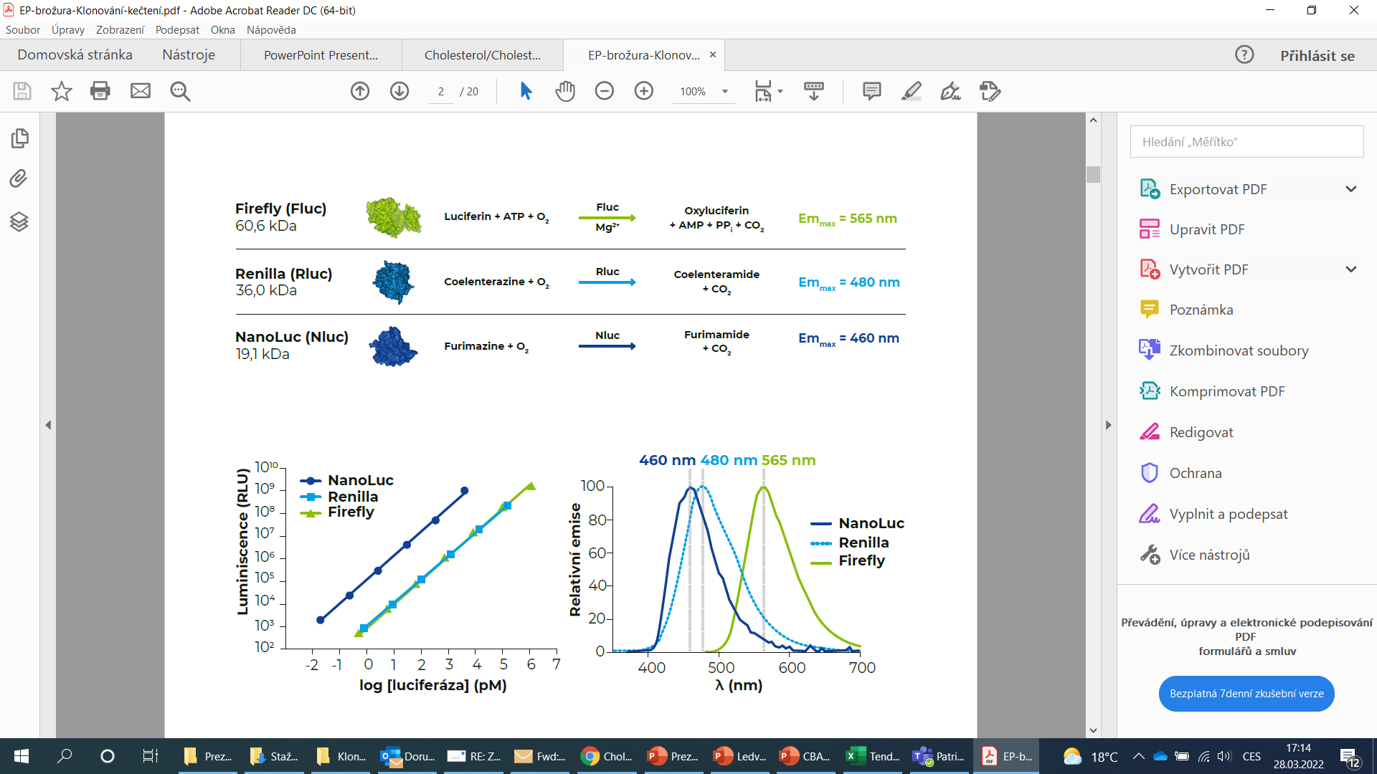

Slide 8
Today‘s Agenda
1
Bioluminescence
2
Other modes of detection
3
What Defines a Live-Cell Kinetic Assay?
4
What Are the Benefits of Live-Cell Kinetic Assay?
5
What to Consider When Using Live-Cell Kinetic Assays?
6
Which Live-Cell Kinetic Assay Do We Offer?

Slide 9
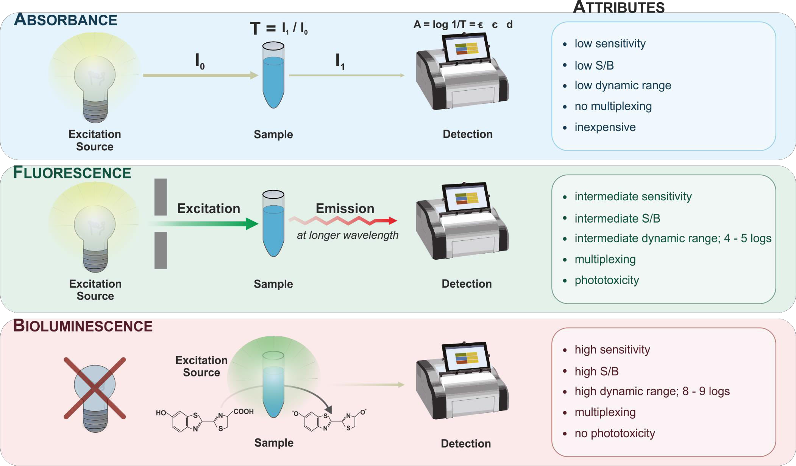

Other Modes of Detection
$$I_{f}=kI_{0}φ(εbc)$$

Slide 10
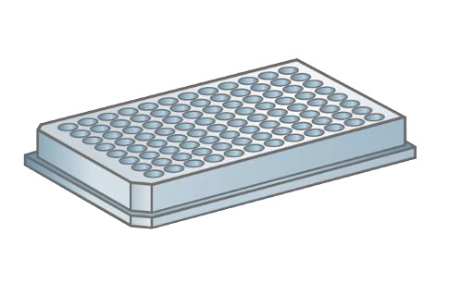
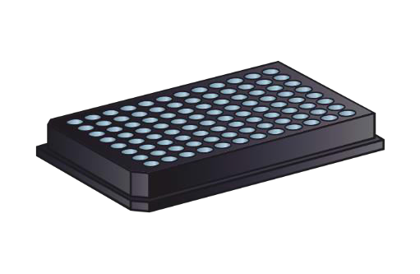
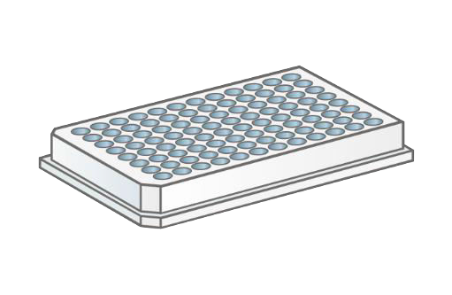
Matching Plate Type and Detection Mode
“clear“
“black”
“white”
TC treated
Sterile
With lid
“solid or clear bottom”
„solid or clear bottom“
ABSORBANCE
YES
(YES)
FLUORESCENCE
YES
(YES)
LUMINISCENCE
NO!
(YES)
YES
• 400 – 800 nm (VIS)
• 200 – 400 nm (UV)
quarz glass
cyclic olefin copolymer
(COC)
plastic autofluorescence (↓)
background (↓)
crosstalk (↓)
maximal reflection
crosstalk (↓)
(!) phosphorescence

Slide 11
Today‘s Agenda
1
Basic modes of detection
2
Bioluminescence
3
What Defines a Live-Cell Kinetic Assay?
4
What Are the Benefits of Live-Cell Kinetic Assay?
5
What to Consider When Using Live-Cell Kinetic Assays?
6
Which Live-Cell Kinetic Assay Do We Offer?

Slide 12

What Defines a Live-Cell Kinetic Assay?
Live-Cell Kinetic Assays…
…are non-toxic & maintain cellular integrity
…allow monitoring a parameter of a sample over extended period of time
…maximize the information gained from one sample within a given time window
…typically allow for extended time course analysis (days)
Endpoint assay
Kinetic assay
Start
End
Start
End

Slide 13
Today‘s Agenda
1
Basic modes of detection
2
Bioluminescence
3
What Defines a Live-Cell Kinetic Assay?
4
What Are the Benefits of Live-Cell Kinetic Assay?
5
What to Consider When Using Live-Cell Kinetic Assays?
6
Which Live-Cell Kinetic Assay Do We Offer?

Slide 14
Benefits of Live-Cell Kinetic Assays
Data quantity / reliability
More data per well
Easy identification of important time points
Draw valid conclusions from your experiments
Economical savings/resource efficient
Saves your precious cells, reagents, consumables…
Time-efficient identification of important time points
Draw valid conclusions
Flexibility
Combine with other assays (multiplexing) for enhanced data reliability and interpretation
Usually compatible with both 2D and 3D cell culture models
Compatible with both, time course and endpoint analysis
No additional instrumentation required
Heating function and gas control is beneficial but optional
(Multimode functionality)

Slide 15
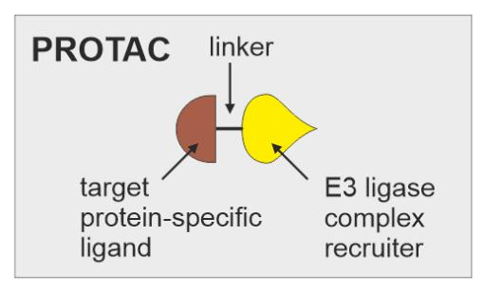
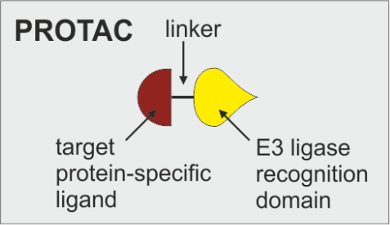
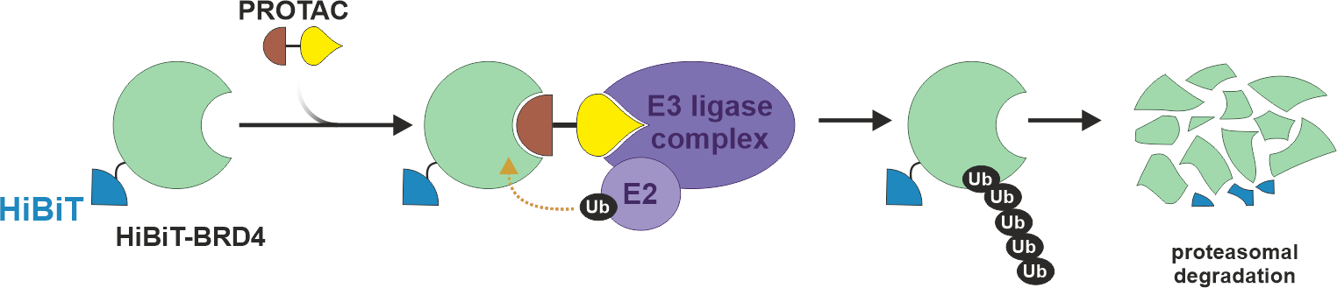
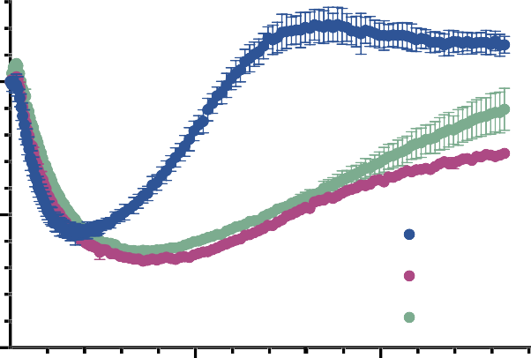

Studying targeted protein degradation with HiBiT
Evaluation of Proteolysis targeting chimeras (PROTACs) Efficiency
JQ1
Thalidomide = dBET1
BRD
Endpoint
Real-Time
rel. Luminescence [RLU]
1.5
BRD4 BRD3 BRD2
rel. Luminescence [RLU]
1.0
1.0
0.5
0.5
BRD2 BRD3 BRD4
0.0
0.0
0
4 hours
16 hours
4
10
16 20
Time [h]
Notes:
JQ1 – thienotriazolodiazepine, potent inhibitor of the BET family of bromodomain proteins (BRD2, BRD3, BRD4 and the testis-specific protein BRDT in mammals)
Thalidomide – binds to cereblon (CRBN) which is a part of the ubiquitin E3 ligase, causes ubiquitinylation of the BRD protein and degradation
Thalidomide

Slide 16
Benefits of Live-Cell Kinetic Assays
Data quantity / reliability
More data per well
Easy identification of important time points
Draw valid conclusions from your experiments
Economical savings/resource efficient
Saves your precious cells, reagents, consumables…
Time-efficient identification of important time points
Flexibility
Combine with other assays (multiplexing) for enhanced data reliability and interpretation
Usually compatible with both 2D and 3D cell culture models
Compatible with both, time course and endpoint analysis
No additional instrumentation required
Heating function and gas control is beneficial but optional
(Multimode functionality)

Slide 17
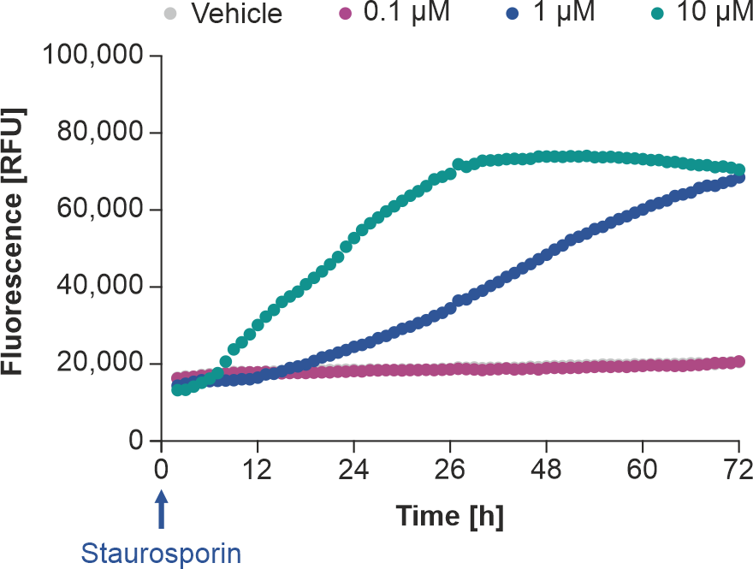
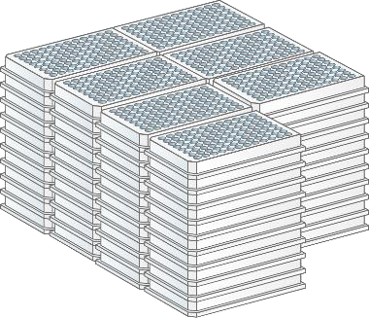

CellTox™ Green Cytotoxicity Assay
Determine Membrane Integrity Using a Fluorescent DNA-binding Dye
endpoint
Early Apoptosis
(1 µM)
HepG2
VS.
real-time
1
less medium, cells and reagent
Notes:
Staurosporin - ATP-competitive kinase inhibitor with high affinity and low selectivity

Slide 18
Benefits of Live-Cell Kinetic Assays
Data quantity / reliability
More data per well
Easy identification of important time points
Draw valid conclusions from your experiments
Economical savings/resource efficient
Saves your precious cells, reagents, consumables…
Time-efficient identification of important time points
Flexibility
Combine with other assays (multiplexing) for enhanced data reliability and interpretation
Usually compatible with both 2D and 3D cell culture models
Compatible with both, time course and endpoint analysis
No additional instrumentation required
Heating function and gas control is beneficial but optional
(Multimode functionality)

Slide 19
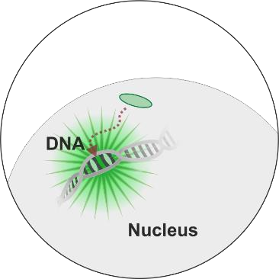
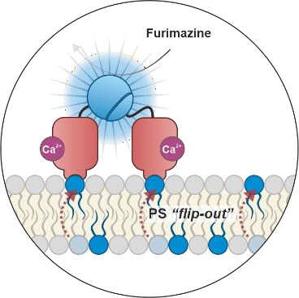


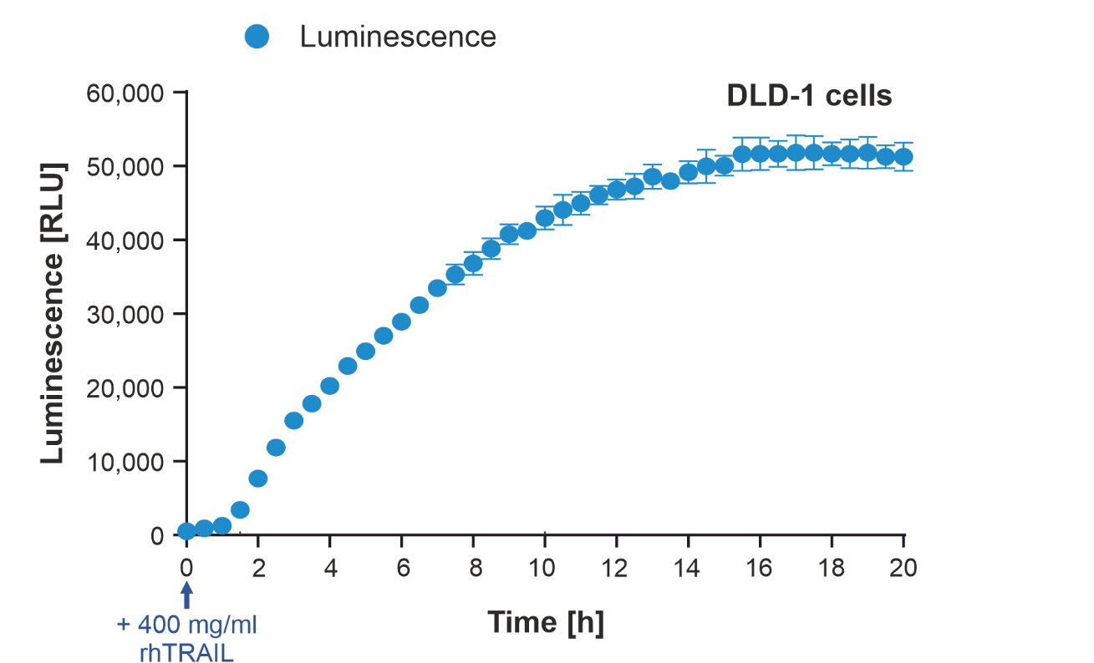
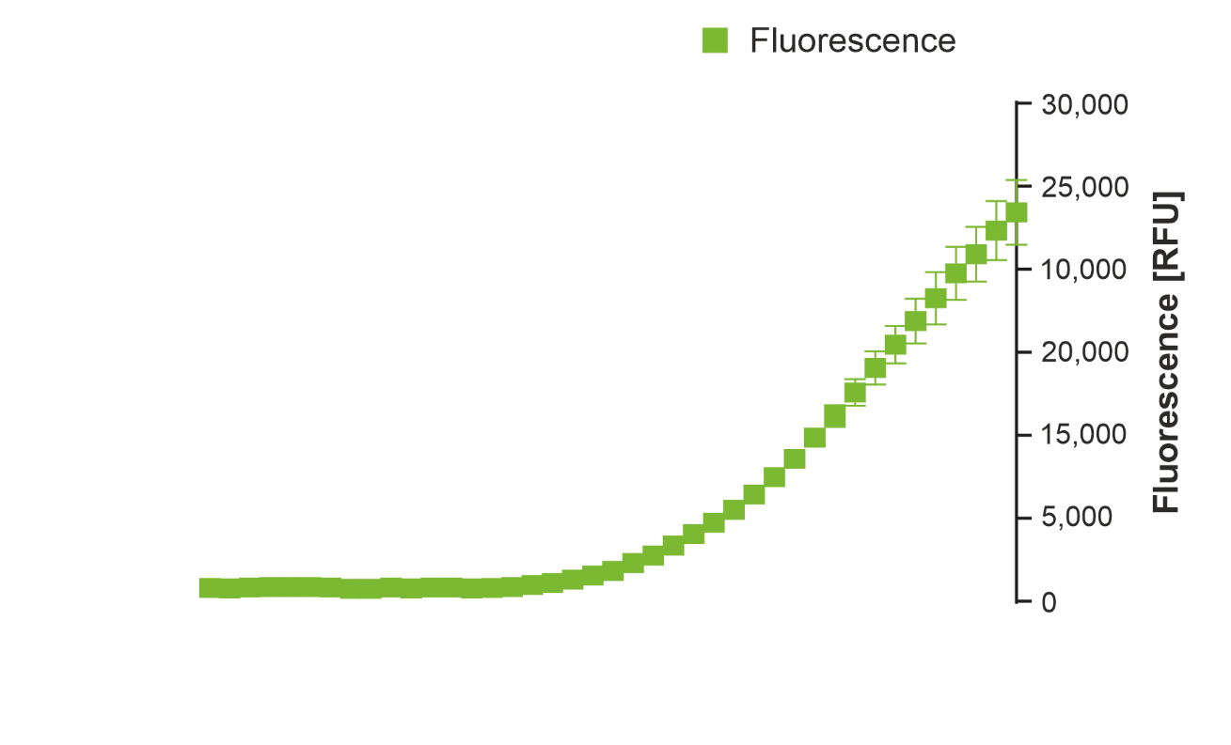
RealTime-Glo® Annexin V Apoptosis and Necrosis Assay
A Live Cell Kinetic Multiplexing Assay per se
Early Apoptosis
Secondary Necrosis

Slide 20
Benefits of Live-Cell Kinetic Assays
Data quantity / reliability
More data per well
Easy identification of important time points
Draw valid conclusions from your experiments
Economical savings/resource efficient
Saves your precious cells, reagents, consumables…
Time-efficient identification of important time points
Flexibility
Combine with other assays (multiplexing) for enhanced data reliability and interpretation
Usually compatible with both 2D and 3D cell culture models
Compatible with both, time course and endpoint analysis
No additional instrumentation required
Heating function and gas control is beneficial but optional
(Multimode functionality)

Slide 21
Today‘s Agenda
1
Basic modes of detection
2
Bioluminescence
3
What Defines a Live-Cell Kinetic Assay?
4
What Are the Benefits of Live-Cell Kinetic Assay?
5
What to Consider When Using Live-Cell Kinetic Assays?
6
Which Live-Cell Kinetic Assay Do We Offer?

Slide 22
What to Consider When Using Live-Cell Kinetic Assays?
Edge Effect
Plate layout
Temperature
Evaporation

Slide 23
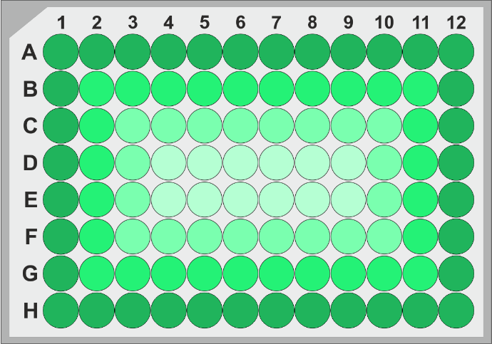
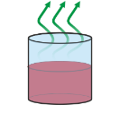

Experimental Plate Layout and Data Variability
The Edge Effect
1563-
384-
96-
48-
24-
12-
6-well
Worki
ng Volume
1 – 3 ml
5 – 10 µl
Edge Effect Incubation time
0.1 – 0.2 ml
0.5 – 1 ml
Evaporation
Use specialized plates/seals for culturing of cells
Fill outer 36 wells (and inter-well space)
with pre-equilibrated sterile water or PBS
Avoid shuttling of plates or hurry up
Keep temperature constant over time
Pre-quilibrate to reading temperature

Slide 24
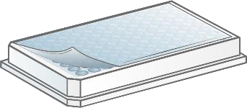
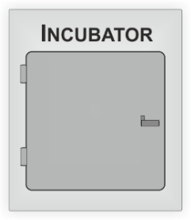
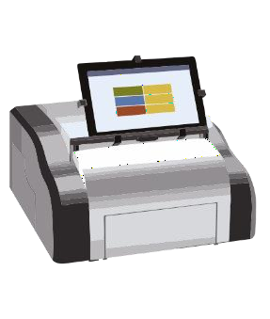
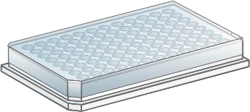
Media Evaporation During Extended Incubations
Counteracting the Edge Effect
37°C
CO₂
~ 95% humidity
Seal *
37°C
24 hours
Lid
* gas permeable

Slide 25
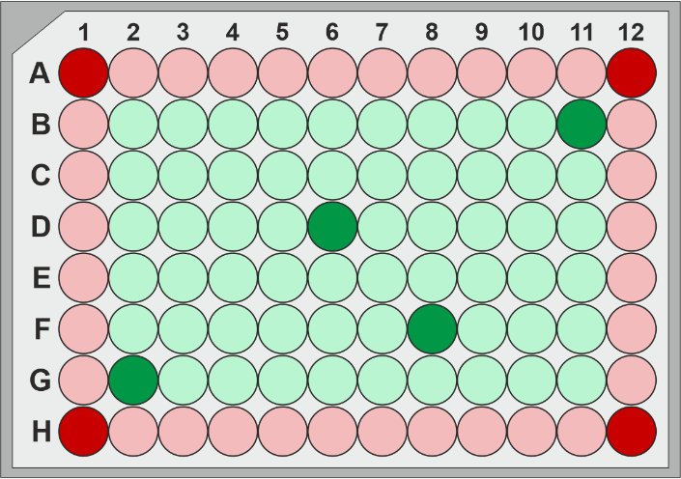
Media Evaporation During Extended Incubations
Counteracting the Edge Effect
60
Incubator
50
inner wells outer wells
100 µl/well
24 hours
37°C
n = 4
Evaporation [%]
40
30
20
10
11
0
11
10
23
+ Seal
+ Lid
60
Plate-reader
Conclusions
Plate seals can help to alleviate the edge effect
If one can spare the outer wells, a lid is an
excellent strategy too
Even under non-humidified conditions, a lid ensures a relatively low degree of evaporation in the inner wells
50
inner wells
Evaporation [%]
40
outer wells
30
20
10
0
30
29
13
46
+ Seal
+ Lid

Slide 26
What to Consider When Using Live-Cell Kinetic Assays?
Edge Effect
Plate layout
Temperature
Evaporation
Instrumentation
No CO₂ control? → CO₂-independent medium
Heating?
Condensation on the lid
Software and protocol setup

Slide 27
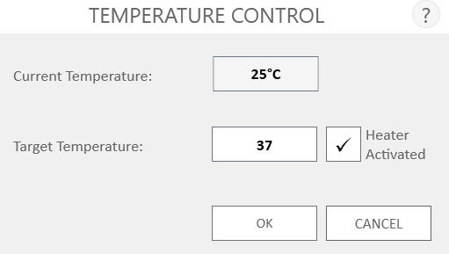
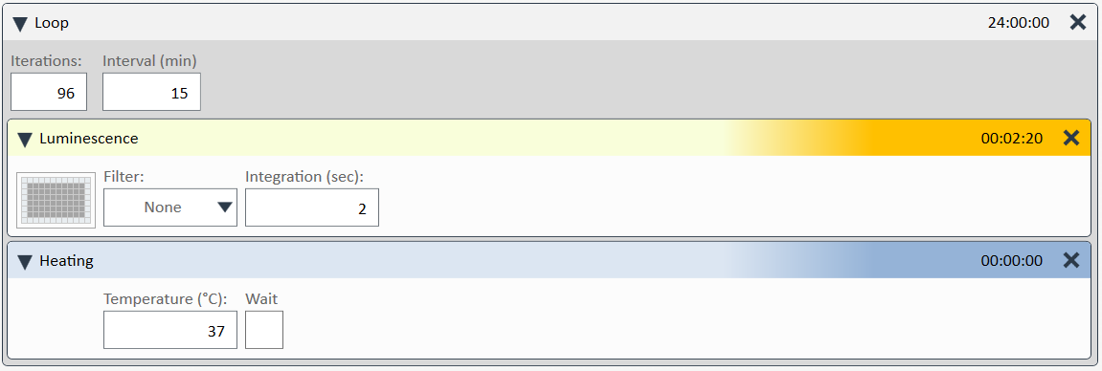
Instrumentation for Kinetic Assays
No additional instrumentation needed
Temperature and CO₂ control are beneficial but not required
No CO₂ control? → use CO₂-independent medium
No heating? → shuttle the plate between the incubator and luminometer
Condensation on the lid?
Cover the inside of the lid with 1-2 ml of 0,5% Triton X-100 in sterile water or PBS
Remove the liquid and let dry for a while
Return the lid on the plate
Heating needs to be activated
Heating step needs to be incorporated in the “Loop”

Slide 28
What to Consider When Using Live-Cell Kinetic Assays?
Edge Effect
Plate layout
Temperature
Evaporation
Instrumentation
No CO₂ control? → CO₂-independent medium
Software and protocol setup
Condensation on the lid
Length of measurements
Always check the manual for the actual length of measurement – 24, 48, 72 hours

Slide 29
Today‘s Agenda
1
Basic modes of detection
2
Bioluminescence
3
What Defines a Live-Cell Kinetic Assay?
4
What Are the Benefits of Live-Cell Kinetic Assay?
5
What to Consider When Using Live-Cell Kinetic Assays?
6
Which Live-Cell Kinetic Assay Do We Offer?

Slide 30

Which Live-Cell Kinetic Assay Do We Offer?
Assays
Biochemical
Endpoint
Timed kinetic
e.g. ADP-Glo®
e.g. CellTiter-Blue® CellTiter-96® AQ CellTiter-FluorTM
e.g. LDH-GloTM,
Glucose-GloTM…
Cell-Based
Lytic
e.g. Caspase-Glo® CellTiter-Glo®…
Live-Cell
Kinetic
Kinetic
e.g. RealTime-GloTM
CellTox-GreenTM…
Notes:
JQ1 – thienotriazolodiazepine, potent inhibitor of the BET family of bromodomain proteins (BRD2, BRD3, BRD4 and the testis-specific protein BRDT in mammals)
Thalidomide – binds to cereblon (CRBN) which is a part of the ubiquitin E3 ligase, causes ubiquitinylation of the BRD protein and degradation
Thalidomide

Slide 31
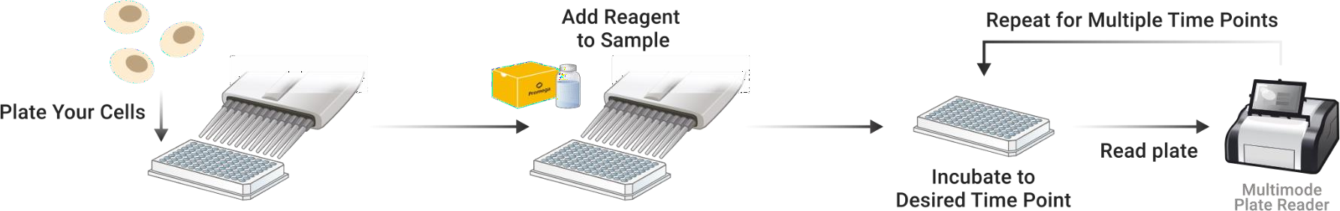
Live-Cell Kinetic Assays
Real-Time Kinetic
RealTime-GloTM MT Cell Viability Assay
RealTime-GloTM Annexin V Apoptosis / Necrosis Assay
RealTime-GloTM Extracellular ATP Assay
CellTox-GreenTM Cytotoxicity Assay
Nano-Glo® Live Cell Assay System
Nano-Glo® VivazineTM Live Cell Substrate
Nano-Glo® EndurazineTM Live Cell Substrate
Continuous reading from one well
Less hands-on time (no transfer steps required)
Non-toxic for the cells
Number of data points is limited only by instrument/software
Workflow
Cytotoxicity
Metabolic phenotype
Apoptosis
Cell Viability
Protein:Protein Interactions
Target Engagement
Reporter Expression

Slide 32
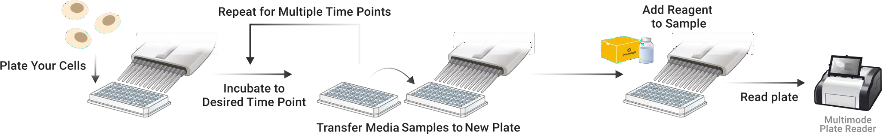
Timed Kinetic Live-Cell Assays
Timed Kinetic
Require periodic sampling of supernatant
Higher hands on time (sampling, dillution, transfer, assay…)
High sensitivity
Number of data points is limited by sampling volume/assay sensitivity
LDH-GloTM Cytotoxicity Assay
Glucose-GloTM Assay
Lactate-GloTM Assay
Glutamate/Glutamine-GloTM Assay
Glutamate-GloTM Assay
Cytotoxicity
Metabolic phenotype
Workflow

Slide 33

Coffee time!
We will continue at 10:50

Slide 34
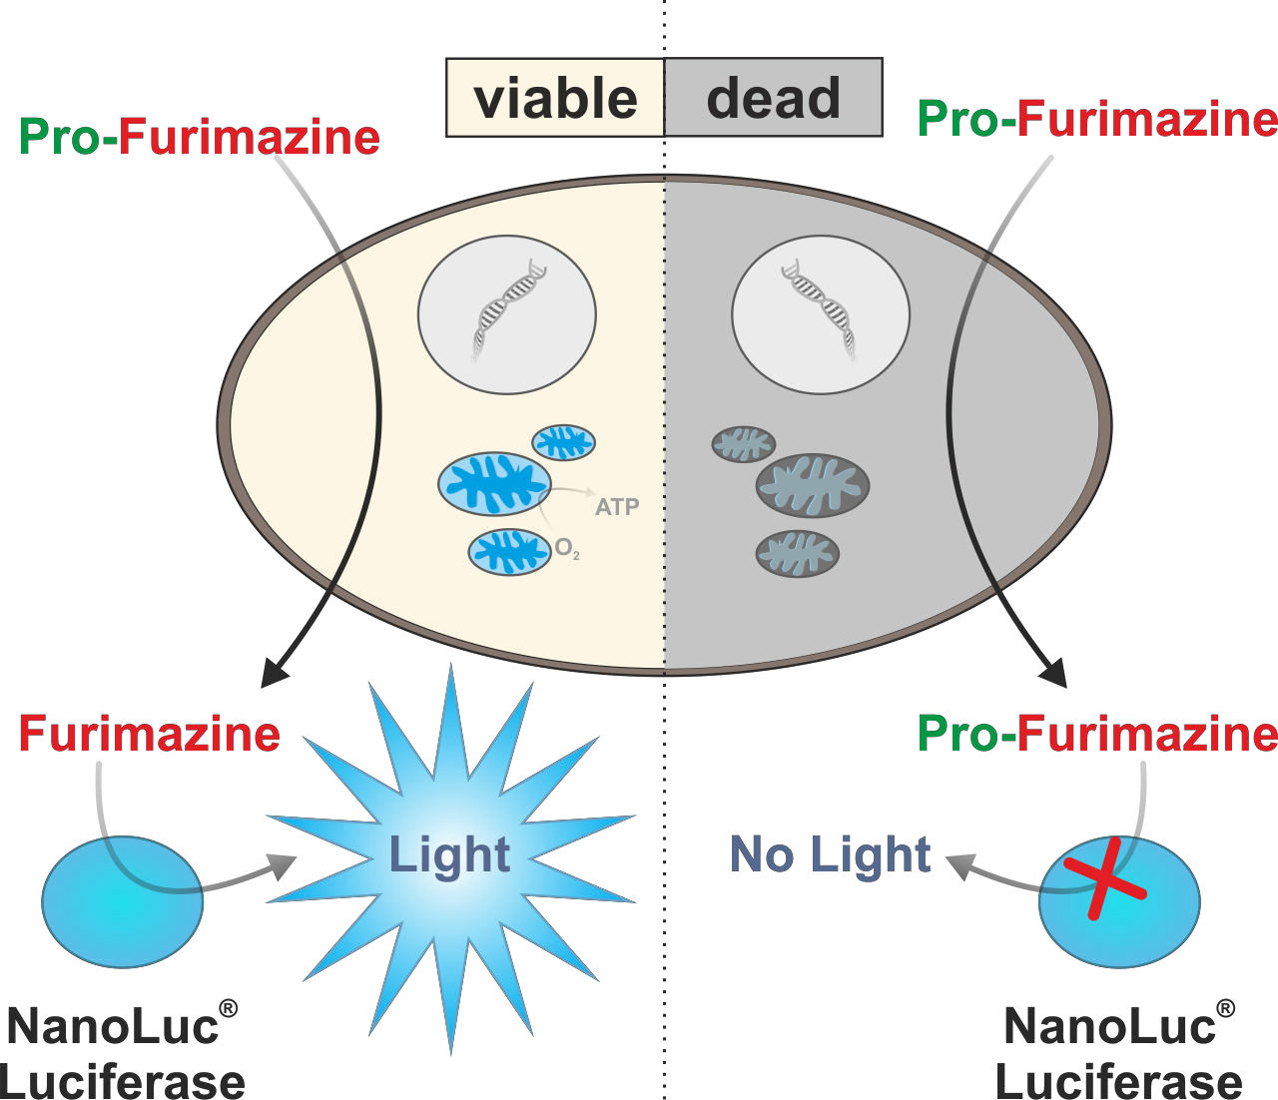
Real Time-Glo MT Cell Viability Assay
True kinetic nonlytic assay based on the NanoLuc luciferase
NanoLuc and prosubstrate pro-furimazine added to the medium
Pro-furimazine diffuses into the cells where it is reduced
Reduced furimazine is released into the medium and processed by the NanoLuc which generates bioluminescence
Suitable for kinetic measurements up to 72 hours

Slide 35
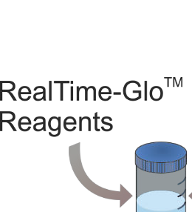
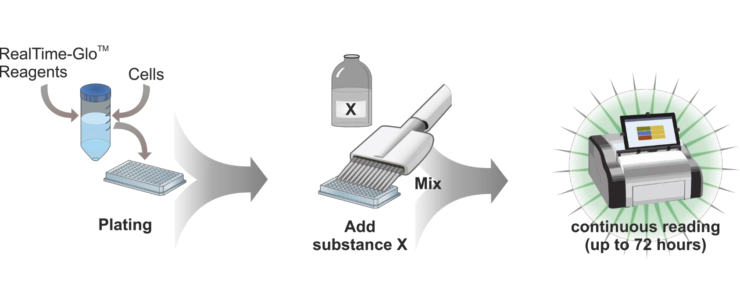
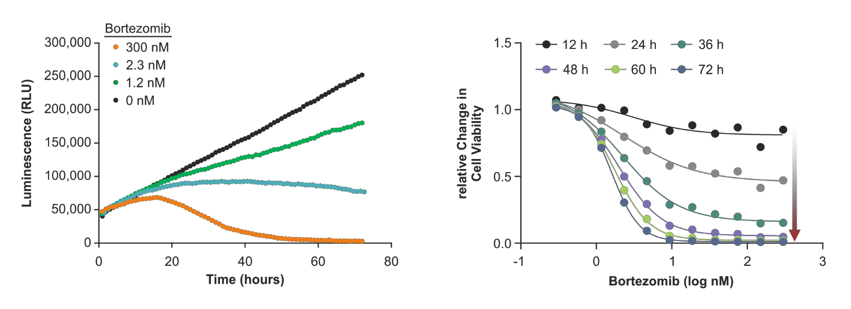
Real Time-Glo MT Assay – workflow a data
Notes:
Bortezomib – blocks the 26S proteasomal subunit and induces apoptosis

Slide 36
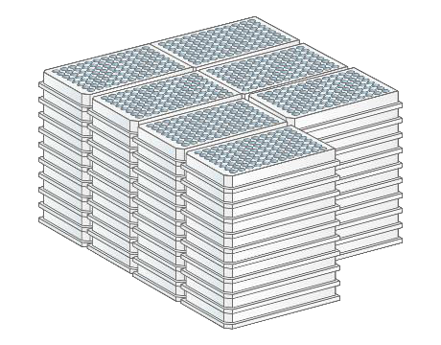
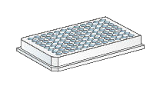
Real Time-Glo MT Assay – Workflow and Data
„endpoint“ vs. „real-time“
and much less medium, cells and reagent

Slide 37
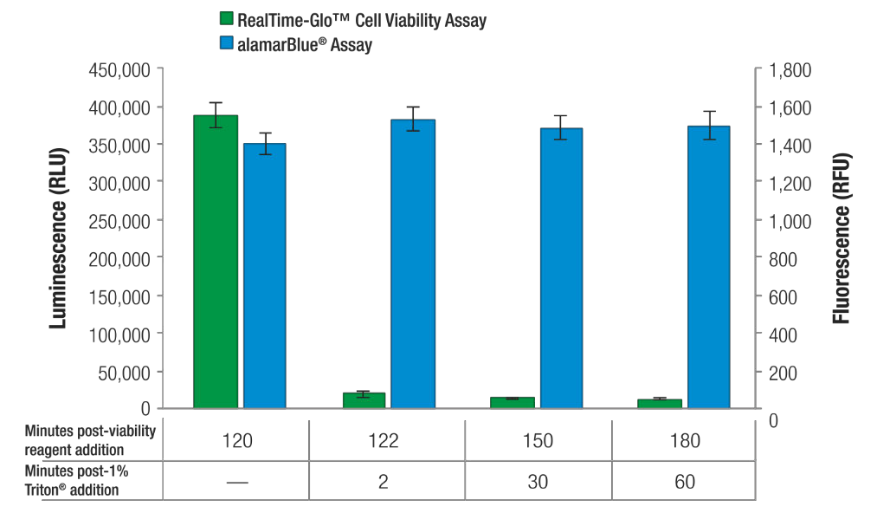
Furimazine does not accumulate in cells
time [min]
+ 1% Triton x-100

Slide 38
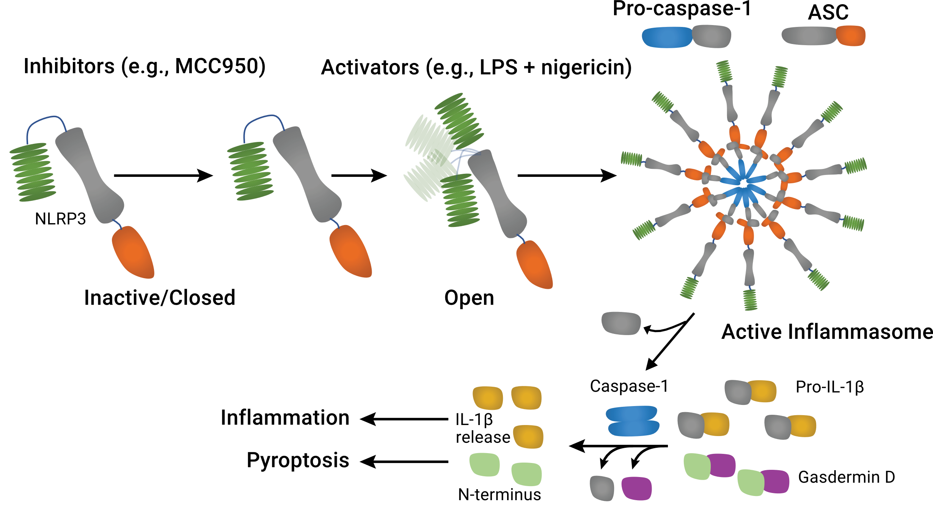
RealTime-Glo Extracellular ATP Assay
Damage-associated molecular patterns (DAMPs) are molecules released into extracellular space as an indicator of cell damage or infection
eATP can function as one of DAMPs and trigger inflammasome activation
eATP
Notes:
JQ1 – thienotriazolodiazepine, potent inhibitor of the BET family of bromodomain proteins (BRD2, BRD3, BRD4 and the testis-specific protein BRDT in mammals)
Thalidomide – binds to cereblon (CRBN) which is a part of the ubiquitin E3 ligase, causes ubiquitinylation of the BRD protein and degradation
Thalidomide

Slide 39
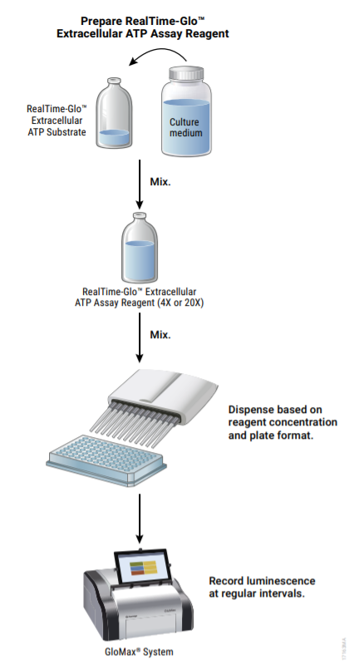
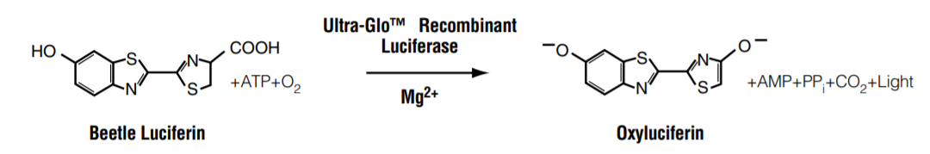
RealTime-Glo Extracellular ATP Assay
Bioluminescent assay for kinetic monitoring of ATP release from dying, stressed or activated cells
Assay suitable for detecting immunogenic cell death or inflammasome activation
Based on the modified Firefly luciferase
Enzyme and substrate are added to the cells and ATP is supplied from the medium
Compatible with 2D and 3D models
Notes:
JQ1 – thienotriazolodiazepine, potent inhibitor of the BET family of bromodomain proteins (BRD2, BRD3, BRD4 and the testis-specific protein BRDT in mammals)
Thalidomide – binds to cereblon (CRBN) which is a part of the ubiquitin E3 ligase, causes ubiquitinylation of the BRD protein and degradation
Thalidomide

Slide 40
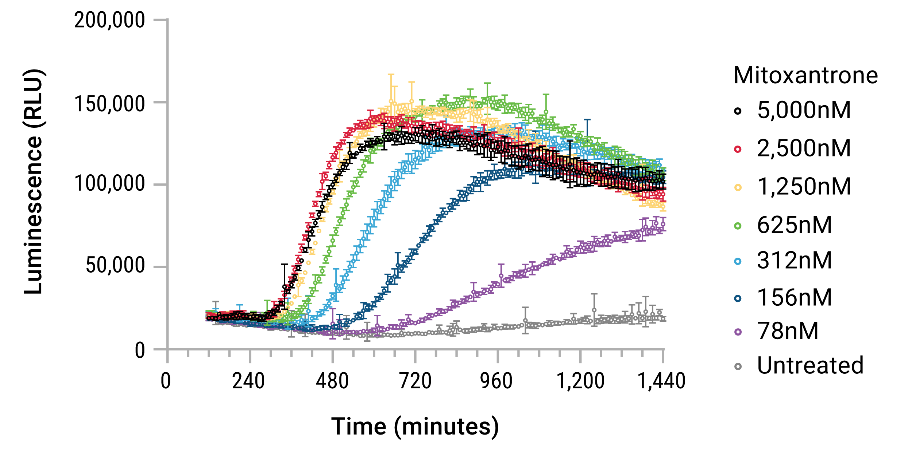
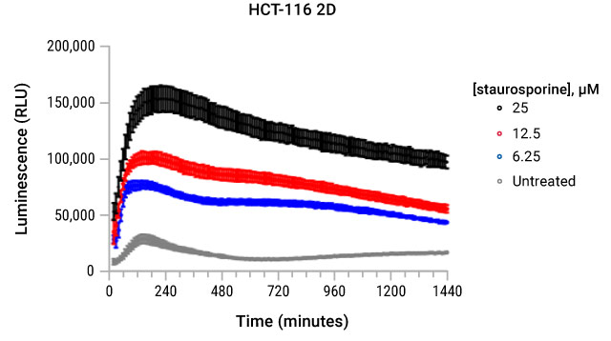
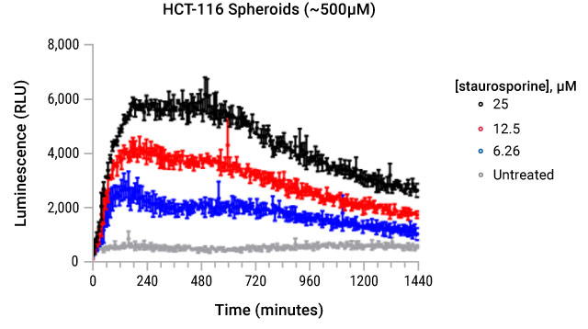
U937 cells treated with a dilution of mitoxantrone and anthracycline to induce immunogenic cell death
ATP release measured every 10 minutes for 24 hours at 37°C
Comparison of 2D and 3D cell culture model
Notes:
JQ1 – thienotriazolodiazepine, potent inhibitor of the BET family of bromodomain proteins (BRD2, BRD3, BRD4 and the testis-specific protein BRDT in mammals)
Thalidomide – binds to cereblon (CRBN) which is a part of the ubiquitin E3 ligase, causes ubiquitinylation of the BRD protein and degradation
Thalidomide

Slide 41
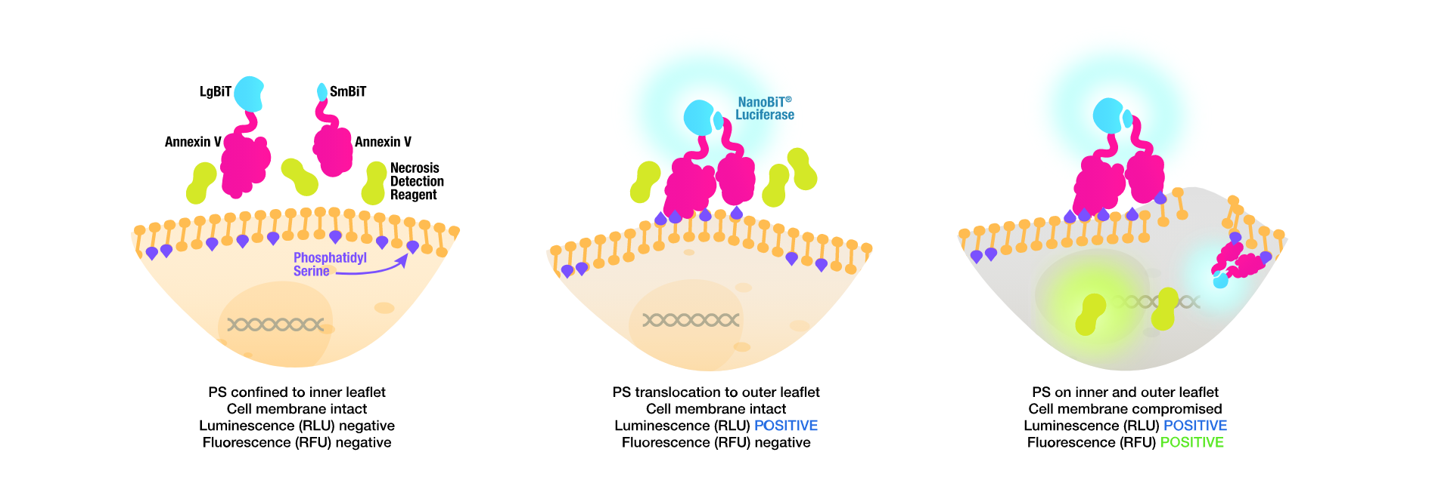
RealTime-Glo Annexin V Assay
Detects onset of apoptosis by measuring the phosphatidylserin (PS) exposure on surface of the cell membrane
Based on the NanoBiT split NanoLuc luciferase technology
Annexin V conjugated with LgBiT and SmBiT subunits of NanoLuc
Annexin V-LgBiT/SmBiT bind to PS on the membrane → subunits brought to close proximity recombine and restore the NanoLuc luminescent activity
Easily combined with CellTox Green
Notes:
Promega vyvinula esej na základě známého markeru apoptózy Annexinu pět, který váže fosfatidylserin. Annexin zfúzovala se dvěma podjednotkami split NanoLuc luciferázy LgBiT a SmBiT. LgBiT a SmBiT k sobě nemají příliš vysokou afinitu. Potřebují nějaký další protein, který by je přivedl k sobě blíž, což se právě stává snadno na vnějším povrchu buňky, která podléhá apoptóze. Buňka vystavuje na svém povrchu fosfatidylserin, na nějž se naváže Annexin, Luciferáza se zkomplementuje a my detekujeme luminiscenci.

Slide 42
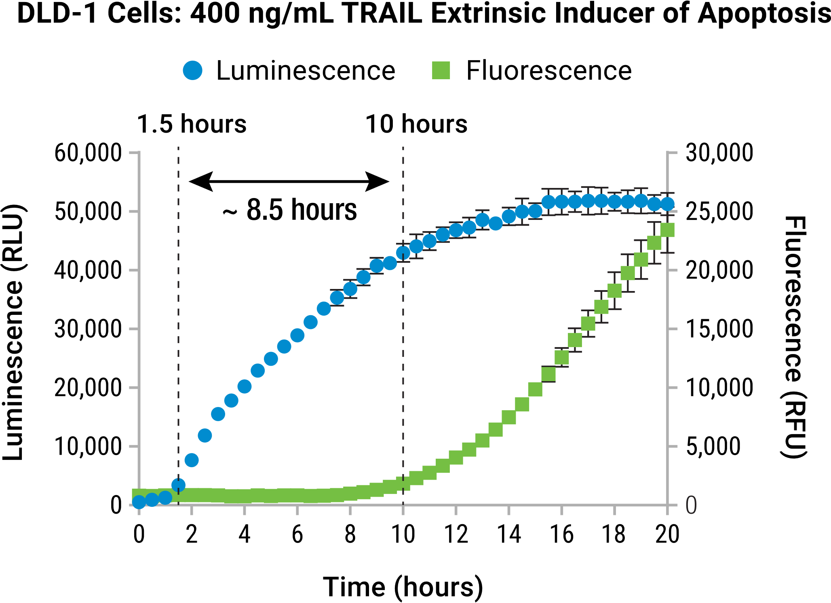

RealTime-Glo Annexin V Assay - Advantages
Different compounds trigger apoptosis with various kinetics in different cell lines
Easily identify the onset of apoptosis caused by your treatment
More information from a single well
Simple no-wash protocol, saves reagents, cells and plates
U2OS cells treated with 1 µM staurosporin at 0 h
Notes:
Esej je velmi užitečná buď v případech, ve kterých nevíme přesně, kdy nastává apoptóza a kdy změřit end point esej. Nebo v případech, kdy nás přímo zajímá kinetika apoptózy, protože různé látky způsobují apoptózu s různou kinetikou a to je samo o sobě cenná informace. Díky tomu, že každou jamku měříme mnohokrát opakovaně, tak v porovnání s end point esejí, která by měla získat stejná data, ušetříme obrovské množstí, reagencií, buněk, eseje a tak dále.
A to už je o apoptotických esejích vše. Na tomto místě bych chtěl připomenout, že East Port nedistribuuje jen Promegu.

Slide 43

CellTox™ Green Cytotoxicity Assay
Dying cells form pores in the membrane and have compromised membrane integrity
Determines membrane integrity by a non-permeable DNA-binding dye
The dye enters the compromised cells, binds to nuclear DNA and enhances its fluorescence
Excluded dye yields very low background fluorescence
Penetrated dye significantly enhances its fluorescence
Notes:
Nyní bych se rád zaměřil na kvantifikaci cytotoxicity.
Jak se běžně definuje cytotoxicita? Především jako ztráta integrity cytoplazmatické membrány.
Představím pouze dvě z mnoha esejí pro cytotoxicitu od Promegy. První je CellTox Green, o kterém už byla řeč u CellTiterGlo 3D. Je to barvička, která se váže na DNA, ale není schopná pronikat přes cytoplazmatickou membránu a tudíž se váže jen na DNA v nekrotických buňkách. Tuto vazbu jsme poté schopni detekovat jako vzrůstající zelenou fluorescenci.
Esej má několik výhod.

Slide 44

CellTox Green Advantages
Well tolerated by the cells
True kinetic assay – measurements for up to 72 hours
Easily multiplex with other fluorescent and BL assays
Suitable for 3D cultures, easily diffuses inside the spheroids
Compatible with standard GFP/FITC filters
Suitable for microplate readers, flow cytometry and fluorescence microscopy
Low price – 1000x dillution for the experiments
Cell Viability
72 h CTxG exposure
15 min CTxG exposure
IC₅₀
Dye is nontoxic for at least 72 hodin
= does not affect the IC₅₀ of tested compound (bortezomib)
Notes:
Lze použít pro kinetická měření až po tři dny. Lze zmultiplexovat s luminiscenčními esejemi. Esej je netoxická a buňky lze posléze na cokoliv použít.
Je kompatibilní i s 3D kulturami, jak už jsme viděli dříve. Detekovat lze nejenom v destičkovém readeru, ale i pomocí mikroskopie nebo flow cytometrie pomocí standardních filtrů pro zelenou fluorescenci. A je to esej, která je opravdu levná, takže se vyplatí jí rutinně přidávat do vašich luminiscenčních esejí.

Slide 45


Flexible Protocol
The reagent can be added:
During cell seeding
With the treatment addition
At the end of the experiment as an end-point assay

Slide 46


HepG2 cells treated with various doses of terfenadine. Fluorescence measured every hour from the same sample wells.
►
Live cell kinetic imaging of CellToxTM staining of a paclitaxel treated HepG2 cell spheroid photographed at different times over 2 days. Green fluorescence shows the accumulation of dead cells.
Notes:
JQ1 – thienotriazolodiazepine, potent inhibitor of the BET family of bromodomain proteins (BRD2, BRD3, BRD4 and the testis-specific protein BRDT in mammals)
Thalidomide – binds to cereblon (CRBN) which is a part of the ubiquitin E3 ligase, causes ubiquitinylation of the BRD protein and degradation
Thalidomide

Slide 47



Assay Designed for Multiplexing
Can be multiplexed with other kinetic/endpoint assays
Allows differentiation between cytotoxic and cytostatic effect
Allows determining the dose that triggers apoptosis or cytotoxicity

Slide 48

LDH-Glo® Assay – measures LDH leaking from cells
Lactate dehydrogenase leaks from damaged cells
Its activity is detected in supernatant in a coupled enzymatic reaction
Pro-luciferin is reduced by a proprietary reductase to luciferin and processed by firefly luciferase in the medium
Timed kinetic assay
Suitable for 3D cell cultures
Suitable for measuring antibody-dependent-cell-mediated cytotoxicity (ADCC)
Notes:
Další esej pro měření cytotoxicity využívá stejný princip, tedy narušení integrity membrány a kvantifikuje aktivitu laktát dehydrogenázy uniklé z nekrotických buněk. Esejí na měření LDH je na trhu spoustu, ale žádná nedosahuje citlivosti luminiscenční eseje od Promegy.
Esej je založená na detekci NADH, které produkuje LDH oxidací laktátu na pyruvát. NADH je ve spřažené enzymatické reakci použito pro redukci proluciferinu na luciferin. Proluciferin je v tomto typu esejí označován Promegou jako reductase substrate. Luminiscence produkovaná přeměnou tohoto substrátu je přímo úměrná množství LDH.
Esej funguje i pro 3D kultury a je možné ji použít i na měření cytotoxicity typicky u rakovinných buněk, na kterých se zkouší různé nové způsoby biologické léčby. Ať už se jedná buď o monoklonální protilátky, antibody drug conjugates, CAR-T buňky a podobně.

Slide 49


LDH-Glo® Can be Used as a Kinetic Assay
SKBR3 cells (breast cancer)
Experimental workflow
Enzymatic marker cytotoxicity
Suitable for timed kinetic analysis
For ideal results, use inactivated FBS – higher sensitivity
Notes:
Skutečná síla této eseje spočívá v tom, že je možné jí použít v pseudo kinetickém formátu. Tím, že je hodně citlivá, stačí odebrat několik mikrolitrů média v každém časovém bodě, tyto vzorky zamrazit a na konci experimentu všechny naráz změřit. Získáme tak zpětně kinetická data. Příklad takových dat je na grafu vpravo, kde byli buňky rakoviny prsu vystaveny účinku antibody drug konjugátu Kadcyla což je Herceptin-antiHER2 protilátka konjugovaná s mikrotubulárním inhibitorem.

Slide 50



NanoLuc®/NanoBiT® Live Cell Substrates
Different Substrates for Different Purposes
Nano-Glo® Live Cell Assay System
Endpoint / up to 2 h
Nano-Glo® VivazineTM Substrate
2-24 h
Nano-Glo® EndurazineTM Substrate
2 - 72 h

Slide 51

Metabolite Assays – One Reaction to Rule Them All
Metabolite-selective dehydrogenases coupled to bioluminescent NAD(P)H detection
“With the aid of auxiliary enzymes nearly every substance of biological interest could
be measured with a pyridine nucleotide system”
Oliver Lowry JBC (1961) 236, 2746
Broad linear range of 3 logs (0,1-100 μM)
Wide dynamic range S/B < 100
High sensitivity, requiring only a small sample volume
Simplified protocol applicable to many sample types – homogenized tissue, 2D & 3D culture, serum, medium
Can be used as timed kinetic assays

Slide 52


Metabolite Assays – One Reaction to Rule Them All
Metabolite-selective dehydrogenases coupled to bioluminescent NAD(P)H detection
Can be used in a timed kinetic format to measure the signal from supernatant

Slide 53

Metabolite Assays – Compatible Sample Types
Homogenize, then assay
Homogenize, then assay
Spheroids – direct assay
Dillute and assay directly

Slide 54


Glucose and Lactate-Glo Assays
optionally store
@ -20°C
A549; 15,000 cells/well
to 50 μl
Only 2–5 μl sample for measurement
Multiple metabolites are easily measured from one sample
Samples can be frozen and measured at the end of the experiment - kinetic information
Investigate glycolysis, a central pathway for providing energy and precursors for biosynthesis
Metabolic profiling of cancer cells, identify vulnerabilities for anti-cancer treatment
Notes:
Výhody těchto esejí jsem se rozhodl ukázat na Glucose-Glo a Lactate-Glo. Jsou velmi citlivé, takže stačí pár mikrolitrů média ke stanovení jednoho metabolitu, takže můžeme odebírat vzorky v čase a nebo i pro několik metabolitů naráz. Měřením koncentrace glukózy a laktátu zároveň získáme dobrý globální přehled o metabolizmu buněk, využívání glyklýzy, jako na grafu vpravo nahoře, kde vidíme, jak buňkám během dvou dnů dojde všechna glukóza v médiu a zvyšuje se produkce laktátu.
Zvýšená glykolýza je znakem různých zajímavých buněk, jako rakovinných buněk nebo aktivovaných T-lymfocytů, což je další možné použití eseje.

Slide 55


Multiple Metabolites Offer a More Complete Image
GLUCOSE CONSUMPTION
15000
7500
2500
LACTATE SECRETION
GLUTAMINE CONSUMPTION
GLUTAMATE SECRETION
Adapted from Leippe, D et al. (2017), SLAS Discov. 22(4):366-377
55
Notes:
Ovarian cancer cell lines
OVCAR-3 low invasivness, low glutamine consumption
SKOV-3 high invasiveness, high glutamine consumption

Slide 56
Multiple Metabolites Offer a More Complete Image
OVCAR-3
Moderate glutamine consumption
Low glutamate secretion
Low invasiveness
SKOV-3
High glutamine consumption (Glutamine “addicted”)
High glutamate secretion
Highly invasive
GLUTAMINE CONSUMPTION
GLUTAMATE SECRETION
Adapted from Leippe, D et al. (2017), SLAS Discov. 22(4):366-377
56

Slide 57


Glycerol/TAG Assay - Principle
Benefits
Quantitative results
No extraction steps, only cell lysis
BL assay = high sensitivity
Simple and fast protocol
57
Notes:
Na základní spřažený systém dehydrogenázy, reduktázy a luciferázy lze napojit i složitější enzymatický systém a detekovat glycerol a triacylglyceroly. Tato esej je zajímavá třeba pro ty, kteří se zabývají jaterními onemocněními. Vzorky se pro tuto esej opět dělí napůl a měří se s a bez přidané lipázy. Ze vzorku bez lipázy zjistíme koncentraci volného glycerolu. Z rozdílu hodnot vzorků s lipázou a bez lipázy zjistíme kolik detekovaného glycerolu ve skutečnosti pocházelo z triglyceridů.
Opět je docela unikátní pro Promegu, že dokáže tyto lipidy kvantifikovat pomocí luminescence bez předchozí extrakce organickými rozpouštědly.

Slide 58

Glycerol/TAG Assay – Experimental Workflow

Slide 59



Stimulation and Inhibition of Lipolysis
Insulin
Isoproterenol
Isoproterenol
25 nM
-
+
+
Insulin
150 nM
-
-
+
3T3L1-MBX fibroblasts plated at 20,000 cells/well and differentiated for 2 weeks to form adipocytes
•
Treatment with Isoproterenol and Insulin for 90 min
Notes:
Insulin – stimulates absorption of glucose into cells
Isoproterenol – lipolysis inducer

Slide 60

Quantification of lipogenesis in differentiated 3T3L1-MBX fibroblasts
Lipid content observed at days 5, 12, 14 and 21 of differentiation (A-D respectively)
The cells were either stained with Oil Red O dye or the lipid content was measured by the Glycerol/TAG-Glo assay from Promega
Simple quantification and complementary information to microscopic techniques and flow cytometry

Slide 61

Cholesterol/Cholesterol Ester Assay
Benefits
Quantitative measurement
No extraction steps, only cell lysis
BL assay = high sensitivity
Simple and quick workflow
Notes:
Podobně lze detekovat i cholesterol a cholesterol ester. A tohle je poslední esej, kterou dnes ukazuji. Bylo jich hodně, tak děkuji za trpělivost.

Slide 62


Cholesterol Assay - Protocol
Measures cholesterol – two measurements have to be done in parallel
Sample without cholesterol estarase – free cholesterol
Sample with cholesterol esterase – total cholesterol
Add lytic buffer to the sample (2D or 3D culture, tissue homogenate, serum), incubate at 37 °C
Add detection reagent and incubate for 60 minutes
Detect bioluminescence

Slide 63









Instruments – Features and Configurations
GloMax® Discover
6-, 12-, 24-, 48-, 96- and 384-well
GloMax® Explorer
6-, 12-, 24-, 48-, 96- and 384-well
GloMax® Navigator
96-well
Heating
Shaking
Luminescence
Fluorescence
UV/Vis Absorbance
BRET / FRET
Heating
Shaking
Luminescence
Fluorescence
Luminescence
Available Upgrades
Vis Absorbance
UV/Vis Absorbance
BRET / FRET
63

Slide 64

Primary Cells, Stem Cells & Media
Primary cells - over 150 human and animal cell types available
Clonetics media a growth factors for wide spectrum of primary cells
Stem cells together with media
Blood and immune cells from vast collection of donors and sources
Specialized X-VivoTM media

Slide 65


Mycoplasma Testing
Mycoplasma = small bacteria lacking cell wall, not susceptible to penicillin and other antibiotics
Widespread contamination in a variety of cell culture systems
Size below 1 μm, hardly visible in optical microscope
BL MycoAlertTM kit:
Mycoplasma from cell culture supernatant are lysed and their enzymes released into the medium
Enzymes convert added ADP to ATP
ATP is processed by firefly luciferase from the detection reagent and in case of contamination bioluminescence is produced

Slide 66


High Quality Cell Culture Media and Sera
German company established in 2013
Specialises on the production of high quality sera and cell culture media and reagents
Possibility of custom manufacturing from 20 liters
Sera
FBS
Other bovine and animal sera
Human sera
Cell Culture Media
Classic liquid media
Classic powdered media
Special culture media
Cryopreservation
Cell Culture reagents
Supplements and additives
Antibiotics
BSA
Trypsin
Cell separation
Balanced Salt Solutions
Liquid buffers
Powdered buffers
Diagnostics
Virology media
Cytogenetics

Slide 67





Label-Free Cell Monitoring
Live-cell monitoring of cells in individual culture vessels (Lux microscopes) or 6 to 384 well plates (Omni microscopes)
Compact microscopes placed directly in the incubator
Confluency measurements, scratch assays, colony counting
Fluorescence versions – fluorescent object counting
Notes:
Další náš dodavatel, který je relevantní pro dnešní přednášku o buněčných esejích je Cytosmart. Nabízí různě velké a různě komplexní mikroskopy pro live cell imaging přímo v inkubátoru. Pomocí těchto mikroskopů můžete například sledovat jak se během několik dní mění konfluence buněk, což je další způsob testování viability nebo cytotoxicity.
Můžeme vám snadno zařídit demo těchto přístrojů nebo vás propojit se zákazníky tady v Česku, kteří už Cytosmart mikroskopy používají.
Úplně na závěr bych vás chtěl upozornit na další zdroj informací.

Slide 68

Thank you for your attention!
Questions?

